Slide 1
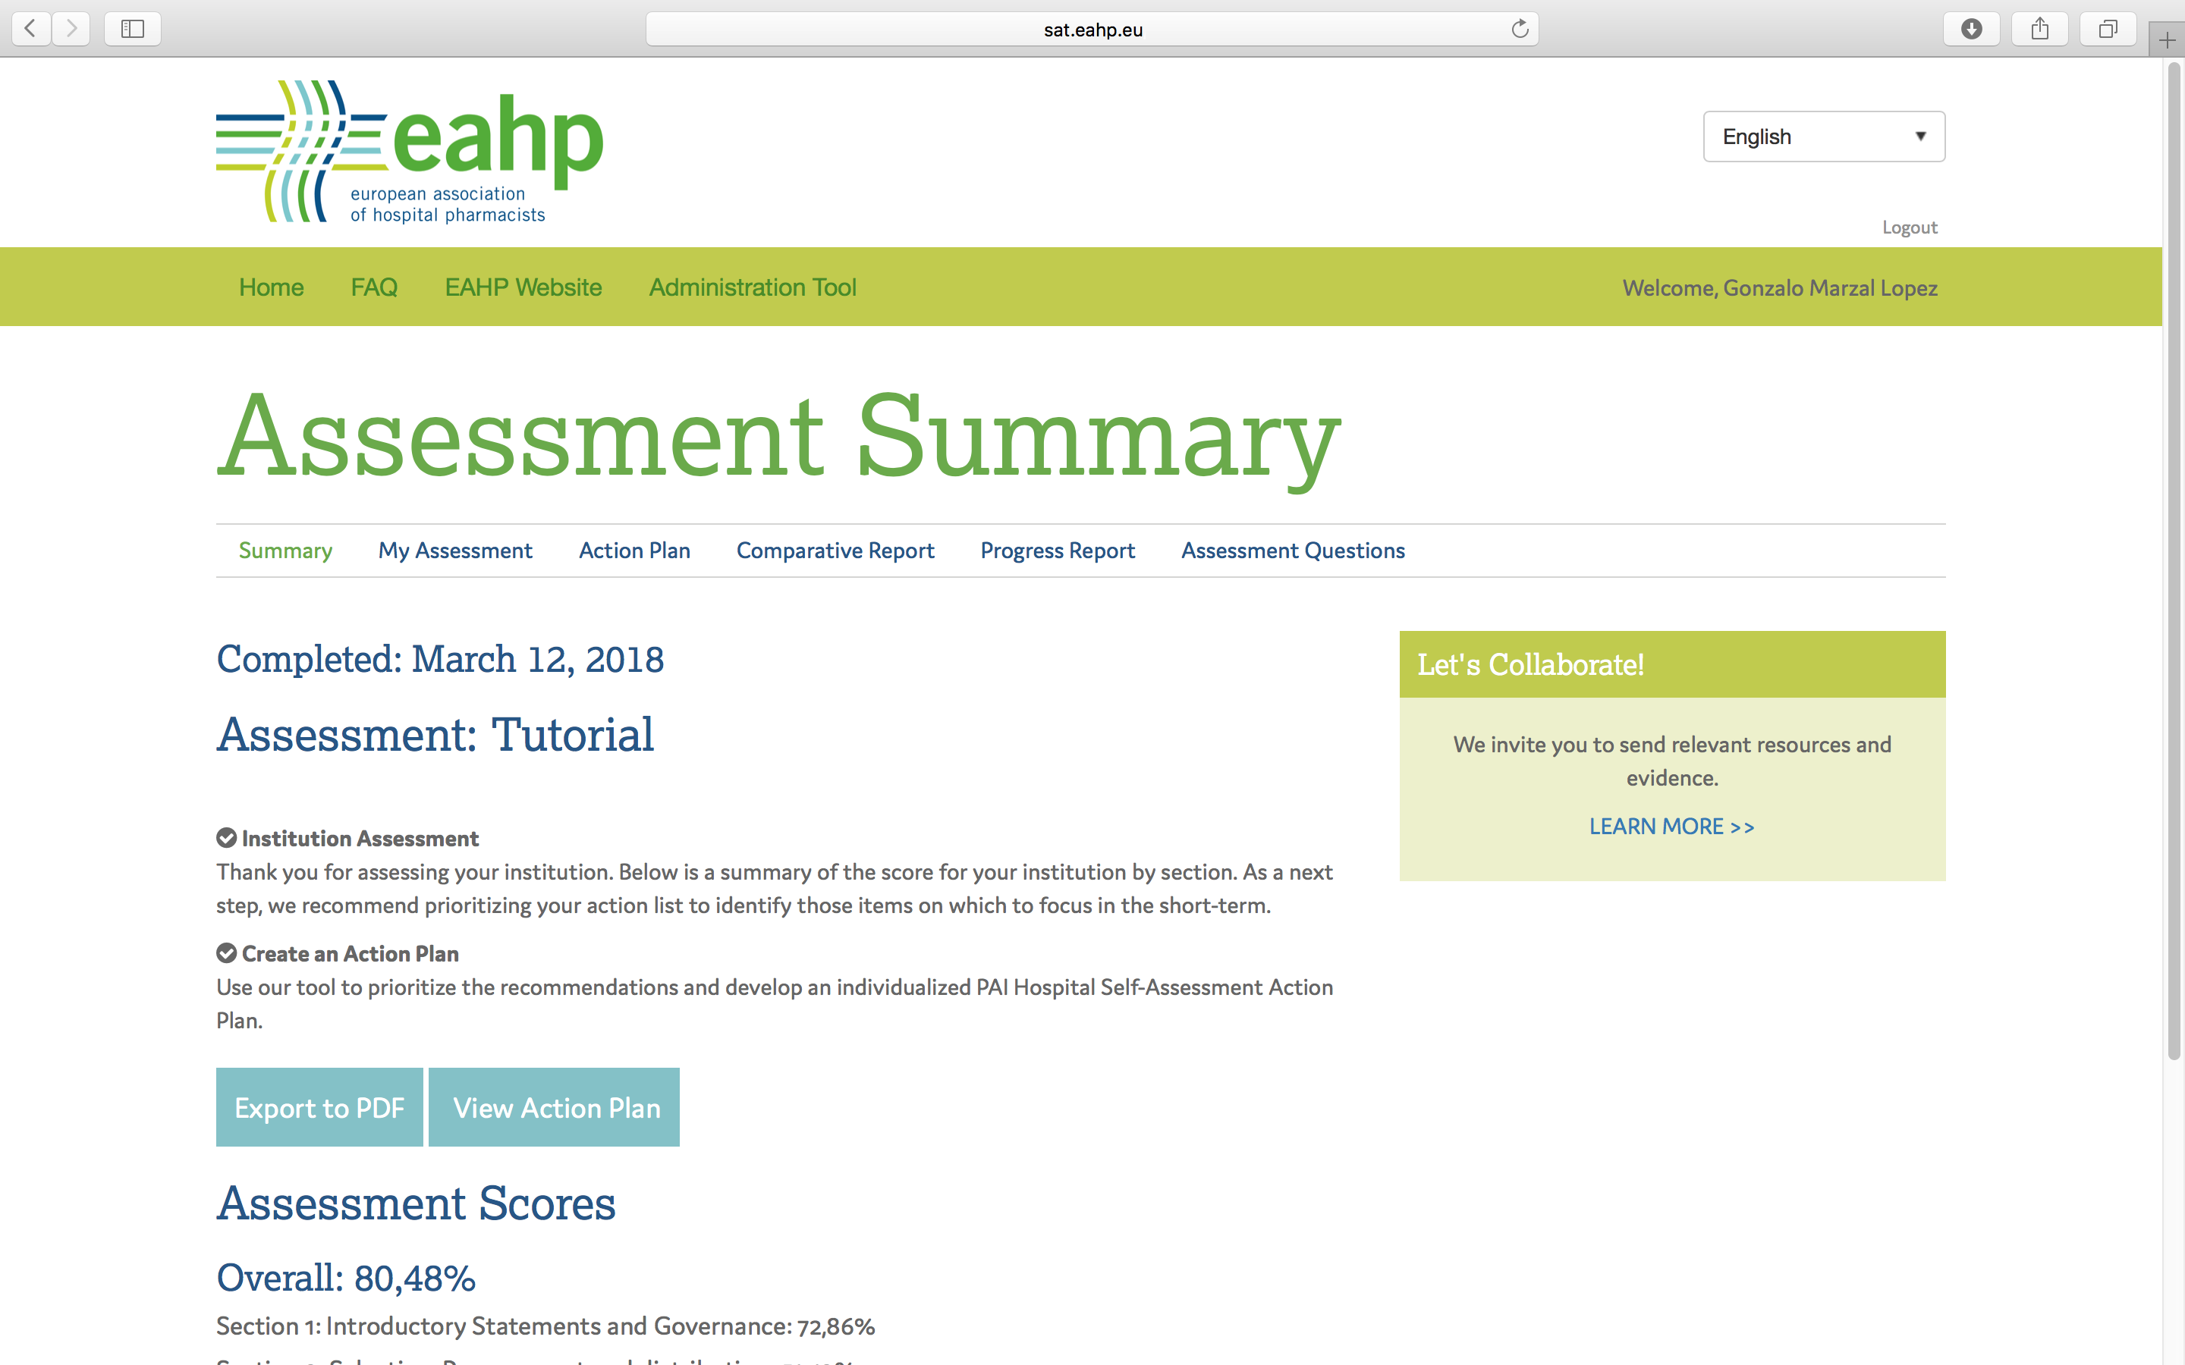
SAT Screenshot

