Slide 1

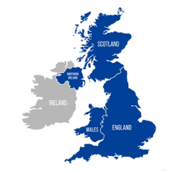

United Kingdom
1226
Number of hospital pharmacies
Number of hospital pharmacists:
~ 15,110
Project achievement / challenge in 2023-24
Reform of Initial Education & Training
Hospital at home / virtual wards
  First prescribing pharmacists at the point of registration enter the register in August 2026
  Integrating examination & prescribing skills into the undergraduate curriculum
  Much of the learning is in practice
  Increased emphasis on the role of the practice supervisor
  GHP championed requirements for support, training and quality assurance of those providing training for future prescriber ready graduates
  Post pandemic, NHS England set a target to treat 50,000 patients a month in their own homes
  Care is face to face, remote or hybrid
  RPS identified a need to develop an interim set of professional standards for these services
  https://www.rpharms.com/recognition/setting-professional-standards/hospital-at-home-interim-standards
Notes:
First challenge in UK; Reform of Initial Education and Training for Pharmacists in the UK Pharmacy undergraduates across the UK study for an MPharm degree for four years (at University) followed by a year of foundation year training (in a range of practice areas including community pharmacy, hospital pharmacy, industry and General Practitioner (GP) (family doctors) practices or a combination of these. The undergraduate pharmacy courses are required to increase the teaching of clinical examination and consultation skills alongside their increased emphasis on applied therapeutics, prescribing and clinical leadership to enable pharmacists to register as prescribers after 5 years – much of this will happen in clinical practice, under the supervision of practising pharmacists, or Clinical Supervisors. During year 5, foundation trainee pharmacists will be supported by Educational Supervisors from the pharmacy workforce where they are employed who will support them towards achieving their prescribing qualification. The first pharmacist prescribers will enter the workforce in 2026. The impact of taking on additional (and in many cases new) roles of supervision both clinically and educationally in an already stretched workforce presents a challenge. In 2023 and 2024, a key focus for GHP has been to highlight the need for clear guidelines for those taking on this work, as well as robust training and support for all supervisors and time in their job plans to ensure that trainee pharmacists and teaching pharmacists are able to deliver to the expected level. In 2023, we discussed an emphasis on the development of Work Based Assessments such as Entrustable Professional Activities (EPAs) and this continues through years 1 to 4 and into year 5 to enable Clinical and Educational Supervisors to determine the ability of new graduates prior to registration.
Project/Challenge/Achievement
Following on from some successes in the NHS response to the Coronavirus Pandemic, the NHS in England (NHS England) set ambitious targets for the expansion of “hospital at home” or “virtual wards” aiming to treat 50,000 patients a month in the patients’ own homes. “Hospital at home” care is an alternative to care in the setting of a hospital, preventing avoidable admission or facilitating early discharge. The care in this setting can be delivered via face to face, remote or hybrid consultations. It is thought that these models of care will ease pressure on the NHS, in particular the strain on hospitals as patients can be monitored and treated in the comfort of their homes. In theory this can also reduce the risk of hospital-acquired infections and lead to faster recovery times whilst also reducing waiting times for care.
The national targets have been stretching, and whilst “hospital at home” models of care have been in existence for many years before COVID, these have been relatively small scale and localised with a high-level variability in their setup. The national target has meant there has been a national proliferation of “hospital at home” care, sometimes without the input of the pharmacy team. In turn ensuring high standards of patient safety and treatment effectiveness have become difficult due to the variability in the setting up of these services.
Identifying this as a risk in 2023 the RPS agreed to develop an interim set of professional standards for pharmacy services for hospital at home (virtual ward) services supported by a task and finish group of hospital at home experts. These have been developed to underpin safe and effective care in hospital at home pharmacy services and are useful to the multi-disciplinary team in assuring the quality and to improve pharmacy services. They can be used to support setting up new “Hospital at Home” pharmacy services across the UK or to audit existing services through self-assessment or gap analysis.
“Hospital at Home” care continues to be a rapidly evolving setting of care in the UK.
The 28 standards describe ‘good’ working practices across the domains of
Putting people first
Episode of care
Integrated transfer of care
Medicine and pharmacy services governance
Safe and efficient supply of medicines
Leadership
Systems of work
Workforce
The standards are open access and available from the RPS website
https://www.rpharms.com/recognition/setting-professional-standards/hospital-at-home-interim-standards

Slide 2

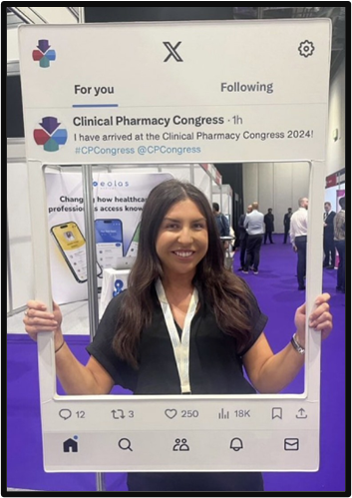
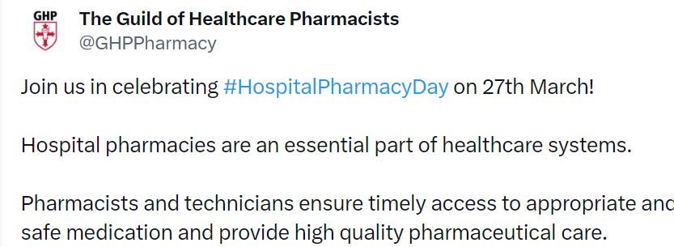



Symposia & member outreach in 2023-24
01
Procurement and Development Interest Group (PDIG)
02
Clinical Pharmacy Congress (CPC)
Quality Assurance and Technical Services SIG (QATs)
03
Notes:
PDIG – bi annual symposia, separate committee, around 500 attendees at every event
CPC - Partner with CPC, bi-annual, May 2024; 3,500 attendees
QATSsig – annual symposia – around 350 attendees in Sept 2023
Regular blog to members, Twitter

Slide 3


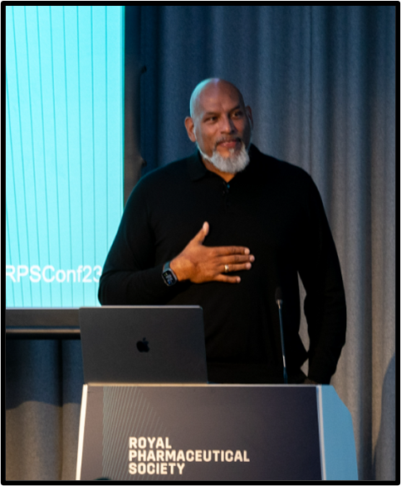
Symposia & member outreach in 2023-24
04
RPS Annual Conference
05
Webinars to support hospital pharmacists in a range of roles
06
Expert advisory groups
07
Early years prescribing task and finish Group
Notes:
RPS annual conference 800 attendees
Primary Care expert advisory group
Hospital Expert advisory group

