Slide 1


TÜRKİYE
Country report for the GA EAHP 2022
delegation: Arif ÖZDEMİR

Slide 2
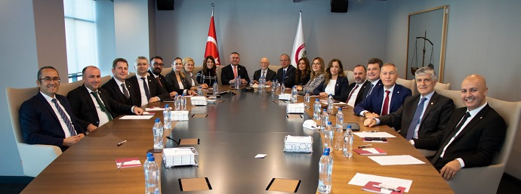
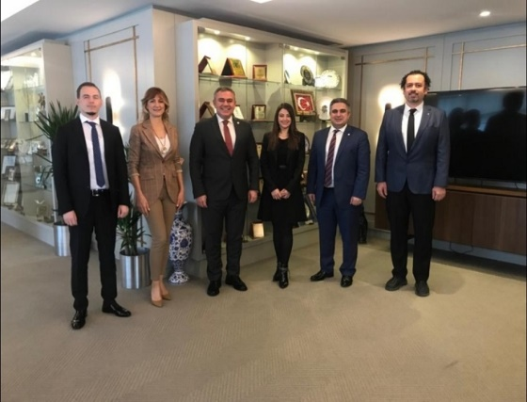
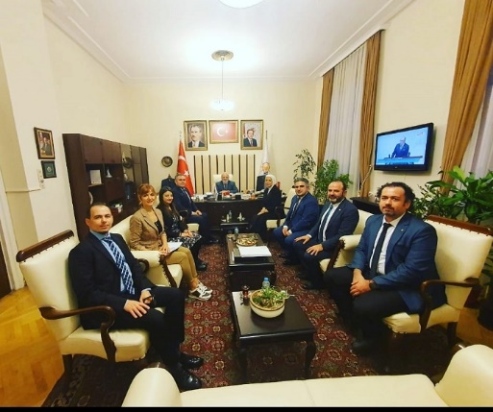
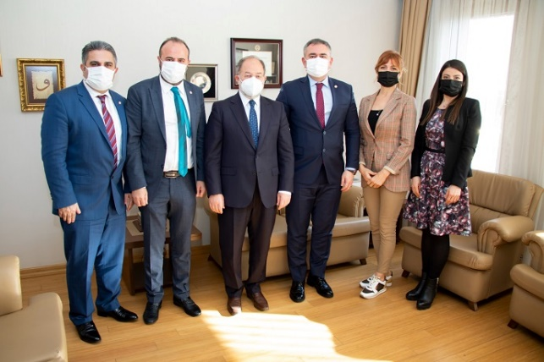
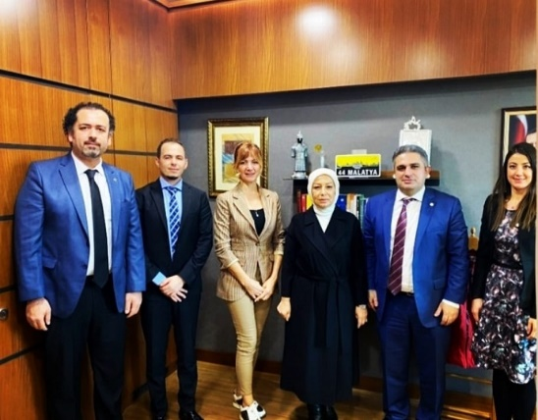
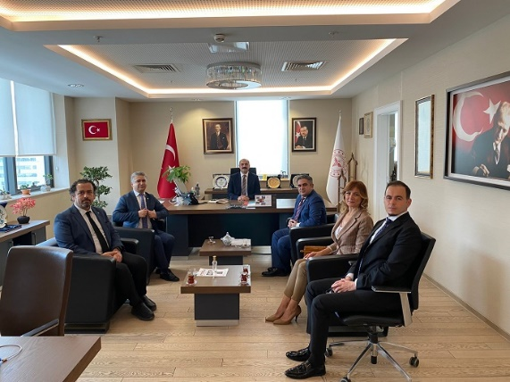
Turkish Pharmacists’ Association
Country Report
PROJECTS
Turkish Pharmacists’ Association elections were held.
President & new Executive Board has been elected.
Studies on improvement of the personal rights of hospital pharmacists
Our Section visited Director of General Health Services and Departmet of Health Professions, in ministry.

Slide 3


Turkish Pharmacists’ Association
Country Report
ONGOING PROJECTS
My guide pharmacy program
  The potential of our Pharmacists in prevention , early diagnosis and patient monitoring; Our unity to reveal on behalf of our patients, our pharmacists, our profession and the public interest has been realized as part of our vision for the future.
  It is a new pharmacy service model that focuses on continuous professional development in pharmacy services and quality in service delivery, with the consultancy and training support of the Turkish Pharmacists Association, Accreditation Council for Pharmacy Education and pharmaexpert groups, and the contributions of our volunteer pharmacists in our country.
«Tebeşir» Online Education Program
  It is a platform that provides online access to in-service training programs prepared to help pharmacists. With this program, pharmacists can constantly update their professional knowledge and refresh their current knowledge; can develop their personal capacities.

