Slide 1
Pharmacotherapy –
COVID19 – Repurposed drugs and treatment
Steffen Pelzl, PharmD, PhD
SLK-Kliniken Heilbronn GmbH
Heilbronn, Germany

Slide 2
Disclosure
Conflict of interest: nothing to disclose

Slide 3
Self-assessment questions
Is there evidence for a significant mortality benefit in Remdesivir treated patients who were on oxygen supplementation but did not require high-flow oxygen or ventilatory support ?
Should Dexamethasone be used for either prevention or treatment of mild to moderate COVID-19 (patients not on oxygen)?
Do ICU patients show an increased risk for venous thromboembolism (VTE) despite prophylactic-dose anticoagulation?

Slide 4
Coronavirus Disease 2019 - Characteristics
Clinical Manifestations
Cough 50%
Fever 43%
Myalgia 36%
Headache 34%
Dyspnea 29%
Sore throat 20%
Diarrhea 19%
Nausea/vomiting 12%
Loss of smell or taste <10%
Abdominal pain <10%
Severity of Symptomatic Infection
Mild disease (no or mild pneumonia) – 81%
Severe disease (eg, with dyspnea, hypoxia, or >50% lung involvement) – 14%
Critical disease (eg, with respiratory failure, shock, or multiorgan dysfunction) – 5%
However
Among hospitalized patients, the proportion of critical or fatal disease is higher. In a study that included 2741 patients who were hospitalized for COVID-19 in a New York City health care system, 665 patients (24 percent) died or were discharged to hospice.
Wu et al., JAMA, 2020, Apr 7, 323
Stokes et al., MMWR, 2020, June 19, 69
Petrilli et al., BMJ, 2020, May 22, 369

Slide 5
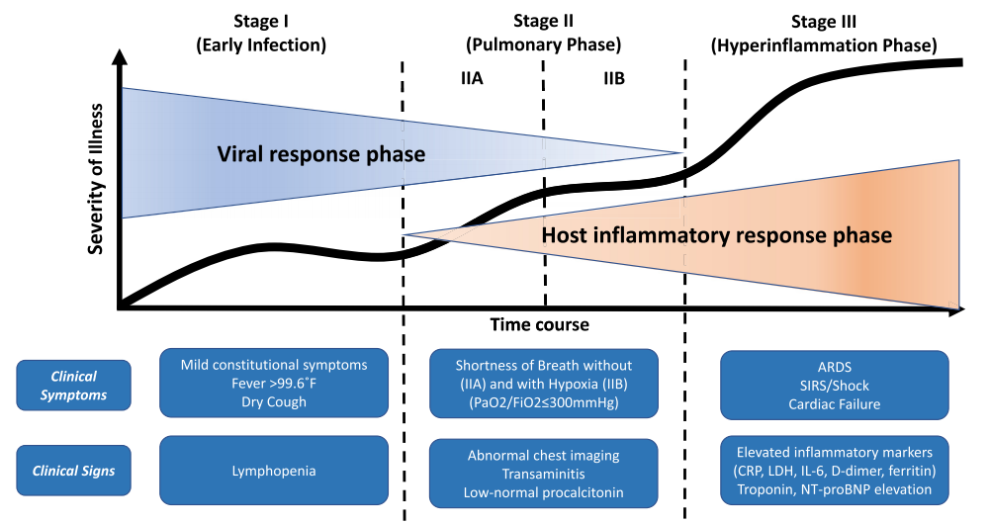
Classification of COVID-19 disease
Siddiqi et al., J Heart Lung Transplant., 2020, May 2020, 39

Slide 6
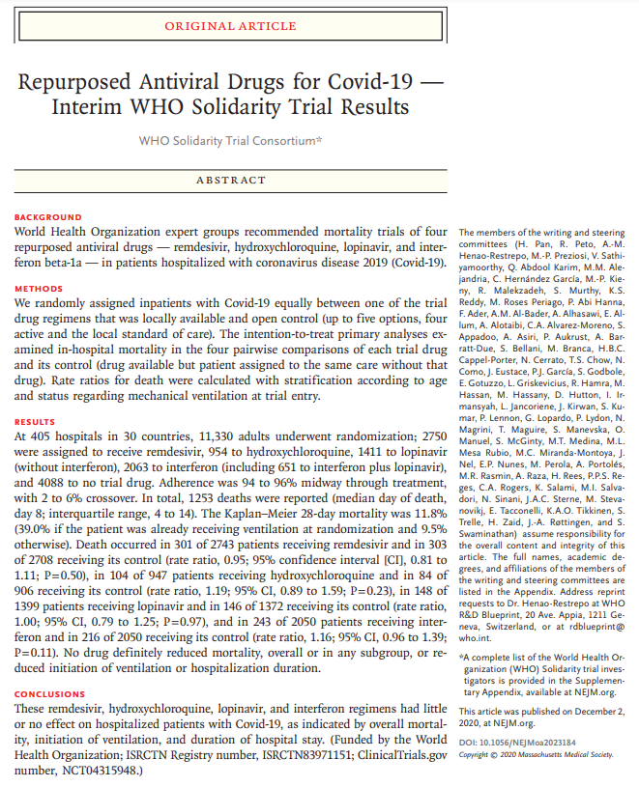
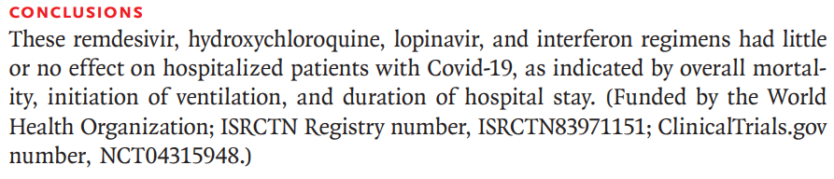
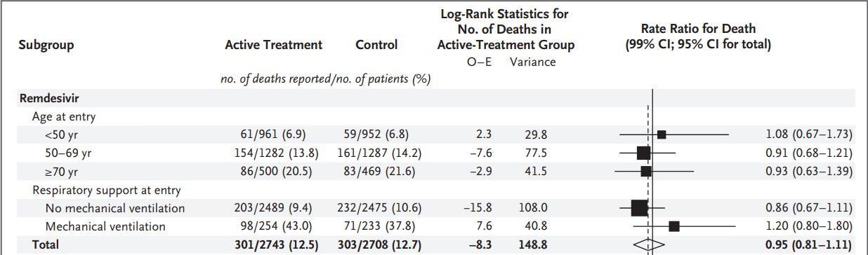
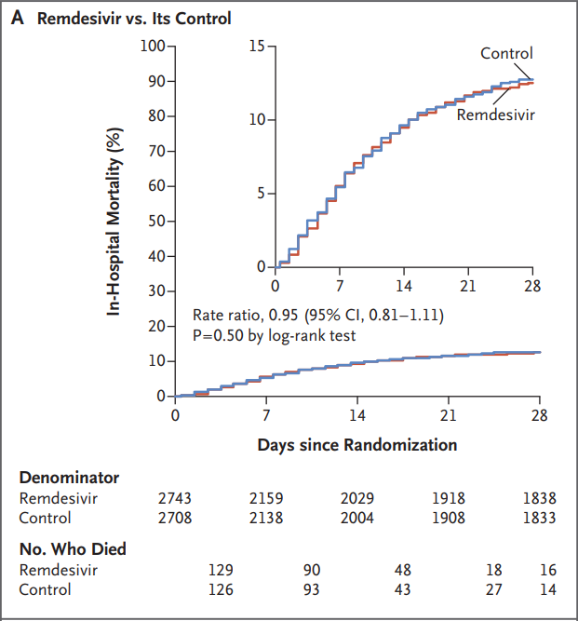
COVID-19-Specific Therapy – viral response phase – early infection
Agents proposed for therapy:
Lopinavir-ritonavir
Azithromycin
Hydroxychloroquine
Remdesivir
Baricitinib
Favipiravir
Sofosbuvir plus Daclatsvir
Fluvoxamine
Famotidine
Colchicine
Ivermectin
Interferons
Vitamin D
Vitamin C
Zinc
Convalescent plasma
WHO Solidarity Trial Consortium. N Engl J Med., 2020, Dec 2, epub

Slide 7
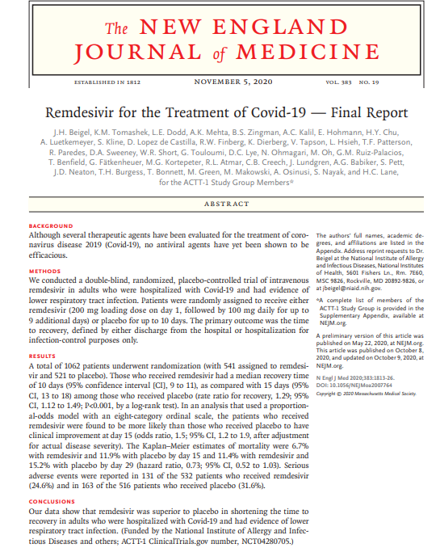
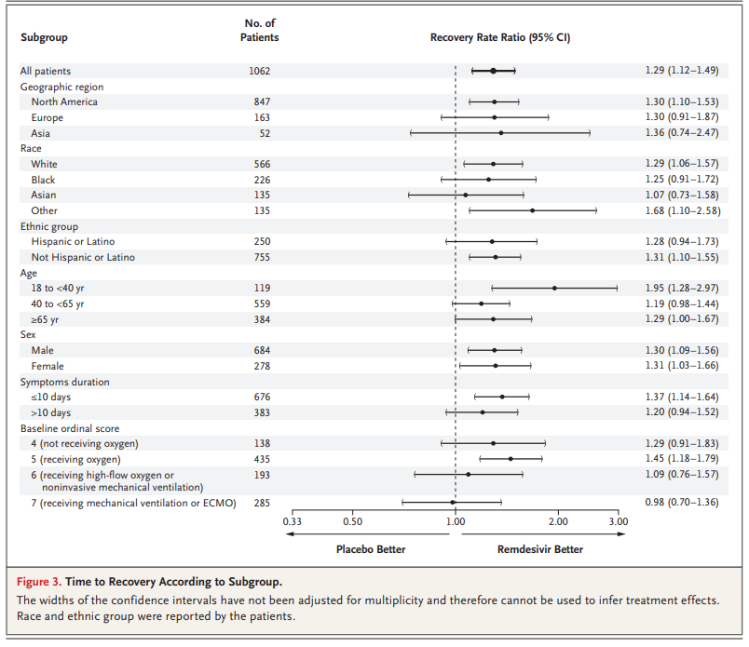
COVID-19-Specific Therapy – viral response phase – early infection
Positive SARS-CoV-2 PCR during last 48h
Ct value <30
Age >12
Symptoms duration <7 days
SARS-CoV-2 pneumonia
Oxygen saturation < 94% under room conditions and need for oxygen supplementation
Normal kidney and liver function
ACTT-1 - multinational, randomized, placebo-controlled trial
1062 patients with confirmed COVID-19 and evidence of lung involvement
85% had severe disease and 27% were receiving invasive mechanical ventilation or ECMO at baseline
Remdesivir resulted in faster time to recovery (median 10 vs. 15 days)
The reduced time to recovery was only statistically significant among patients who were on low-flow oxygen at baseline
Among the subset of patients on mechanical ventilation or ECMO at baseline, the time to recovery was similar with remdesivir and placebo
Overall, there was a trend towards lower 29-day mortality that was not statistically significant (11.4% vs. 15.2% with placebo)
Among the subset of patients who were on oxygen supplementation but did not require high-flow oxygen or ventilatory support, there was a statistically significant mortality benefit (4.0% vs. 12.7%, HR 0.30, 95% CI 0.14-0.64).
Beigel et al., N Engl J Med., 2020, Nov 5, 383
www.rki.de/covid-19-therapie-stakob - accessed on 21 January 2021

Slide 8
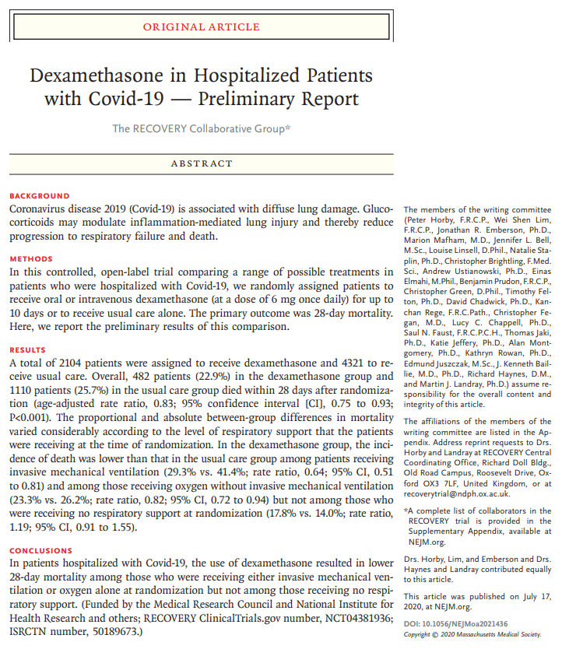
COVID-19-Specific Therapy – host inflammatory response – pulmonary phase
Patients with confirmed or suspected COVID-19
2104 and 4321 patients randomly assigned to receive dexamethasone or usual care
Baseline comorbidities and need for oxygen or ventilatory support were comparable
Reduction in 28-day mortality:
  Overall – 17% relative reduction (22.9 vs. 25.7%)
  Patients on IMV or ECMO at baseline – 36 % relative reduction (29.3 vs. 41.4%) Age-adjusted analysis - 12.3% absolute reduction
  Patients on noninvasive oxygen therapy at baseline – 18% relative reduction (23.3 versus 26.2%)
  Age-adjusted analysis - 4.1% absolute reduction
  No benefit among patients who did not require either oxygen or ventilatory support -nonstatistically significant trend towards higher mortality (17.8 vs. 14%)
The RECOVERY Collaborative Group, N Engl J Med., 2020, Jul 17, epub

Slide 9
COVID-19-Specific Therapy – host inflammatory response – pulmonary phase
Data from randomized trials overall support the role of glucocorticoids for severe COVID-19
Recovery Collabvorative Group - reduced mortality (RR 0.83, 95% CI 0.75-0.93) – randomized trial
Sterne et al. – reduced mortality (OR 0.66, 95% CI 0.53-0.82) – meta-analysis
Siemieniuk et al. – reduced mortality (OR 0.87, 95% CI 0.77-0.98) – meta-analysis
Dexamethasone –
for severely ill patients with COVID-19 who are on supplemental oxygen or ventilatory support.
at a dose of 6 mg daily for 10 days or until discharge, whichever is shorter.
not be used for either prevention or treatment of mild to moderate COVID-19 (patients not on oxygen).
monitor for adverse effects including hyperglycemia and infections.
The RECOVERY Collaborative Group, N Engl J Med., 2020, Jul 17, epub
Sterne et al., JAMA, 2020, Oct 6, 324
Siemienik et al., BMJ, 2020, Jul 30, 370

Slide 10
COVID-19-Specific Therapy – host inflammatory response – hyperinflammation phase
Background
Critical COVID-19 - elevated inflammatory markers (D-dimer, ferritin) and elevated pro-inflammatory cytokines (IL-6)
Blocking inflammatory pathway may prevent disease progression
Several agents that target IL-6 pathway have been evaluated in randomized trials for treatment of COVID-19
Clinical trials
Results from randomized trials, have been mixed, and several trials do not indicate a mortality benefit or other clear clinical benefit
Mehta et al., Lancet, 2020, Mar 28, 395
Stone et al., N Engl J Med., 2020, Oct 21, 383
Hermine et al., JAMA Intern Med., 2021, Jan 1, 181
Salvarani et al., JAMA Intern Med., 2021, Jan 1, 181
Salama et al., N Engl J Med. 2021, Jan 7, 384
Gordon et al., https://www.medrxiv.org/content/10.1101/2021.01.07.21249390v2.full.pdf (Accessed on January 19, 2021)

Slide 11

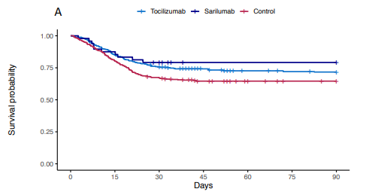
COVID-19-Specific Therapy – host inflammatory response – hyperinflammation phase
open-label international randomized trial of 803 patients with severe COVID-19 who were admitted to the intensive care unit and required either respiratory or cardiovascular support
Tocilizumab (n = 353) and sarilumab (n = 48) each reduced in-hospital mortality compared with standard of care (28 and 22 versus 36 percent; odds ratio for hospital survival 1.64, 95% CrI 1.14-2.35 for tocilizumab and 2.01, 95% CrI 1.18-4.1 for sarilumab).
All patients were enrolled within 24 hours of admission to the intensive care unit, >80 percent received concomitant glucocorticoids, and 33 percent received remdesivir.
Gordon et al., https://www.medrxiv.org/content/10.1101/2021.01.07.21249390v2.full.pdf (Accessed on January 19, 2021)

Slide 12
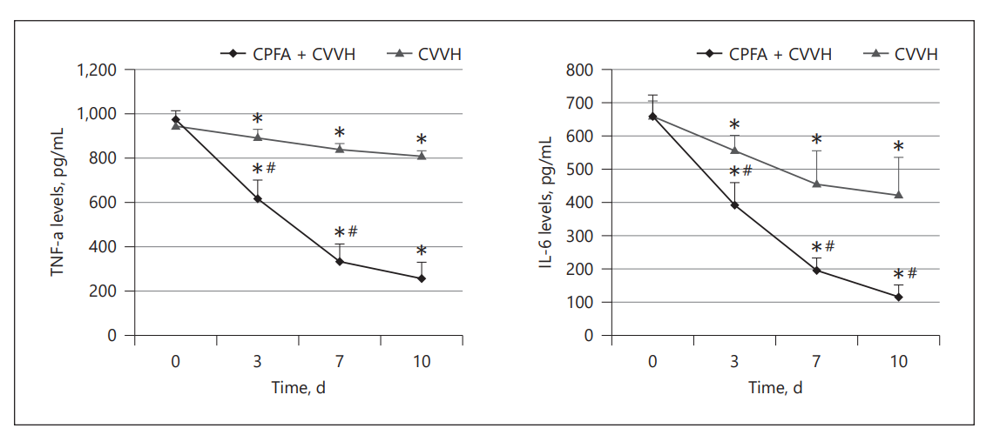
COVID-19-Specific Therapy – host inflammatory response – hyperinflammation phase
Evaluation of trial results
Overall mortality rates in other trials were lower, suggesting a more severely ill population in this trial.
IL-6 inhibitors can benefit a selected group of critically ill patients who are treated early (eg, within 24 hours) in the course of critical illness.
Potential role for extracorporeal technologies to absorb cytokines
Coupled-Plasma Filtration Adsorption (CPFA) + Continuous Veno-Venous Hemofiltration (CVVH)
Shareef et al., Blood Purif., 2020, May, 28
Chen et al., Ren Fail., 2020, Nov, 42

Slide 13
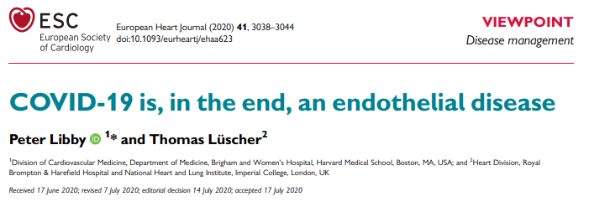
COVID-19-Specific Therapy – host inflammatory response phase – coagulation abnormalities
COVID-19 associated with hypercoagulable state associated with acute inflammatory changes
Fibrinogen and D-dimer increased - modest prolongation of prothrombin time (PT) and activated partial thromboplastin time (aPTT) - mild thrombocytosis or thrombocytopenia
Risk for venous thromboembolism (VTE) increased - prevalences of 25 to 43 percent in ICU patients - despite prophylactic-dose anticoagulation
Pulmonary microvascular thrombosis increased - risk for arterial thrombotic events such as stroke and myocardial infarction increased
Libby P, Lüscher T, Eur Heart J., 2020, Sep 1, 41
Connors et al., J Thromb Haemost., 2020, Jul, 18
Allegra et al., Ann Hematol., 2020, Sep, 99

Slide 14
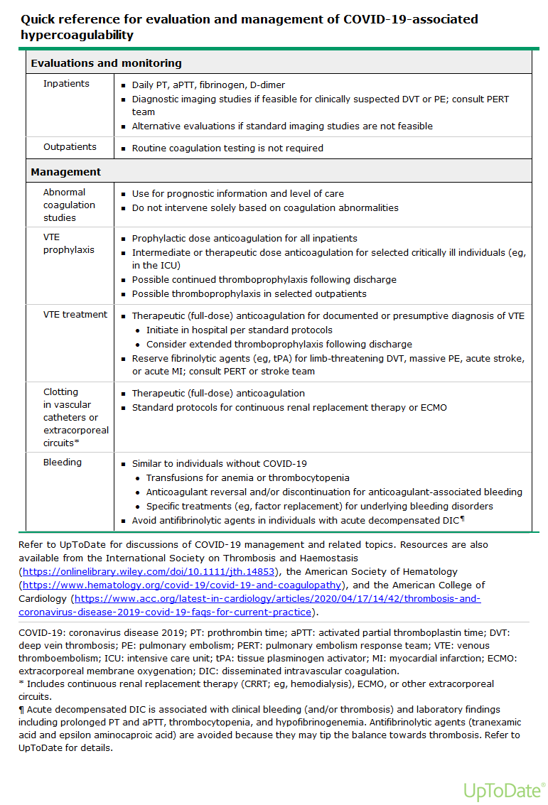
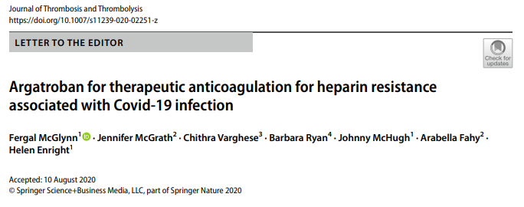
COVID-19-Specific Therapy – host inflammatory response phase – coagulation abnormalities
J Thromb Thrombolysis., 2020, Aug, 24
Accessed on 21 January 2021

Slide 15
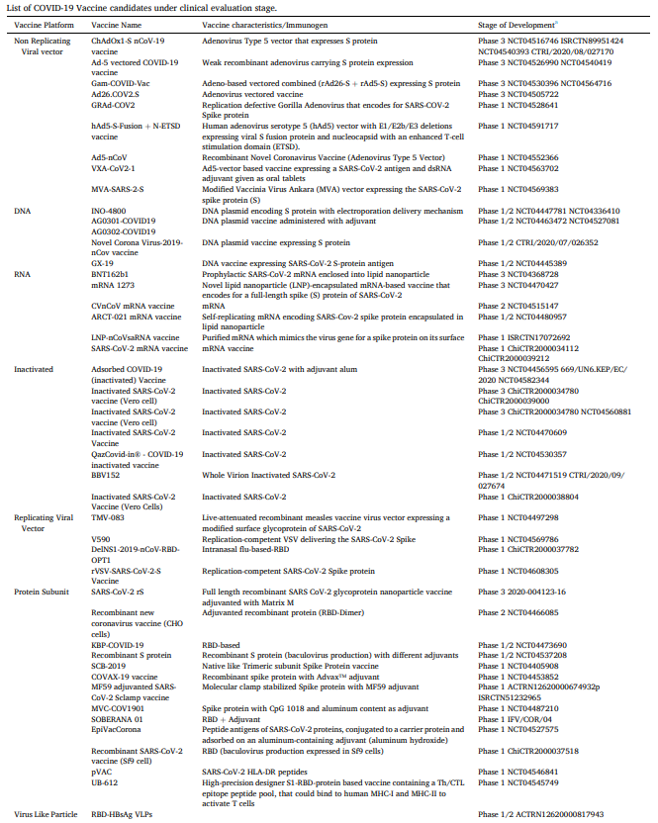
COVID-19-Specific Therapy –
Vaccinations
mRNA
BNT162b1
Prophylactic SARS-CoV-2 mRNA enclosed into lipid nanoparticle
NCT04368728
mRNA
1273
Novel lipid nanoparticle (LNP)-encapsulated mRNA-based vaccine that encodes for a full-length spike (S) protein of SARS-CoV-2
NCT04470427
Viral vector
ChAdOx1-S nCoV-19 vaccine
Adenovirus Type 5 vector that expresses S protein
NCT04516746 ISRCTN89951424 NCT04540393 CTRI/2020/08/027170
Viral vector
Ad26.COV2.S
Adenovirus vectored vaccine
NCT04505722
Rawat et al., Eur J Pharmacol., 2021, Feb 5, 892

Slide 16
Take home messages
The optimal approach for treatment of COVID-19 is still uncertain.
Trial data suggest a mortality benefit with dexamethasone and a possible clinical benefit with remdesivir.
Based on the pathogenesis of COVID-19, approaches that target the virus itself are more likely to work early in the course of infection, whereas approaches that modulate the immune response may have more impact later in the disease course.

Slide 17
Thank you for your attention

