Slide 1

The European Association of Hospital Pharmacists
EAHP
the association for all hospital pharmacists
in Europe
Hospital Pharmacists making the difference in medication use
www.eahp.eu

Slide 2
Hospital Pharmacists making the difference in medication use
There is a large evidence* reported in high level international literature that the interventions by Hospital Pharmacists improve
Clinical outcome of patients in different settings
(e.g. ICU, Oncology, Surgery, Internal Medicine, Paediatrics)
Economic outcome
Patient safety
* For a list visit www.eahp.eu
2

Slide 3
The European Association of Hospital Pharmacists
3
helps hospital pharmacists from Europe improve health care through
Science and education
Sharing best practice
Collaborating with like-minded organisations
Ensuring patient safety

Slide 4
European Association of Hospital Pharmacists (EAHP)
Created in 1972 in The Hague (NL)
Federation of National Associations of Pharmacists
Members of the Council of Europe
32 countries: 24 EU + 8 outside EU
More than 21,000 Hospital Pharmacists
working in hospitals and other healthcare facilities in Europe

Slide 5
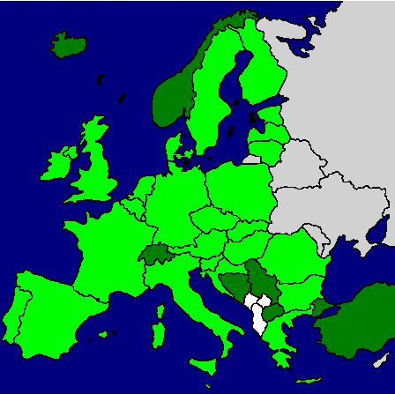
EAHP Members
Austria Belgium
Bosnia Herzegovina Bulgaria
Croatia Czech Republic
Denmark Estonia
Finland France
Germany Greece
Hungary Iceland
Ireland Italy
Latvia Lithuania Luxembourg FYROM
Malta Netherlands
Norway Poland
Portugal Rumania
Serbia Slovakia
Slovenia Spain
Sweden Switzerland
Turkey United Kingdom
34 members

Slide 6
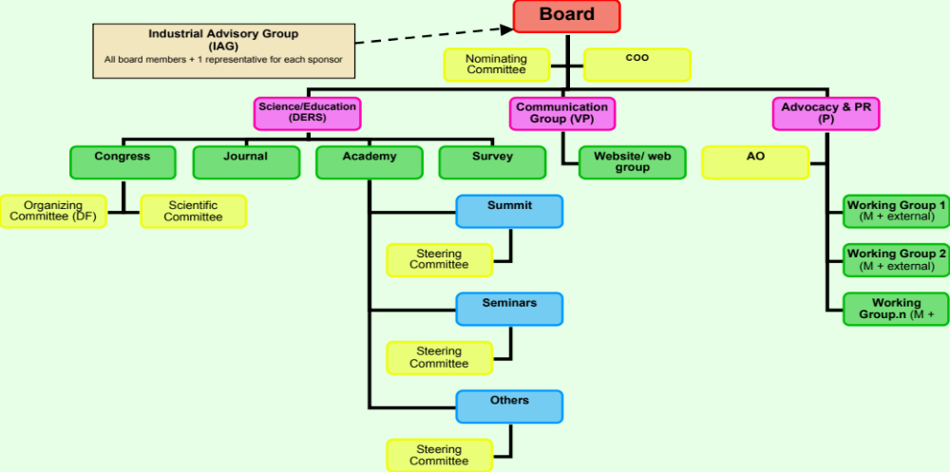
Structure of EAHP
General Assembly

Slide 7



EAHP is a member of
FIP: the International Pharmaceutical Federation, www.fip.org
EPHA: the European Public Health Alliance, www.epha.org
IHE: Integrated Healthcare Enterprise,
www.ihe.net

Slide 8

EAHP relations with link-minded organizations
EAHP exchanges points of view and share projects with many European and international associations representing the healthcare professionals.
To name a few of them:
ASHP, American Society of Health -System Pharmacists
CPME, Standing Committee of European Doctors
EAFP, European Association of Faculties of Pharmacy
EIPG, European Industrial Pharmacists Group
EFN, European Federation of Nurses
EHTEL, European Health Telematics Association
ESCP, European Society of Clinical Pharmacists
ESOP, European Society of Oncology Pharmacy
EPF, European Patients Forum
EPSA, European Pharmacy Students Association
HOPE, European Hospital and Healthcare Federation
PGEU, Pharmaceutical Group of the EU
Notes:
What is EPF ? What is ASP?

Slide 9

Code of conducts
9
Integrity of EAHP
The major income of the association is based on industry sponsorship
 Risk to be influenced by industry and loss of independence and reputation of EAHP
Code of conducts

Slide 10
Code of conduct
Key points of the code of conduct:
All funds from industry are to be truly unrestricted
  EAHP might also have positions unfavourable to the sponsor
  Proposed industry support for a project should not alter the agendas of EAHP
  No single industry source should be responsible for the majority of total industry funding.
No sharing of addresses with sponsors
No logo of EAHP together with a sponsor’s logo on education material
Disclosure of conflict of interest for board members and staff
(no financial relationships)

Slide 11
For more information and materials…
Contact Richard Price
Policy and Advocacy Officer EAHP
po@eahp
Phone +32 2 741 68 35

Slide 12
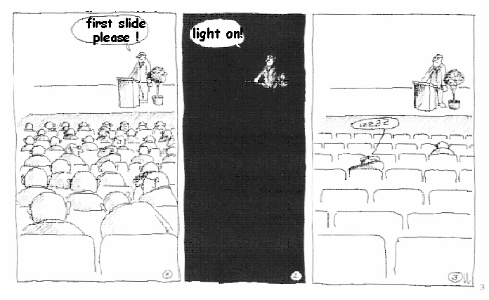

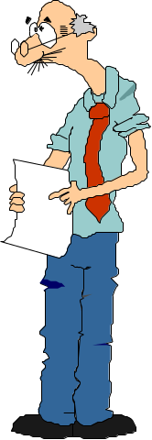
Thank you very much for your attention!

