Slide 1
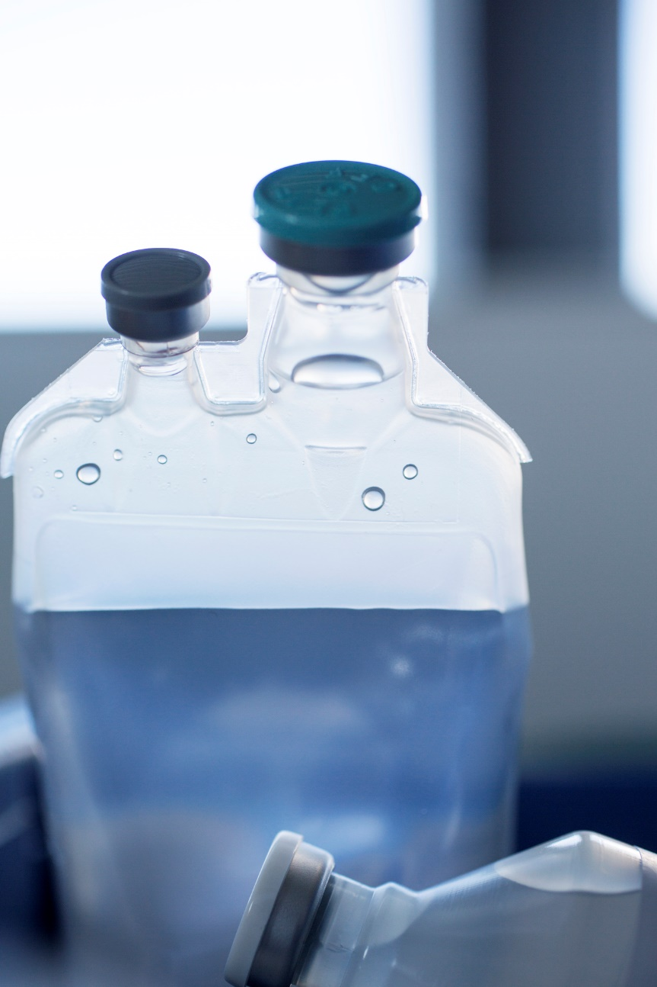
TASKFORCE TO FACILITATE THE INTRODUCTION OF BIOSIMILARS NATIONALLY
The cases of Infliximab and Etanercept

Slide 2
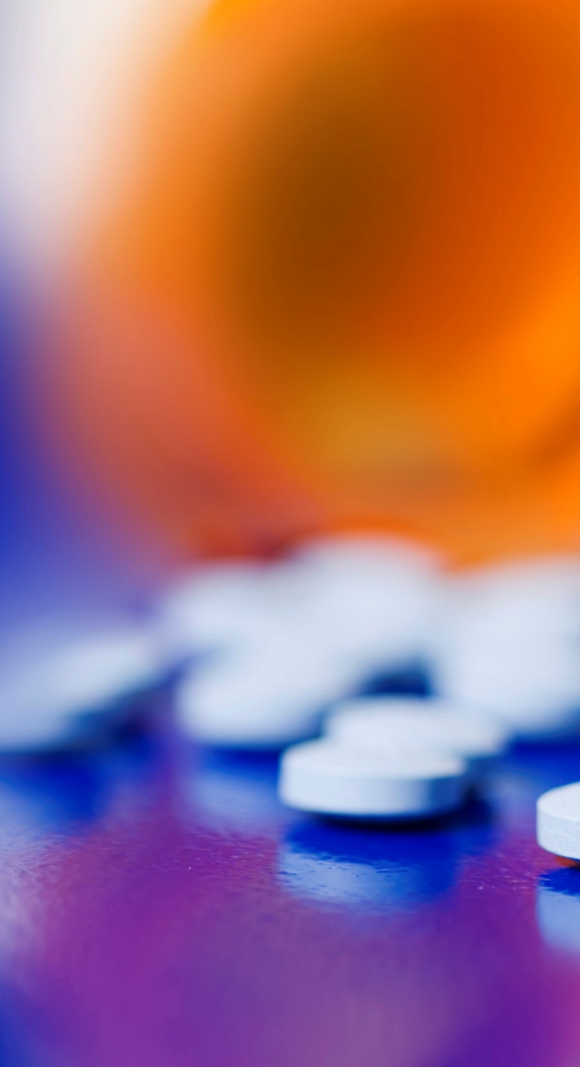
Karina Bentzen
Tender Specialist
AMGROS
Denmark
Notes:
Hello.
My name is Karina Bentzen and I work at AMGROS in Denmark.
At AMGROS we make EU tenders for almost all medicines used in public hospitals in Denmark.
I am a pharmacist – and before I started working as a tender specialist at AMGROS, I spent 10 years as a clinical pharmacist at a public hospital.

Slide 3
Introducing biosimilars
Biosimilars may reduce hospital medicines expenditure
… but only if they are used
Lack of knowledge and insecurities about biosimilar medicines among healthcare professionals and patients must be addressed to ensure implementation
Notes:
I am here to tell you a little about the successful introduction of Biosimilar medicines in Denmark.
Biosimilars were introduced in neighboring countries around 6 months before the patents expired in Denmark. Price reductions of around 60 percent were seen, so we knew there was a potential to save a lot of money.
However… we knew that there were a lot of insecurities about what biosimilar medicines ”really” were. Both among healthcare professionals and patients.
These insecurities had to be dealth with - if we were to take full advantage of the lower prices.

Slide 4

Introducing biosimilars
To facilitate the introduction of biosimilars on a national level a Taskforce was appointed
Notes:
So on this ground a special taskforce was appointed.
The aim for the ”Taskforce for the introduction of biosimilars” was to enhance knowledge of biosimilar medicines among healthcare professionals and thereby prepare the implementation of biosimilars in the clinical setting.

Slide 5
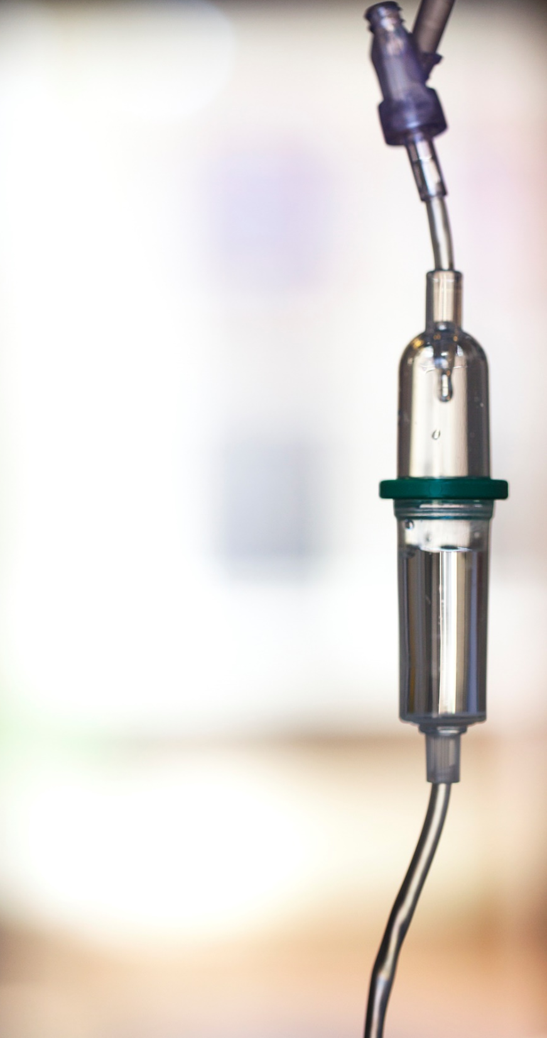
Taskforce members
Physicians
Clinical pharmacologists
Pharmacists
Drug tender specialists
Staff from the ”Council for the Use of Expensive Hospital Drugs”
Notes:
The taskforce consisted of
physicians including clinical pharmacologists,
pharmacists,
drug tender specialists
and staff from ”RADS” - the ”Council for the Use of Expensive Hospital Drugs” - who issue national treatment guidelines in Denmark.

Slide 6

Seminars and meetings
Seminars and meetings with specialists from the clinical setting to
- provide knowledge of biosimilars
- discuss the introduction of biosimilar medicines and switching patients to biosimilar medicines
Notes:
Planning the introduction of the first biosimilar in Denmark – biosimilar infliximab – started more than a year prior to the granting of marketing authorization.
The Taskforce arranged seminars on biosimilars for clinicians and specialists from the clinical setting.
Leading specialists held lectures on biosimilars and on the process in EMA leading to marketing authorisation – which requirements the manufacturer have to apply to – which studies they have to do – extrapolation of data and so forth.
Later meetings were held with specialists from the clinical setting to discuss the introduction of biosimilar medicines – and to discuss switching patients to biosimilar medicines.

Slide 7

Rekommendation
Based on these discussions the ”Council for the Use of Expensive Hospital Medicines” recommended the use of biosimilar medicines nationally
Notes:
The specialists from the clinical setting agreed on terms for switching – and based on this the “Council for the Use of Expensive Hospital Medicines” issued a recommendation to switch to biosimilar medicine - taking into account the individual patient history.
The councils national treatment guidelines and recommendations have to be complied to by every clinician in public hospitals in Denmark.
It basically said that all new patients starting treatment with infliximab or etanercept has to start treatment with the cheapest alternative (ie biosimilar infliximab or biosimilar etanercept) – and all patients being currently treated with infliximab or etanercept should switch to the cheapest alternative (ie biosimilar infliximab or biosimilar etanercept) unless special circumstances applies to that individual patient.

Slide 8
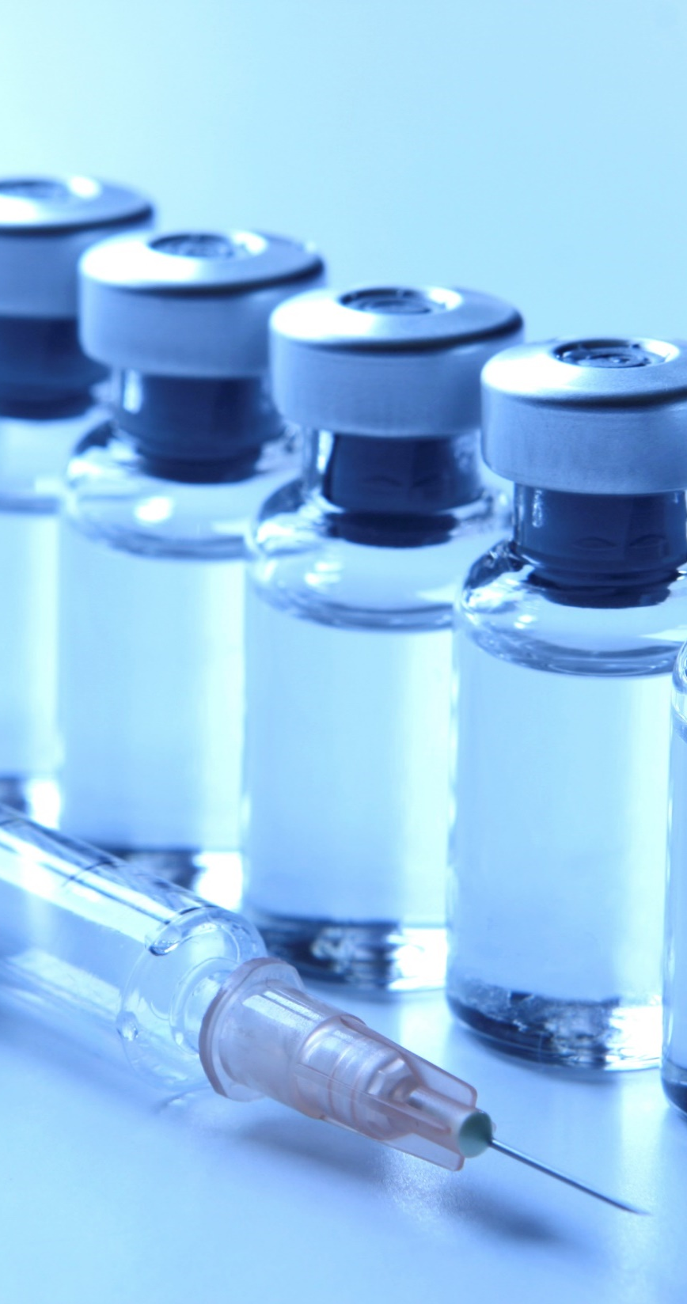
Information
Educational materials for
- Doctors and nurses
- Patients
Q & A website about biosimilars
Notes:
Based on the seminars and meetings the Taskforce made educational materials for doctors and nurses. The material included a general introduction to what biosimilar medicine is.
Later - after the introduction of biosimilar infliximab - we came to realize that there were some issues with information material for the patients – each region had made their own patient material.
The Taskforce therefore set about to make patient information materials about biosimilars before the next biosimilar medicine was introduced. This was done involving patient associations.
The taskforce also made a Q & A website answering some of the most frequent questions encountered in the clinic and among patients.

Slide 9

Infliximab
The patent for infliximab expired in Denmark in 2015 – and AMGROS made a tender as soon as possible after that
The biosimilar infliximabs Inflectra® and Remsima® made a bid on the tender – as well as the originator Remicade®
Notes:
The patent for infliximab expired in Denmark in early 2015 – and AMGROS made a tender as soon as possible after that.
Both suppliers of the biosimilar infliximab from Celltrion – Inflectra and Remsima – made a bid on the tender – as well as the originator Remicade.
A contract was made with the cheapest biosimilar - Remsima – as well as with the originator Remicade for those patients that were not eligible for switching.

Slide 10
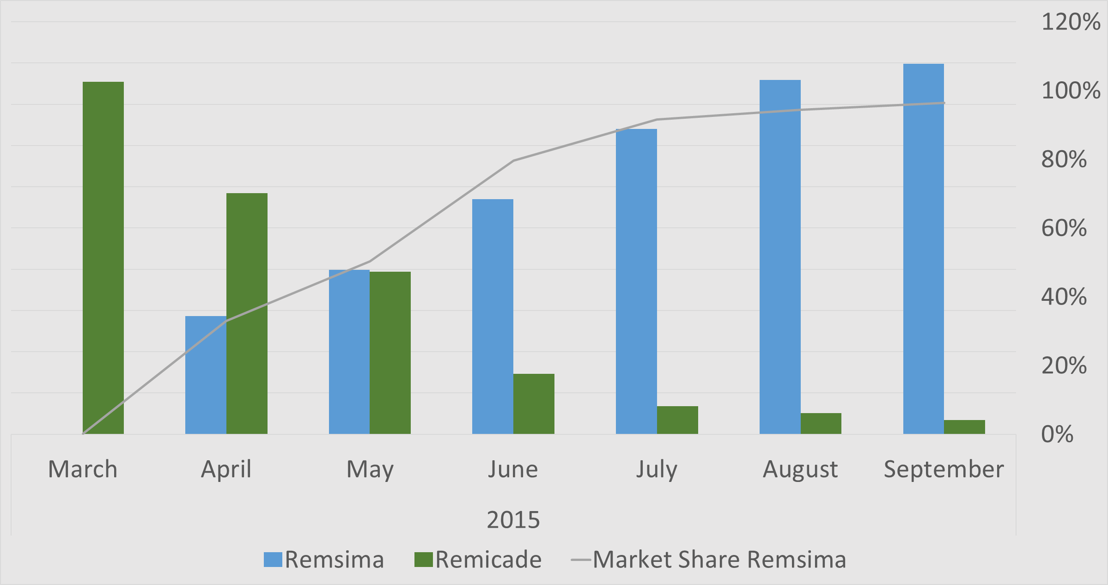
Market uptake of biosimilar infliximab
Notes:
So what did we achieve?
Biosimilar infliximab was adopted into the Danish market after a very quick introduction. The market share of the biosimilar was 95% within 4 months. After two years the market share for Remsima is steady at 97 - 98 %.

Slide 11
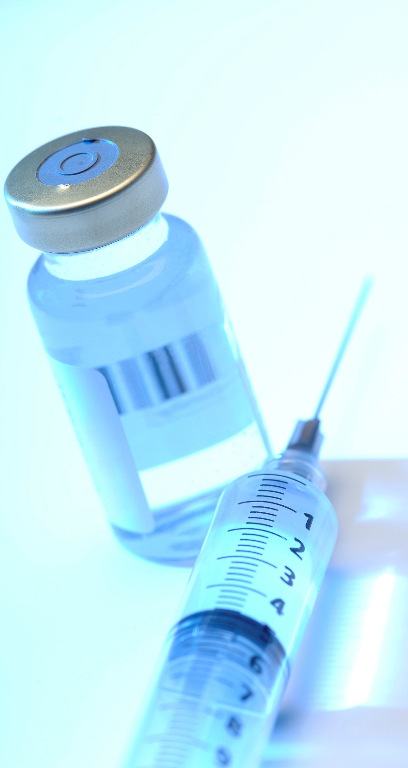
etanercept
Biosimilar etanercept was introduced in Denmark in 2016
The biosimilar etanercept Benepali® made a bid on the tender – as well as the originator Enbrel®
Notes:
Next biosimilar medicine to be introduced into the Danish market was etanercept – just one year after infliximab.
Like with infliximab AMGROS made a tender – and contracts with both the biosimilar – Benepali - as well as the originator Enbrel for those patients that were not eligible for switching.

Slide 12
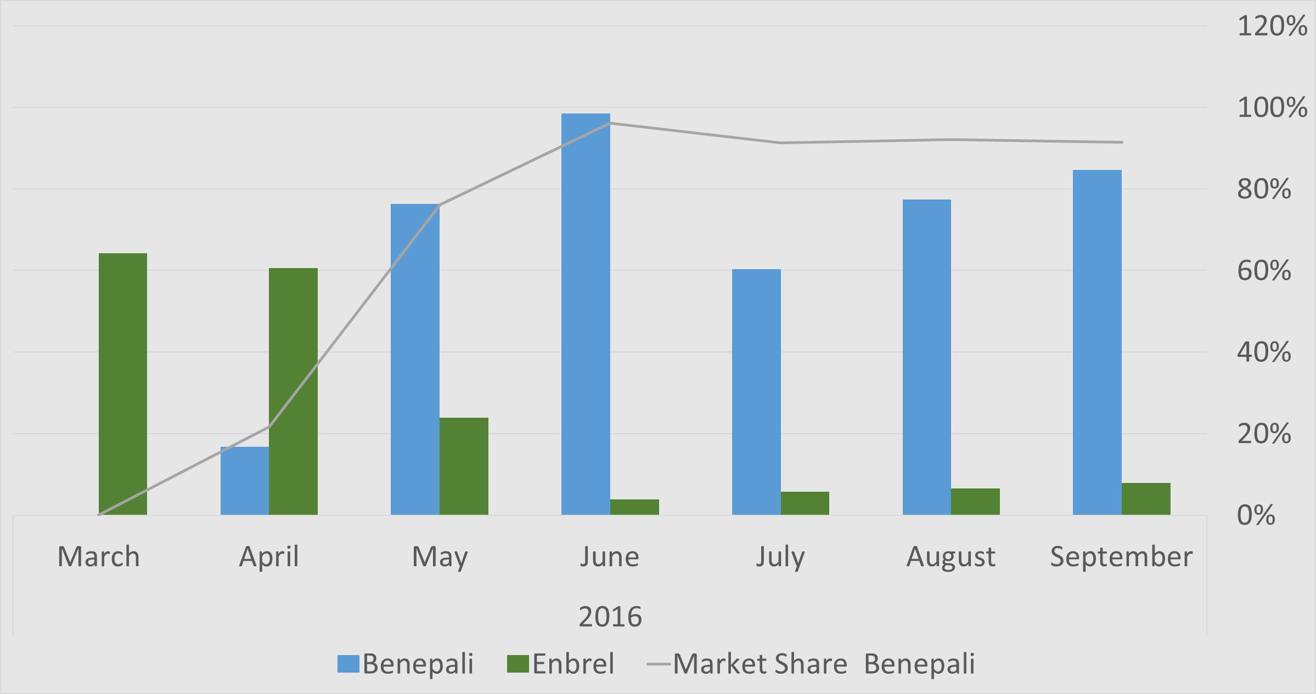
Market uptake of biosimilar etanercept
Notes:
Introduction of biosimilar etanercept was even quicker than the introduction of infliximab. In the third month after introduction most patients had been switched to the biosimilar - Benepali. After nearly a year the market share of biosimilar etanercept is steady at around 90 %.

Slide 13

savings
Price reduction after introducing biosimilars was approx. 60% for both infliximab and etanercept
Total annual savings in Denmark
Infliximab - 22 mio €
Etanercept - 15 mio €
Notes:
There was a large price difference between the prices previously paid for the originator – and the new tender prices for the biosimilar medicines.
For both medicines the reduction was approximately 60 %.
The quick inplementation of the biosimilar medicines in the clinic allowed us to make the most of the price reductions – with an annual saving on
infliximab of approx. 22 million Euros in the first year after introduction
– and an estimated annual saving of 15 million Euros in the first year of using biosimilar etanercept.

Slide 14

What next?
More new biosimilars are expected to be introduced into the Danish market in the near future
The Taskforce will continue their work to ensure similar successful implementations of the next biosimilars
Notes:
And now what?
It would be nice to just lean back and sip a cup of coffee – but there are more new biosimilars standing in line at EMA – waiting to be introduced into the Danish market.
Next up is rituximab - and with rituximab we have to adress a whole new group of clinicians compared to the two previous biosimilars.
Therefore the Taskforce will continue their work – to ensure similar successful implementation in the clinical setting.
Thank you very much for your attention.

