Slide 1

Federatie
Medisch Specialisten
naam
functie

Slide 2
Programma
Opening en inleiding – Huib Cense
Voorstelronde
Presentatie Willem van den Wijngaart
Presentatie Wim Janssen
Koffiepauze
Interactief gedeelte
Discussie
Rondvraag en sluiting

Slide 3

Inleiding
Aanleiding en doel bijeenkomst
Samenvatting reacties: 49 reacties; 28 specialismen; naast UEMS ook actief in 24 andere gremia
Actief in Europa van een half jaar tot meer dan twintig jaar. Gemiddeld vijf jaar.
Tijdsinvestering loopt uiteen van het bijwonen van 1 vergadering per jaar tot een dagdeel per week.
Belangrijkste onderwerpen in gremia: Duur opleiding; Europees examen; wederzijdse erkenning opleiding; accreditatie; stemverhouding UEMS; certificering; harmonisering opleiding(seisen).
Toegevoegde waarde van Europa: Uitwisselen kennis en ideeën; laatste ontwikkelingen; Nederlandse belangen behartigen; netwerken; samenwerking; harmonisatie opleidingen; gelijkschakeling van Europese regelgeving, opleidingscurricula, examinering en certificering; lobbyen.
Rol Federatie en Platform van “klein”, “coördinerend en faciliterend”, “sturend”, tot “financieel ondersteunend”

Slide 4
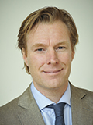
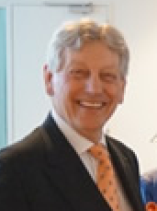
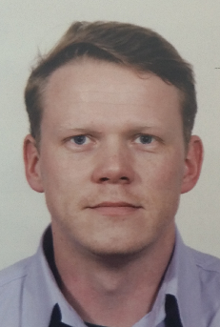
Inleiding
Vertegenwoordiging vanuit Federatie
Huib Cense Willem van den Wijngaart
Vicevoorzitter FMS Huidige FMS-vertegenwoordiger
Aantredend FMS-vertegenwoordiger in UEMS Council
in UEMS Council
        Janwillem van den Berg
        Adviseur Beleid FMS
        Coördinator Platform Europa

Slide 5











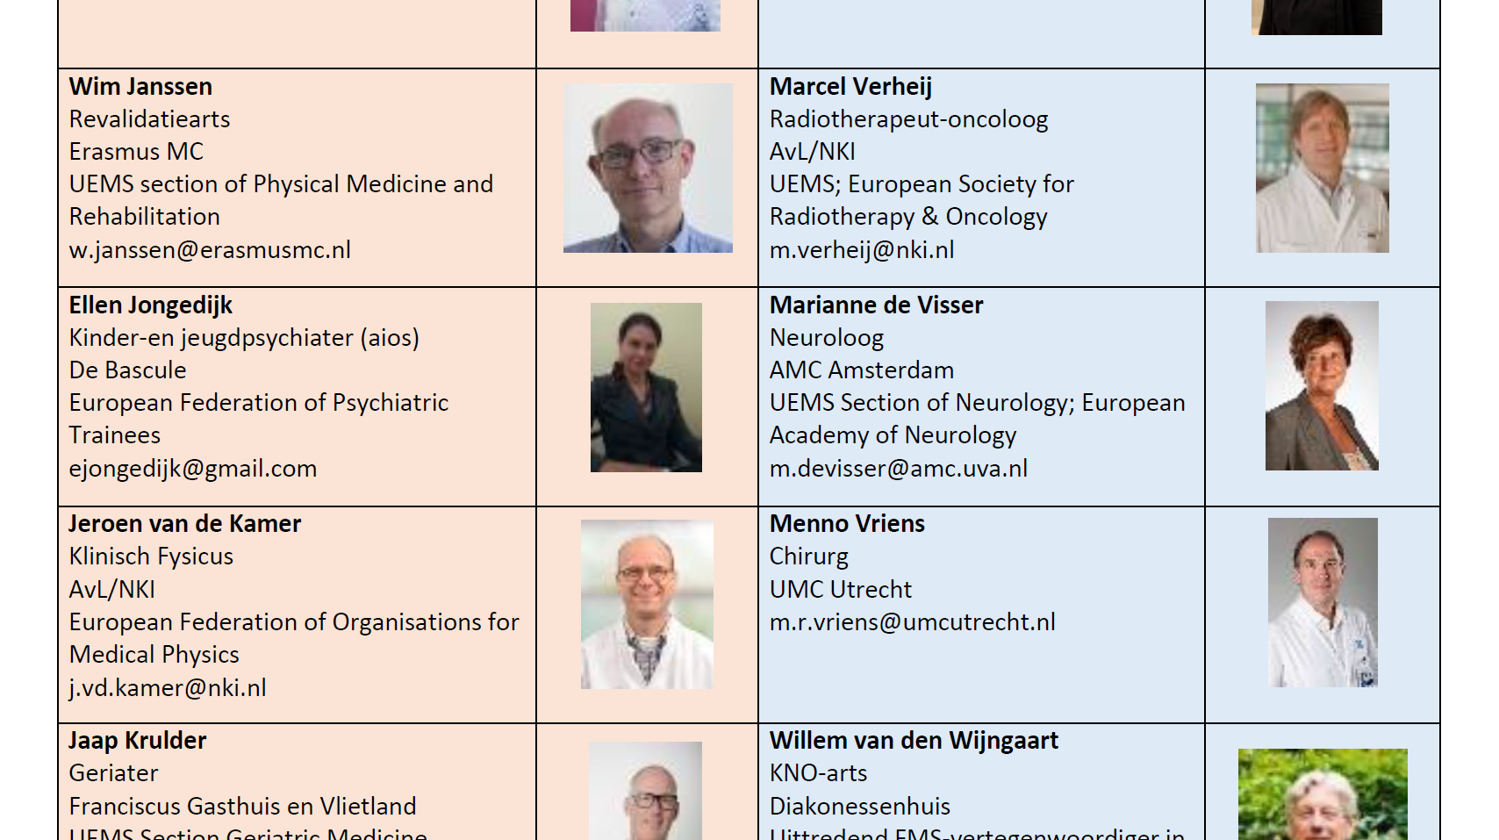



Voorstelronde

Slide 6
Presentatie Willem van den Wijngaart
Huidige FMS-vertegenwoordiger in UEMS Council

Slide 7
UEMS
Willem van den Wijngaart
Hoofd van de Nederlandse Delegatie bij de UEMS

Slide 8
What is UEMS
The European Union of Medical Specialists (UEMS) is a non-governmental organisation representing national associations of medical specialists in the European Union and in its associated countries.
With a current membership of 37 countries and operating through 43 Specialists Sections and European Boards, the UEMS brings together approximately 1.6 million medical specialists in Europe.
With the support of its membership, the UEMS is committed to the promotion of free movement of European medical specialists while ensuring the highest quality of medical care for European citizens.

Slide 9
Objectives
UEMS aims for the following international non profit-making objectives:
The study, promotion and harmonisation of the highest level of training of the medical specialists, medical practice and health care within the European Union;
The study and promotion of free movement of specialists doctors within the EU;
The representation, within this framework of the medical specialist profession in the Member States of the EU, to EU authorities and any other authority and/or organisation dealing with questions directly or indirectly concerning the medical profession, and any action which might further the achievement of the afore mentioned objectives.
The defence of the professional interests of European Medical Specialists.

Slide 10
Activities
The activities UEMS proposes in order to achieve these objectives are notably the following:
Setting up Sections and Boards for each medical specialty;
Setting up a general system of accreditation of Continuing Medical Education and Professional Development, Postgraduate Training and Quality Management at European level;
Setting up working groups on issues of interest for medical specialists at European level;
Organising seminars and studies in the relevant fields of specialist medicine;
Any other activity which would be considered necessary.

Slide 11
Countries
The UEMS is representing 37 Countries which have different status within the organization: full member, associate member, observer member. Each National Member Association represents its country at the UEMS Council.

Slide 12
Projects
The UEMS is involved in different EU-funded projects and provides its expert-based knowledge to relevant decision-makers. It provides the viewpoint of practising health professionals.
The UEMS is currently involved in Momentum, Renewing Health, ECAB and the Joint Action Healthcare Workforce.

Slide 13
Representation of medical specialities
In 1962, the UEMS created its first Specialist Sections in order to promote and defend the interests of the different medical specialties at the European level.
Above all, UEMS Specialist Sections develop European standards of medical training in their respective medical discipline.
In discipline which are part of a main specialty, UEMS Specialist Sections can request to the UEMS Council the creation of a Divisions which also promote and defend the interests of this particular branch of a medical specialty (ex: Paediatric Allergology being a division of the UEMS Specialist Section of Paediatrics).
In disciplines involving several specialties, UEMS Specialist Sections can request to the Council the creation of a Multidisciplinary Joint Committee. (ex: MJC in Spine Surgery which involved Orthopaedics, Surgery…).

Slide 14
Advantages
The UEMS is in close contacts with European institutions as well as with other organisation having a stake in healthcare matters. Over the years, it has developed a wide network of contacts. The UEMS promotes the values, concerns and expectations of practicing medical specialists at the European level. It advocates for increased involvement of Medical Doctors in decision-making processes as the best way to implement changes in the healthcare sector.
In doing so, the UEMS offers the European Institutions the expertise of its Members. It notably involves several specialties in different EU funded projects to provide their knowledge and experience, thereby giving significant input and feedback to shape European health policies.
National Member Associations of UEMS can have their views and concerns promoted to the relevant European institutions. They also receive regular information on the latest developments as regards European health-related issues.
Members of UEMS Specialist Sections and European Boards contribute to shaping the European standards of medical care through elaboration of standards, guidelines and recommendations in the field of Post graduate training or Continuing Medical Education.

Slide 15
Structure
The UEMS is formally made up of the following bodies:
A General Assembly: the UEMS Council
An Executive: the UEMS Executive
In order to carry out its daily running, the UEMS is supported by its Brussels secretariat.
To achieve its objectives, the UEMS established:
Specialist Sections, Divisions, Multidisciplinary Joint Committees and European Boards
Working groups in specific areas: Post Graduate Training, eHealth, Medical Practice, Ethics
Accreditation Councils in each key area of UEMS: EACCME®, ECAMSQ® and EACQM

Slide 16
Sections
A Specialist Section is a UEMS entity in charge of promoting and defending the interests of a given medical specialty. It is composed of medical specialists nominated by the different member associations of the UEMS Council.
UEMS Specialist Sections develop standards, policy recommendations and draft European Curriculum in their specialty.

Slide 17
Boards
A European Board is a working group within a Specialist Section aiming at addressing in particular training issues. In this respect, it involves members from the Section and members from scientific societies in accordance with UEMS regulations.

Slide 18
Multidisiplinary Joint Committee
A Multidisciplinary Joint Committee is a grouping of different UEMS Specialist Sections created in order to discuss scientific and training issues of interest to several specialties (ex; Oncology, Spine Surgery, Sports Medicine…). Currently, 11 MJC exist within UEMS.
MJCs can be created upon request to the Council of one or more Specialist Section or by the UEMS Council itself.

Slide 19
Divisions
A division is a sub entity within a Specialist Section which aims to address the issues of a sub specialty within a main specialty
(ex: Neuroradiology is a sub specialty of Radiology).
UEMS Divisions can be created by UEMS Specialist Sections after the approval of the UEMS Council.

Slide 20
EACCME
The EACCME® stands for European Accreditation Council for Continuing Medical Education. It provides a mechanism of mutual recognition of evaluation of CME events by National Accreditation Authorities.

Slide 21
National Acceditation Authorities (NAA)
National Accreditation Authorities are the competent authorities in the different European countries in charge of accrediting CME event. Through UEMS-EACCME®, these authorities collaborate together in the accreditation process

Slide 22
EACCME
European Accreditation means the decision by UEMS-EACCME® that a CME activity, event, programme or e-learning material has fulfilled the UEMS-EACCME® quality requirements. A CME activity or e-learning material will be accredited by UEMS-EACCME®

Slide 23
CESMA
CESMA stands for “Council for European Specialty Medical Assessment”. It aims to provide recommendations on European specialty examinations.

Slide 24
ECAMSQ
The ECAMSQ® stands for “European Council for Accreditation of Medical Specialist Qualifications”. The aim of this body is to address the issue of medical specialist qualifications across Europe and ensure that medical specialists meet the highest standard of qualification in order to ensure quality and safety of care provided to patients.
The ECAMSQ® ultimately aims to assess and certify medical specialists’ competence on the basis of harmonised European standards developed by the UEMS.

Slide 25
Training Charter
In 1994, the UEMS adopted its “Charter on Training of Medical Specialists in Europe”. This documents sets the basic standards of high quality Medical training at the European level.

Slide 26
Chapter 6 /ETR
In 1994, the UEMS adopted its “Charter on Training of Medical Specialists in Europe”. This documents sets the basic standards of high quality Medical training at the European level. It includes 6 chapters.
Preamble
Chapter 1 - National Authority
Chapter 2 - General Aspects of Training of Medical Specialists
Chapter 3 - Requirements for Training Institutions
Chapter 4 - Requirements for Chief of Training
Chapter 5 - Requirements for Trainees
Chapter 6 - Requirements for Specialty (to be filled in by the appropriate UEMS Specialist Section)
Each Specialist Section is in charge of developing its Chapter 6 to set the European standards in their specialty. Once elaborated, the Sections’ Chapter 6 is submitted to the UEMS Council for consideration and decision.

Slide 27
European Examinations
UEMS Specialist Sections and European Boards have developed European Standards in Medical Training and have organized, certain for more than 20 years, European Specialist Examinations in different medical specialties to assess the competence of medical trainees according to these standard.

Slide 28
Legal standing of European Diplomas
Trainees passing these European Exams receive a European Diploma which proves that they reached a high level of knowledge in their discipline.
Formally, the European Diploma delivered by the UEMS Specialist Sections and European Boards have no legal value as such and cannot grant any rights to their beneficiaries. They are to be considered as marks of excellence.
However, in some countries, given their high quality and the increasing number of trainees taking these examinations, European examinations have been recognised as part of national assessme

Slide 29

Presentatie Wim Janssen
Delegate UEMS section of Physical Medicine and Rehabilitation

Slide 30



EUROPA
UEMS / FMS / VRA
Wim Janssen

Slide 31
Inleiding
Revalidatiegeneeskunde
Structuur Dutch en European bodies
Eigen rol
PRM Board activiteiten
Examen
Inleiding
Revalidatiegeneeskunde
Structuur bodies
Eigen rol
Board activiteiten
Examen

Slide 32
Revalidatiegeneeskunde
duur opleiding 4 jaar*
omvang Nederland n= 558 specialisten
omvang Europa n= 18.000 specialisten / 2.600 AIOS /
3897 European Board certified
(grote) verschillen per land qua
aantal
structuur opleiding
werkomstandigheden
Inleiding
Revalidatiegeneeskunde
Structuur bodies
Eigen rol
Board activiteiten
Examen
Notes:
Nederland Middelgroot specialisme.
In Nederland naar 3 jaar en 7 maanden
balneology

Slide 33
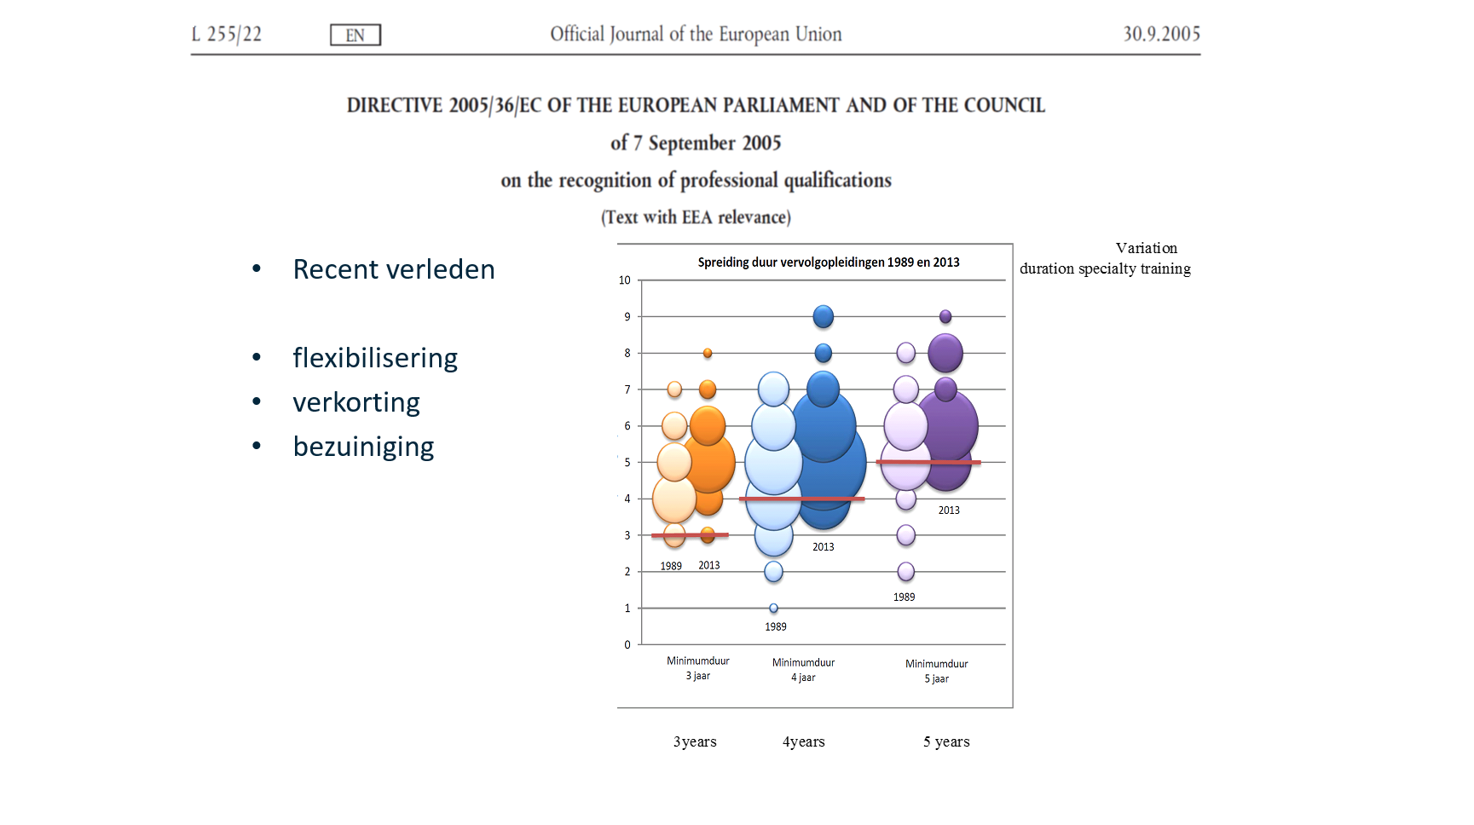
Notes:
uit: eindrapportage quickscan 2013 LSJ project groep
De oranje bollen tonen de spreiding van de vervolgopleidingen met een EU-norm van drie jaar. De Blauwe bollen representeren de opleidingen met een minimumnorm van vier jaar, de paarse staan voor opleidingen van minimaal vijf jaar. Bij elk paar bollensets geeft de lichtgekleurde linkerset de situatie in 1989 weer en toont de donkergekleurde rechterset de situatie in 2013. Hoe groter een bol, hoe meer opleidingen met deze duur.

Slide 34
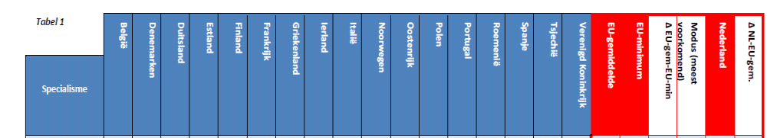
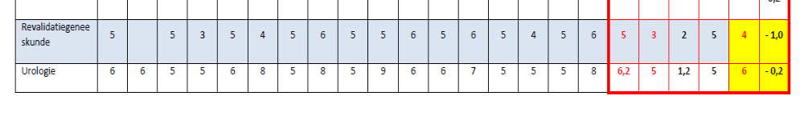

Slide 35
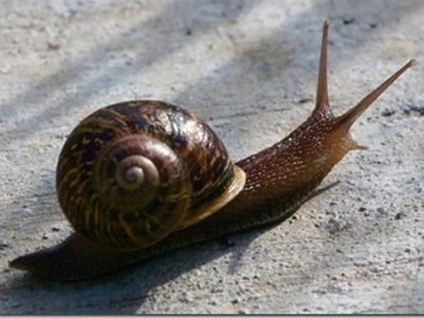
UEMS Council and UEMS PRM
STELLING
“zo traag als stroop en weinig effectief”

Slide 36




Structuur Internationale Bodies
Dutch
European
Mondial
Nederland
VRA
Federatie Medisch specialisten
VWS
Europa
ESPRM
UEMS PRM Section & Board
UEMS
European Council
Mondiaal
ISPRM
Inleiding
Revalidatiegeneeskunde
Structuur bodies
Eigen rol
Board activiteiten
Examen

Slide 37
delegate UEMS PRM sinds 2010
Nederland drie delegates UEMS PRM
via FMS
UEMS PRM
  Board
  Professional Practice Committee
  Clinical Affairs Committee
  tevens
  Treasurer
  National Manager
Inleiding
Revalidatiegeneeskunde
Structuur bodies
Eigen rol
Board activiteiten
Examen

Slide 38
UEMS PRM
  Board PRM activiteiten
  Educational material (curriculum)
  Logbook trainees
  European Exam
  Accreditatie congressen/scholing EACCME
verder
Harmonisatie training
European School Marseille and Syracuse
e-books
White Book on PRM
Inleiding
Revalidatiegeneeskunde
Structuur bodies
Eigen rol
Board activiteiten
Examen

Slide 39
stelling
IN NEED OF A COMMON LANGUAGE IN EUROPE
Inleiding
Revalidatiegeneeskunde
Structuur bodies
Eigen rol
Board activiteiten
Examen

Slide 40
Nederlandse <> Europese Accreditatie
Het Accreditatie Overleg heeft in de afgelopen 10 jaar driemaal op het punt gestaan om een overeenkomst met de UEMS/ EACCME te tekenen, maar dit is driemaal niet doorgegaan.

Slide 41
UEMS PRM
  Board PRM activiteit
Europees Examen
Schriftelijk
MCQ
100 vragen
via NM per land
alleen lidstaten
1 x / jaar
fee 200 Euro (hierbij 1x herkansing)
Inleiding
Revalidatiegeneeskunde
Structuur bodies
Eigen rol
Board activiteiten
Examen

Slide 42
UEMS PRM
  Board PRM activiteit
UEMS PRM Board Exam
Question Bank Group
Jury
Waardering
Zwitserland verplicht !
als onderdeel van nationale certificering (UK optie)
Nederland ?!
waardering Midden en Verre Oosten
Inleiding
Revalidatiegeneeskunde
Structuur bodies
Eigen rol
Board activiteiten
Examen

Slide 43
Pauze

Slide 44
Stellingen
Iraniërs en andere niet-EU landen moeten worden toegelaten tot de Europese examens van de UEMS-secties. *Zie ook bijlagen in e-mail met programma
Harmonisatie van de opleidingseisen (en -duur): goed streven of misplaatste Europese bemoeizucht?
De rol van de Federatie binnen UEMS moet worden uitgebreid of afgebouwd.
Nederland, als gidsland in opleiden, moet leverancier worden van medisch specialisten aan Europa.

Slide 45
Discussie - Stelling 1
Iraniërs en andere niet-EU landen moeten worden toegelaten tot de Europese examens van de UEMS-secties.

Slide 46
Discussie - Stelling 2
Harmonisatie van de opleidingseisen (en -duur): goed streven of misplaatste Europese bemoeizucht?

Slide 47
Discussie - Stelling 3
De rol van de Federatie binnen UEMS moet worden uitgebreid of afgebouwd.

Slide 48
Discussie - Stelling 4
Nederland, als gidsland in opleiden, moet leverancier worden van medisch specialisten aan Europa.

Slide 49
Rondvraag
Individualisation of training duration in the Netherlands

