Slide 1
Induction Day of new EAHP Board Members
18th September 2017

Slide 2
Agenda
Introduction Day for new EAHP Board Members
Agenda
Part 1 - the European Union
Part 2 - EAHP’s stakeholders
Part 3 - Policy

Slide 3
Part 1 – the European Union

Slide 4
Part 1 – European Institutions
A brief history
https://www.youtube.com/watch?v=XgnXwrsMBUs
Notes:
Winston Churchill – United States of Europe
Schuman declaration – ECSC
Treaty of Rome – EEC (common market for services, capital, goods, people)
1992 Maastricht Treaty – EU and Euro

Slide 5
Part 1 – European Institutions
The European Union as we know it now
It’s based on two principle treaties:
the Treaty on European Union (TEU; Maastricht Treaty, effective since 1993)
the Treaty on the Functioning of the European Union (TFEU; Treaty of Rome, effective since 1958)
Both the TEU and the TFEU (and their attached protocols and declarations) have been altered by amending treaties. The latest alteration happened in 2009 when the Treaty of Lisbon entered into force.

Slide 6
Part 1 – European Institutions
The European Institutions – Art. 13 TEU

Slide 7
Part 1 – European Institutions
European Council
Participants: Heads of State, Government Leaders & President of the European Commission
Meets 4x per year
Role: decides on the EU’s overall direction and political priorities

Slide 8
Part 1 – European Institutions
Council of the EU (Council of Ministers)
Participants: Government Ministers (changing composition per topic)
Rotating presidency changing every 6 month
Role: decides on policies and adopts legislation together with the European Parliament
and the European Commission

Slide 9
Part 1 – European Institutions
Council of the EU (Council of Ministers)
Employment, social policy, health and consumer affairs council (EPSCO)
usually four EPSCO meetings a year
2 generally devoted exclusively to employment and social policy topics
Council adopts, together with the European Parliament, legislation relating to the quality and safety of human organs and blood, patients' rights in cross-border healthcare and the quality and safety of medicines and medical devices.

Slide 10
Part 1 – European Institutions
COREPER
COREPER stands for “Committee of Permanent Representatives of the Governments of the Member States”. It is responsible for preparing the agenda for the ministerial Council of the European Union meetings.
It is not an EU decision-making body, and any agreement it reaches can be called into question by the Council, which alone has the power to make decisions.
Main tasks
coordinates and prepares the work of the different Council configurations
ensures consistency of the EU's policies
works out agreements and compromises which are then submitted for adoption by the Council

Slide 11
Part 1 – European Institutions
European Parliament
Members: 751 parliamentarians that have been elected in the 28 European Member States
Role: directly elected legislative arm of the European Union; responsible for the establishment of the EU budget; exercises democratic scrutiny

Slide 12
Part 1 – European Institutions
Composition of the European Parliament
EPP
Notes:
EPP - Group of the European People's Party (Christian Democrats)
S&D - Group of the Progressive Alliance of Socialists and Democrats in the European Parliament
ECR - European Conservatives and Reformists Group
ALDE - Group of the Alliance of Liberals and Democrats for Europe
GUE - Confederal Group of the European United Left - Nordic Green Left
Verts/Greens - Group of the Greens/European Free Alliance
EFDD - Europe of Freedom and Direct Democracy Group
ENF - Europe of Nations and Freedom

Slide 13
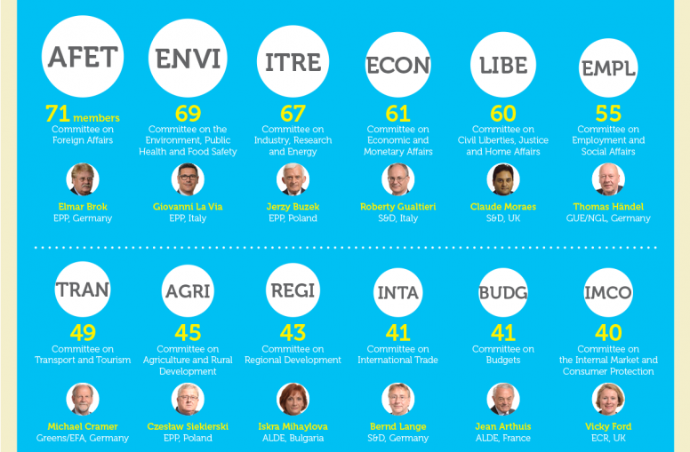
Key Committees of the European Parliament
Key Committees of the European Parliament
Video

Slide 14
Part 1 – European Institutions
Important terminology
1) ‘Rapporteur’
An MEP who is delegated the task of leading scrutiny on a policy file on behalf of the Parliament. Selected from within the relevant committee via a points based system to ensure fair allocation to the party groupings.
Works along side ‘shadow rapporteurs’ from other parties and will typically reach out to the impacted stakeholder community for opinion and advice.
2) ‘Interest Groups’
In theory, an alignment and coordination mechanism for MEPs with joint interest in a topic (E.g. cancer, mental health). In reality, often almost wholly instigated and operated by outside sponsoring organisations.
e.g. http://healthfirsteurope.org/index.php?page=ep-interest-group-on-innovation-in-health-and-social-care
3) ‘Resolutions’
Non-binding statements of the Parliament’s desire to see policy action in a certain area.

Slide 15
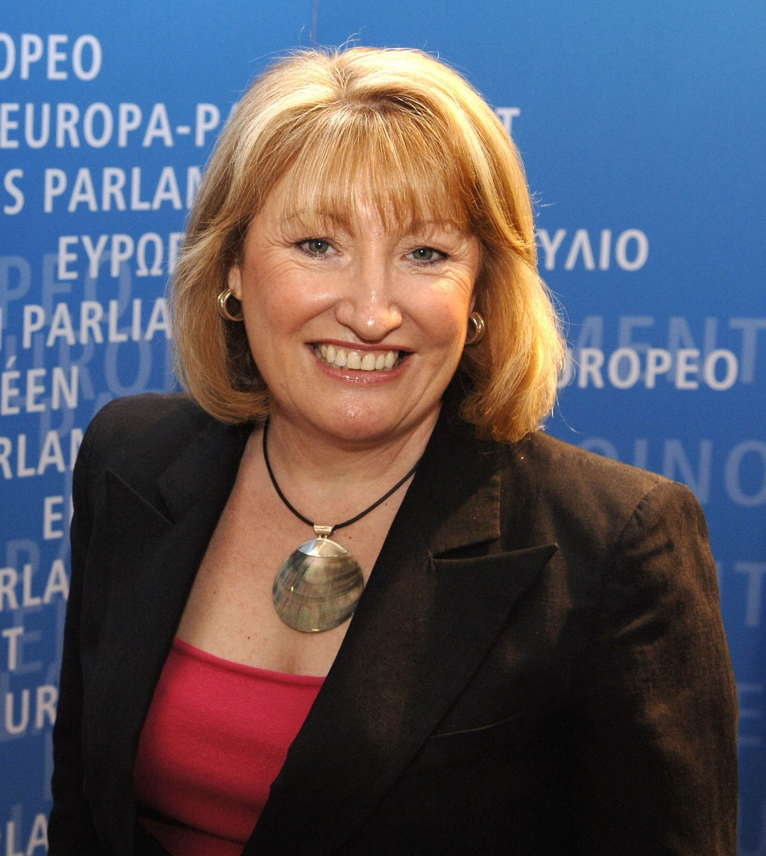

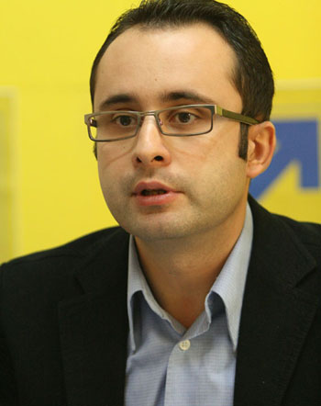
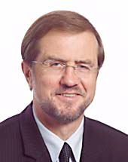

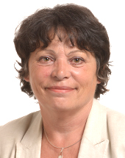

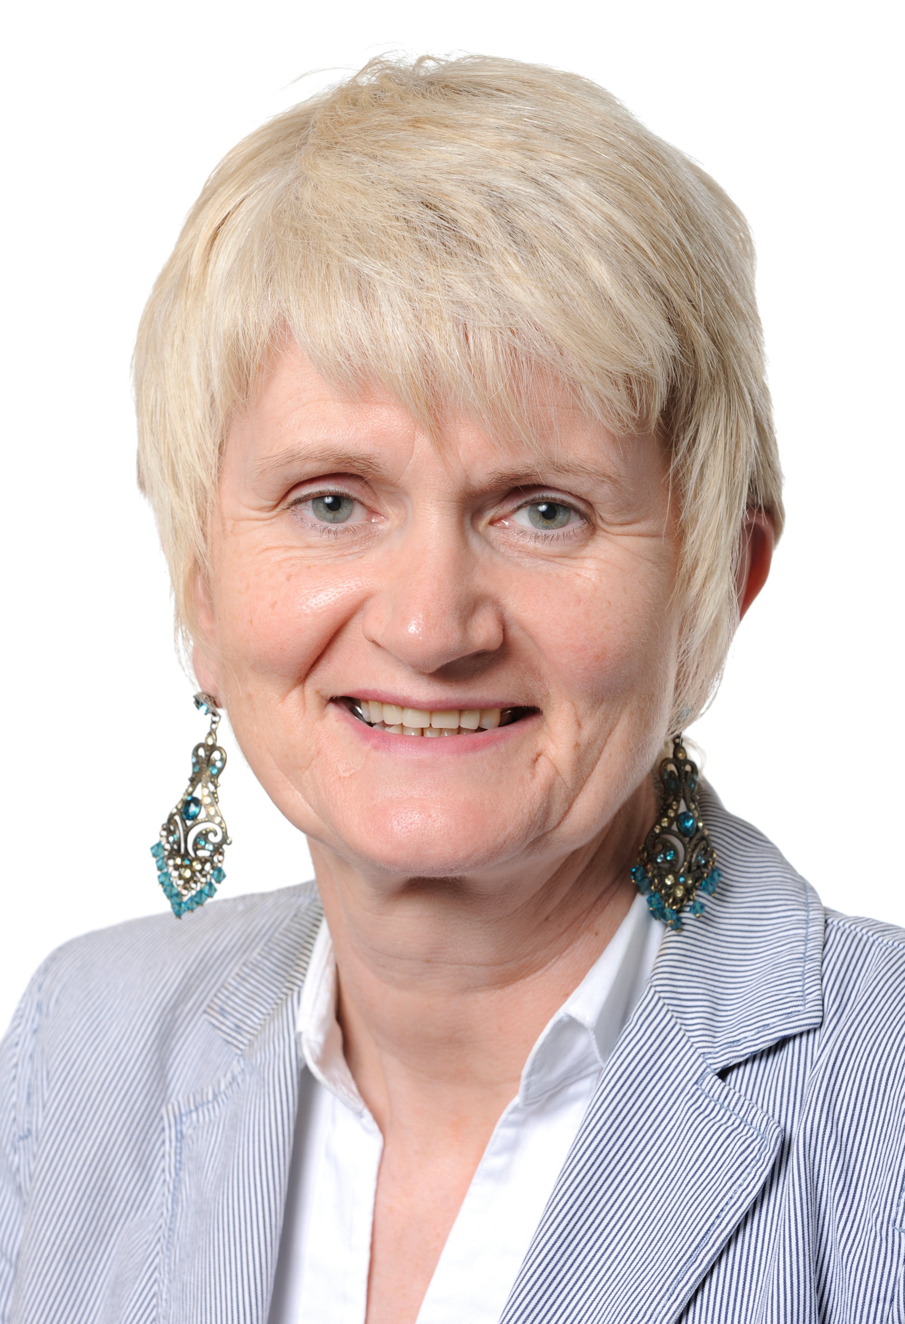
Glenis Willmott
UK, S&D
Nessa Childers
Ireland, S&D
Cristian Silviu Bușoi
Romania, EPP
Alojz Peterle, Slovenia, EPP
Biljana Borzan, Croatia, S&D
Michele Rivasi, France, Greens/EFA
Christel Schaldemose, Denmark, S&D
Marian Harkin, Ireland, ALDE

Slide 16
Part 1 – European Institutions
European Commission
Composition: a college of Commissioners, headed by Jean-Claude Juncker, presides over the different areas of interest of the EU. Each EU Member State appoints one Commissioner.
Role: executive arm of the EU that proposes legislative actions, works on policy agreements, upholds EU laws and treaties and promotes the EU

Slide 17
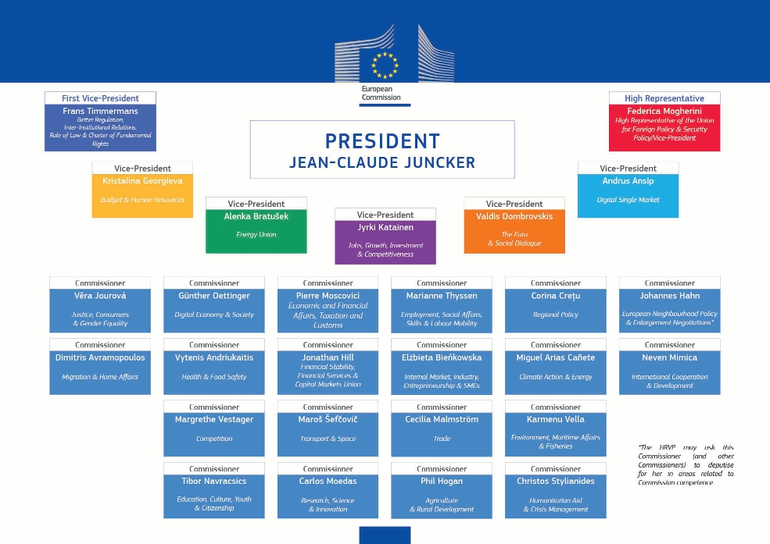
Part 1 – European Institutions

Slide 18
Part 1 – European Institutions
Directorate General – Health and Food Safety
(DG SANTE)
Role of DG SANTE:
Protects and improves public health
Ensures Europe’s food is safe and wholesome
Protects the health and welfare of farm animals
Protects the health of crops and forests
It achieves its aims by monitoring, listening and acting.

Slide 19
Part 1 – European Institutions

Slide 20
Part 1 – European Institutions
Directorate General – (DG GROW)
Role of DG GROW:
Promote the growth of Europe
Supporting the free movement of professionals in the EU is part of DG GROW’s mission

Slide 21
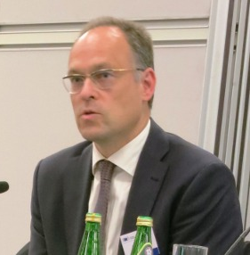
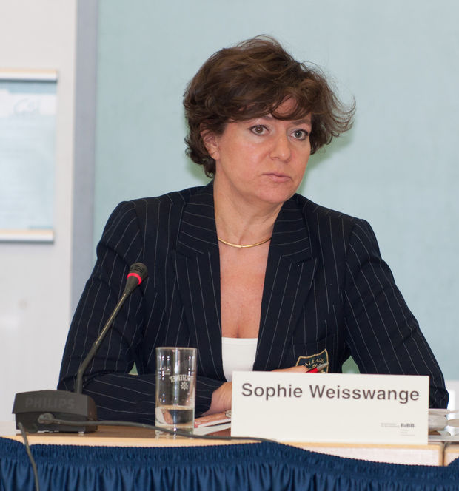
Part 1 – European Institutions
DG GROW – Unit E5 professional qualifications and skills
Headed by Martin Frohn
Sophie Weisswange in charge of CTF work
Alma Basokaite leading European Professional Card introduction
Raluca Nicoleta Ionescu overseeing mutual evaluation of professional regulation requirements and further development of regulated professions database

Slide 22
Part 1 – European Institutions
Court of Justice of the European Union (CJEU)
Role: judicial branch of the EU, arbitrating and advising on the application of EU law
Actions:
European Commission can take a member state to court if it believes it is in breach of EU law (e.g. community pharmacy ownership rules)
Member States can take the Commission to
court if it believes it is acting outside its legal
remit.

Slide 23
Part 1 – European Institutions
European Economic and Social Committee
Role: represents organised civil society
Participants: “social partners” – employers (employers organisations), employees (trade unions) and representatives from various other interest groups
Activities:
Advise the European Parliament, the European Commission and the Council
Make sure the views of civil society organisations are heard in Brussels
Support and strengthen organised civil society both inside and outside the EU

Slide 24
Part 1 – European Institutions
Committee of the Regions
Role: advisory body that represents Europe’s cities and regions
Participants: representatives from different European regions
Activities:
Issues opinions on legislation that directly affects local and regional authorities

Slide 25
Part 1 – European Institutions
European Ombudsman
Role: investigates maladministration (i.e. unfairness, discrimination, abuse of power, lack or refusal of information, unnecessary delay and incorrect procedures)
Current Ombudsman: Emily O’Reilly

Slide 26
Part 1 – European Institutions
Other European Organisations
European Central Bank
Manages the euro and the euro area monetary policy
European Court of Auditors
Checks that EU funds are collected and used correctly
European Data Protection Supervisor
Protects EU citizens’ personal data processed by EU
European Investment Bank
Makes long-term finances available for EU-related projects

Slide 27
Part 1 – European Institutions
European Agencies
Specialised institutions situated in the EU Members States that offer information or advice to the EU institutions
Each institution has specific technical, scientific or managerial tasks
Most important to EAHP:
European Medicines Agency (EMA)
European Centre for Disease Prevention and Control (ECDC)
Consumers, Health and Food Executive Agency (Chafea)

Slide 28

Part 1 – European Institutions
European Medicines Agency (EMA)
EMA’s main responsibility is the protection and promotion of public and animal health, through the evaluation and supervision of medicines for human and veterinary use. Since it’s establishment in 1995, it has taken on additional roles in areas such as pharmacovigilance & clinical trial result publication.
Pharmaceutical companies can apply via a centralised procedure for marketing-authorisations. Once granted by the European Commission its valid in the entire EU, as well as in the European Economic Area (EEA) countries Iceland, Liechtenstein and Norway.
EAHP is a member of the EMA’s Healthcare Professional Working Party, and through this takes part in many ad hoc working groups (e.g. trials; shortages)

Slide 29

Part 1 – European Institutions
European Centre for Disease Prevention and Control (ECDC)
Established in 2005 as an EU agency aimed at strengthening Europe's defences against infectious diseases. Its headquarters are in Stockholm.
ECDC works in partnership with national health protection bodies across Europe to strengthen and develop continent-wide disease surveillance and early warning systems (very limited advisory role in respect however).
In 2007 ECDC started to coordinate the European Antibiotic Awareness Day (EAAD) an initiative through which EAHP is seeking to enhance its relations with ECDC.

Slide 30

Part 1 – European Institutions
Consumers, Health and Food Executive Agency (Chafea)
Chafea implements the EU Health Programme which is the main instrument for enacting the EU’s Health Strategy (i.e. TFEU Article 168 activity).
The Programme funds:
Specific projects (following a public call)
Operating grants (Small pot)
Joint Actions (led by Member State health authorities)

Slide 31
Part 1 – European Institutions
Permanent Representations to the EU
Role: Permanent Representations (PermReps) function as “embassies” to the EU
Composition: Staffed by civil servants from the member states
Actions: represent and convey national interests in Council discussions.
Advocating positions to Permanent Representations can be crucially important during the ‘trilogue’ process – which are the tripartite meetings between the Council, the European Parliament and the European Commission

Slide 32
Part 1 – European Institutions
Other institutions
Another institution relevant to EAHP which is not part of the EU is the Council of Europe - an inter-governmental organisation of 47 European Member States that is situated in Strasbourg.
The European Directorate for the Quality of Medicines and Healthcare (EDQM) is the most interesting body with the Council of Europe for EAHP.

Slide 33

Part 1 – European Institutions
Other institutions - EDQM
EDQM protects public health by: enabling the development, supporting the implementation, and monitoring the application of quality standards for safe medicines and their safe use, principally via its legally binding European Pharmacopoeia.
Also provides guidelines, reports and facilitates cooperation in its areas of interest. E.g. prospective E-tact system; 2007 medication safety report

Slide 34
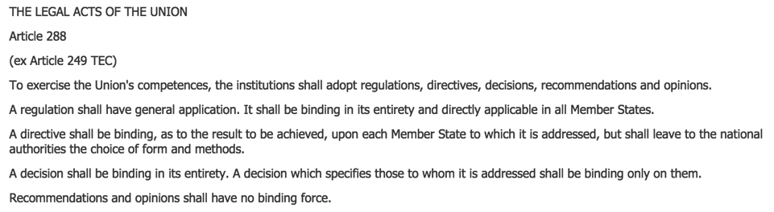
Part 1 – European Institutions
Legal actions by the European Union
In accordance with Article 288 TFEU the EU can take different legal actions provided that it has the competency to act.

Slide 35
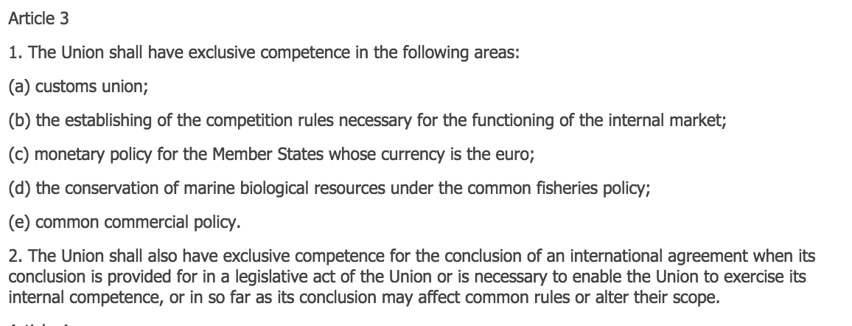
Part 1 – European Institutions
Competencies within the TFEU
The European Union is based on the rule of law. If a policy area is not cited in a treaty, the Commission cannot propose a law in that area.
Article 3 of TFEU sets out where the EU has “exclusive competence” i.e. the EU alone is able to legislate and adopt binding acts in these fields.

Slide 36
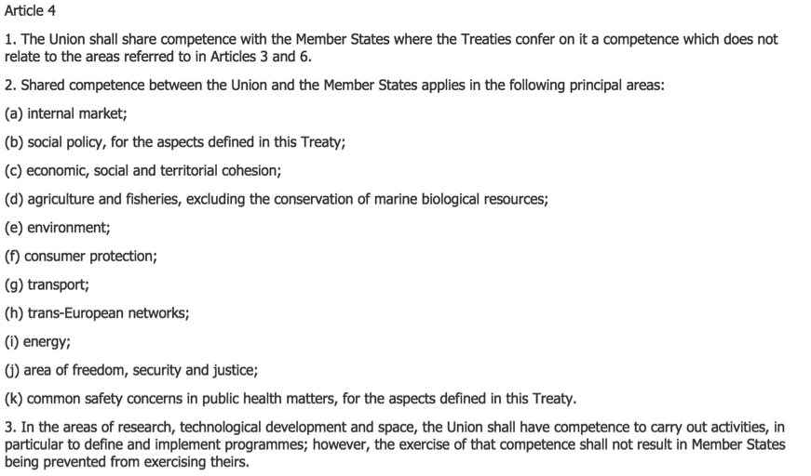
Competencies within the TFEU
Article 4 of TFEU sets out where the EU has “shared competence” i.e. the EU and Member States are authorised to adopt binding acts in these fields. However, Member States may exercise their competence only in so far as the EU has not exercised, or has decided not to exercise, its own competence.

Slide 37
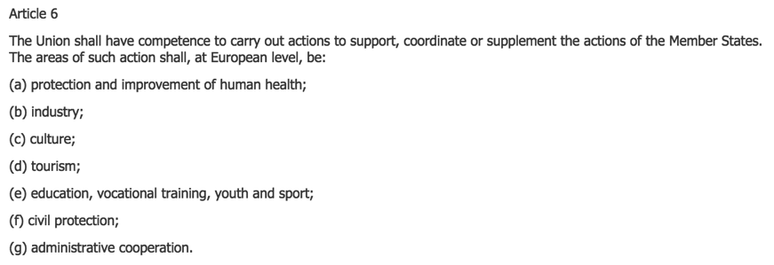
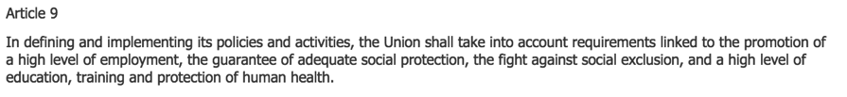
Competencies within the TFEU
Article 6 of TFEU sets out where the EU has “supporting competence” i.e. the EU EU can only intervene to support, coordinate or complement the action of Member States. Consequently, it has no legislative power in these fields and may not interfere in the exercise of these competences reserved for Member States.
To also note:

Slide 38
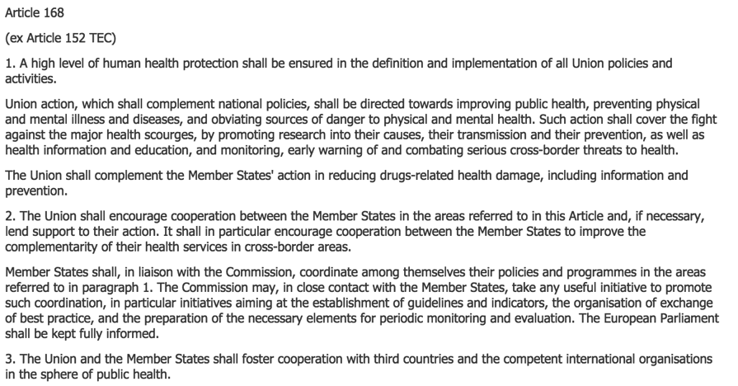
Part 1 – European Institutions
Article 168 TFEU – the basis for actions in the area of health

Slide 39
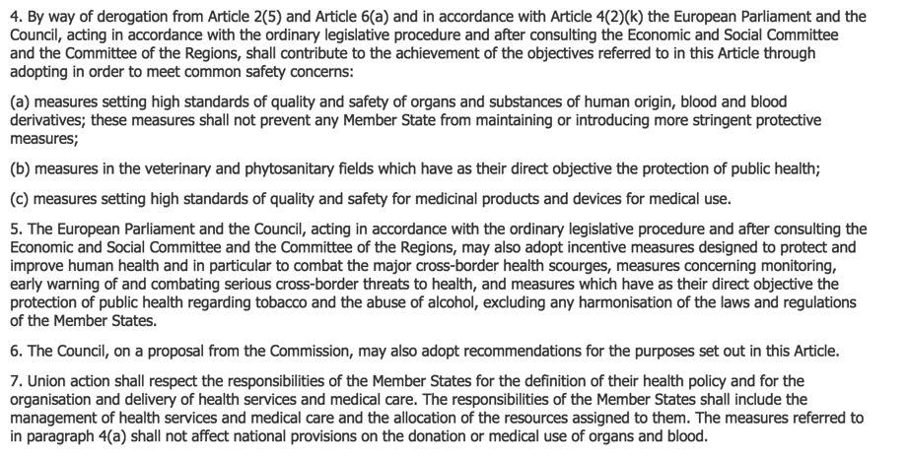
Legal basis of the European Union: Article 168
Part 1 – European Institutions

Slide 40
Part 1 – European Institutions
In summary, though the EU does not have exclusive competency in health, it certainly has scope for action via Article 168 TFEU… despite what the Commission may say!

Slide 42
Part 2 – EAHP’s Stakeholder

Slide 43
EAHP’s Stakeholder
Why do we need stakeholder understanding?
In the crowded advocacy field, building alliances with other stakeholders can greatly strengthen the chances of lobbying success by pooling resource and demonstrating breadth of support on an issue. Knowing where these potential alliances might be, and establishing relationships of trust, therefore matters.
Equally, potential misunderstanding of motive and effect of an organisation’s advocacy position can arise due to disrupted communication. Inter-organisational relations need to be managed therefore.
Sometimes, another stakeholder organisation will be the principal lobbying point.

Slide 44








EAHP’s Stakeholder
Our current “top” stakeholders
Associations
Falsified Medicines Directive

Slide 45



EAHP’s Stakeholder
European Public Health Alliance (EPHA)
Network of NGOs/ other not-for-profit organisations working in the field of public health in Europe
Wide membership of healthcare professionals, patient organisations and other campaigning NGOs.
Very member-led organisation, EAHP engage closely with its work.
Key areas EAHP works with:
Medicines shortages and access
Wide range of health system issues
eHealth/mHealth
AMR
EMA HCP and Patient Working Parties
EAHP statements
Nina Renshaw,
Secretary General
Sascha Marshang, Director of Operations and Membership

Slide 46
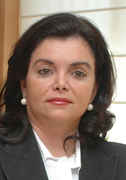

EAHP’s Stakeholder
International Pharmaceutical Federation (FIP)
global body representing pharmacy founded in 1912
represents over 3 million pharmacists and pharmaceutical scientists around the world through its 132 national organisations, academic institutional members and individual members
Key areas EAHP works with:
Medicines shortages
Basel Statements & EAHP Statements
Consultations
Ad hoc cooperation on miscellaneous matters
Carmen Pena,
President
Marianne Ivey,
President of HP section

Slide 47


EAHP’s Stakeholder
Pharmaceutical Group of the European Union (PGEU)
PGEU is the principal representative body for community pharmacy at the European level
Key areas EAHP works with:
Medicines shortages
EMVO
EMA issues
Ad hoc cooperation on consultations
Jurate Svarcaite,
Secretary General
Jamie Wilkinson,
Director of Professional Affairs

Slide 48

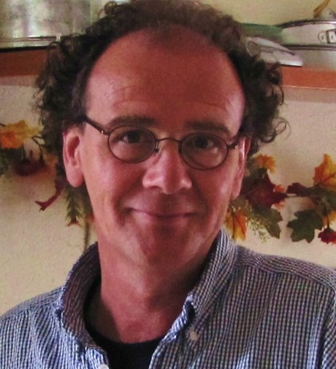

EAHP’s Stakeholder
European Specialist Nurses Organisation (ESNO)
Collaboration of 12 specialist nursing organisations, including oncology nurses and nurse directors
Key areas EAHP works with:
Common Training Framework
European Professional Card
Medicines shortages
Medicines barcoding
EAHP statements
EMA Healthcare Professional Working Party
Francoise Charnay-Sonnek, President
Ber Oomen, Executive Secretary

Slide 49


EAHP’s Stakeholder
European Union of Medical Specialists (UEMS)
NGO representing national associations of medical specialists in the EU and associated countries, it operates through 43 Specialists Sections and European Boards.
UEMS specialist sections work on harmonisation of training requirements and education accreditation.
Key areas EAHP works with:
Common Training Framework
European Professional Card
Prof. Vassilios Papalois,
Secretary General
Dr Romuald Krajewski, President

Slide 50



EAHP’s Stakeholder
GS1
GS1 is a not-for-profit, international organization that develops and maintains standards for supply and demand chains across multiple sectors.
With local organisations in over 110 countries, GS1 works with trading partners, industry organizations, governments and technology providers and responds to their business needs through the adoption and implementation of global standards.
Key areas EAHP works with:
Medicines bar-coding
Very positive working relationship on this topic.
Ulrike Kreysa, VP Healthcare, GS1 Global
Géraldine Lissalde-Bonnet, Senior Public Policy Manager

Slide 51

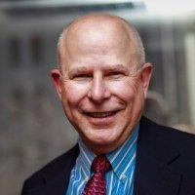
EAHP’s Stakeholder
American Society of Health System Pharmacists (ASHP)
ASHP represents pharmacists who serve as patient care providers in acute and ambulatory settings. The organization’s more than 40,000 members include pharmacists, student pharmacists and pharmacy technicians .
Key areas EAHP works with:
Conferences and congresses
Medicines shortages and access
Paul Ambramowitz,
Chief Executive
David Witmer,
Chief Operating Officer

Slide 52
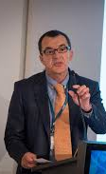
EAHP’s Stakeholder
The European Federation of Pharmaceutical Industries and Associations (EFPIA)
Formed in 1978, EFPIA is the trade association representing the research-based pharmaceutical industry operating in Europe.
Key areas EAHP works with:
Medicines bar-coding
Medicines shortages
Falsified Medicines Directive
Pricing and access discussions
EPFIA is interest in collaborating more on biosimilars
Nathalie Moll, Director General
Francois Bouvy,
Director of Market Access

Slide 53


EAHP’s Stakeholder
Medicines for Europe
Formed in 1993, Medicines for Europe represents generic pharmaceutical companies and their subsidiaries from throughout Europe, either directly or through national associations.
Key areas EAHP works with:
Medicines shortages
Medicines bar-coding
Medicines for Europe is always very keen to discuss biosimilar uptake.
Adrian van den Hoven, Director General
Maarten Van Baelen, Market Access Director

Slide 54
EAHP’s Stakeholder
European Medicines Verification Organisation (EMVO)
The European Medicines Verification Organisation (EMVO) is a Belgian non-profit organisation representing stakeholders united in securing the legal supply chain from falsified medicines
Its founding members are EFPIA, Medicines for Europe, PGEU, GIRP and EAEPC.
HOPE and EAHP are affiliate members
Key areas EAHP works with:
Implementation of the Falsified Medicines Directive
Andreas Walter, General Manager

Slide 55
EAHP’s Stakeholder
European Healthcare Distribution Association (GIRP)
GIRP is an umbrella organisation for pharmaceutical full-line wholesalers and distributors of healthcare products and services in Europe
Key areas EAHP works with:
Implementation of the Falsified Medicines Directive
Monika Derecque-Pois, Director General
Martin Fitzgerald, Deputy Director General

Slide 56
EAHP’s Stakeholder
European Association of Euro-Pharmaceutical Companies (EAEPC)
EAEPC represents Europe's licensed parallel distribution industry, an integral part of the European pharmaceutical market that adds value to society by introducing price competition and a supplementary layer of product safety
Key areas EAHP works with:
Implementation of the Falsified Medicines Directive
Richard Freudenberg, President
Heinz Kobelt, Director of European Affairs

Slide 57
EAHP’s Stakeholder
Other “Pharmacy” Organisations
Pharmaceutical Organisations
EAFP | European Association of Faculties of Pharmacy
EIPG | European Industrial Pharmacists Group
EPSA | European Pharmaceutical Students Association
ESCP | European Society of Clinical Pharmacy
ESOP | European Society of Oncology Pharmacy
PCNE | Pharmaceutical Care Network Europe
PGEU | Pharmaceutical Group of the European Union
Hospital Organisations
EAHM | European Association of Hospital Managers
EHMA | European Health Management Association
HOPE | European Hospital and Healthcare Federation

Slide 58
EAHP’s Stakeholder
Healthcare Professions
Acronym | Name
CPME | Standing Committee of European Doctors
EBVS | European Board of Veterinary Specialisations
ECCO | European Cancer Organisation
EFLM | European Federation of Clinical Chemistry and Laboratory Medicine
EFN | European Federation of Nurses Association
EHA | European Haematologists Association
EONS | European Oncology Nursing Society
ERS | European Respiratory Society
ESC | European Society of Cardiology
ESCIM | European Society of Intensive Care Medicine
ESMO | European Society for Medical Oncology
SIOPE | European Society for Paediatric Oncology

Slide 59
EAHP’s Stakeholder
Engagement with other organisations
Associations EAHP’s has “joined”:
European Connected Health Alliance (ECH Alliance)
European Medicines Verification Organisation (EMVO)
European Public Health Alliance (EPHA)
International Pharmaceutical Federation (FIP)
All trials
Integrated Healthcare Enterprise (IHE)
Associations that list EAHP as “partner”
European Pharmaceutical Students’ Association (EPSA)
European Specialist Nurses Organisation (ESNO)

Slide 60
Part 3 – Policy

Slide 61


Part 3 - Policy
EAHP’s main policy fields and projects
AMR
eHealth/ mHealth
Biosimilars
FMD
Barcoding
Medicine Shortages

Slide 62
Part 3 - Policy
Antimicrobial Resistance (AMR)
Main messages of EAHP’s position paper:
Improving stewardship of antimicrobials through pharmacist management
Need for new incentives to develop antibiotics
Need to tackle misuse of antibiotics in the veterinary sector

Slide 63
Part 3 - Policy
Antimicrobial Resistance (AMR)
Actions EAHP was/is involved in:
New EU Action Plan
EU Guidelines on prudent use of antimicrobials
Update of ECDC hospital toolkit (to be published in October 2017)
European Antibiotic Awareness Day (EAAD)

Slide 64
Part 3 - Policy
Medicines Shortages
EAHP’s position paper:
Outlines the problem that medicines shortages pose
Calls for action in the supply chain (i.e. prescribers, hospital pharmacists, wholesalers and manufacturers)
Calls for action on national and international level that address the issue of medicine shortages

Slide 65
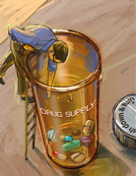
Part 3 - Policy
Medicines Shortages
Actions taken:
EAHP's 2014 survey on medicines shortages in European hospitals
Initiating the COST Action on medicine shortages
Joint statement of different supply chain actors

Slide 66

Part 3 - Policy
eHealth and mHealth
Main messages of EAHP’s position paper:
Need to achieve universal use of electronic prescribing, administration and electronic medical records
Use of barcode scanning technology to promote patient safety
Opportunities from mHealth for improving patient empowerment and self-management
Appropriate training opportunities on eHealth/mHealth for healthcare professionals
need to involve hospital pharmacists in hospital ICT design and specification

Slide 67
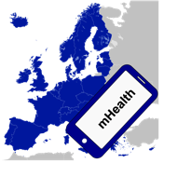
Part 3 - Policy
eHealth and mHealth
Concrete actions taken
Involvement in different Commission networks (i.e. eHealth Stakeholder Group and EC mHealth assessment guidelines working group)
Participation in the topic group 'Digital Health' set up by EMA
Active engagement in the EPHA eHealth Working Group
Recognition and consultations in eHealth matters at EU level (currently working on the Digital Single Market Consultation on Health and Care)

Slide 68
Part 3 - Policy
Biosimilar Medicines
Main areas covered by the position paper:
Naming of biosimilar medicines
Extrapolation of indications
Interchangeability, switching and substitution
Information about biosimilar medicines
Role of the hospital pharmacists
No concrete actions apart from participation in the organisation of the yearly Commission Biosimilar event

Slide 69
Part 3 - Policy
Falsified Medicines Directive (FMD)
FMD and the Delegated Regulation (DR) form the legislative framework in accordance with which the safeguards for combatting falsified medicines need to be implemented.
EMVO is in the body tasked with the implementation
EAHP affiliate member of EMVO
EAHP is currently setting up a “task force” – the so-called “hospital platform” – with HOPE

Slide 70
Part 3 - Policy
Barcoding medicines to the single unit
EAHP’s reasons for supporting barcoding:
Enables significant improvements for patient safety to be achieved
Assists in the comprehensive management of medicines recalls and alerts
Provides further assurance against potential counterfeit medicines intrusion
Supports comprehensive management of medicines information
Helps to prepare health systems for an aging society

Slide 71
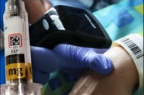
Part 3 - Policy
Barcoding medicines to the single unit
Actions EAHP was/is involved in
Meeting in Leuven on bedside scanning
Joint Statement with GS1 on barcoding to the single unit
Awareness raising via GS1
Mailing campaign targeting CEOs of pharmaceutical companies

Slide 72
Part 3 - Policy
Other Policy Areas
Clinical Trial Regulation
Public spending austerity
Medical Device Regulation
Access to medicines
Patient safety
Ageing society

Slide 73
Part 3 - Policy
Clinical Trial Regulation + Medical Device Regulation
Both statements are calling for the improvement of the Clinical Trial and the Medical Devices Regulations
Update of Medical Devices adopted in May 2017
Update of Clinical Trial legislation adopted in April 2014
Both of EAHP’s statements were adopted prior to the amendment of the legislation concerning clinical trials and medical devices

Slide 74
Part 3 - Policy
Public spending austerity
Concerns relating to public spending austerity raised in EAHPs position
increasing expectancy placed upon patients to meet the up-front costs of their medicines
the unintended impacts national cost-cutting measures are having in respect of medicines shortage
short-staffing in hospitals
diminished opportunities for healthcare professional training and development
shrinking investment in areas of patient safety enhancement
Position includes European Commission review into the potential for greater joint level cooperation between governments in terms of reducing the detrimental health impacts of austerity measure

Slide 75
Part 3 - Policy
Access to medicines
EAHP’s statement outlines the current trends in medicines pricing and access
Austerity and emergency measures related to medicines pricing
Operation of external reference pricing
Health Technology Assessment (HTA), value based pricing and other innovations
Transparency of orphan drug pricing models
Generic tendering

Slide 76
Part 3 - Policy
Patient safety + Aging society
Patient safety
Adoption of statement in 2011 outlining how hospital pharmacists safeguard patient safety
Aging society
Adoption of position in 2016 addressing the value of medicines reconciliation; need to train healthcare professionals; review of the clinical trial rules for older patients; aging workforce as well as inter-sector communication and multidisciplinary approaches

