Slide 1

Good Practice Initiatives
EAHP 2016

Slide 2
GPI Session 2016
The 6 overall EAHP Statements 2014
Introductory Statements and Governance
Selection, Procurement and Distribution
Production and Compounding
Clinical Pharmacy Services
Patient Safety and Quality Assurance
Education and Research

Slide 3
GPI Session 2016
The first 4 overall EAHP Statements 2014
2. Selection, Procurement and Distribution
IS IT POSSIBLE TO TURN AROUND THE TREND ON THE INCREASING AMOUNT OF BACKORDERS - ON NATIONAL LEVEL (Lars Munk, Denmark)
3. Production and Compounding
DEVELOPMENT OF A COMPUTER APPLICATION TO REDUCE THE RISK OF ERRORS IN RECONSTITUTION OF CYTOTOXIC DRUGS (Amine Cheikh, Morocco)

Slide 4
GPI Session 2016
The first 4 overall EAHP Statements 2014
4. Clinical Pharmacy Services
DEVELOPMENT OF AN INTERACTIVE PLATFORM FOR PROVINCE CLINICAL PHARMACEUTICS WHO ARE IN CHARGE OF THE TREATMENT OF HEPATITIS C INFECTED PATIENTS (Marta Martín Marqués, Spain)
IMMPACT: A THERAPEUTIC EDUCATION PROGRAM TO SUPPORT SEAMLESS CARE FOR PATIENTS LIVING WITH CANCER (André Rieutord, on behalf of Audrey Decottignies, France)

Slide 5
GPI Session 2016
The first 4 overall EAHP Statements 2014
Introductory Statements and Governance
DEVELOPMENT OF A 7 DAY CLINICAL PHARMACY SERVICE (Sotiris Antoniou,United Kingdom)
RENAL PHARMACIST OPTIMISES HEALTH OUTCOMES FOR PATIENTS (Annett Frisch, Germany)

Slide 6
Is it possible to turn around the trend of increasing amounts of backorders even at the national level
Lars Munck (lmu@amgros.dk)
Procurement and Logistics
Amgros, Denmark

Slide 7

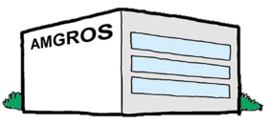

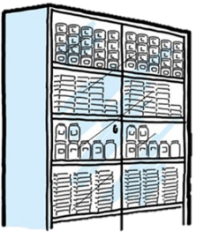

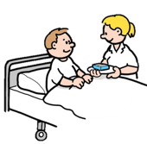
Drug supply chain in Denmark
Denmark:
6 million people
50 public hospitals
National tenders and backorder management
180 suppliers
focus point
8 hospital pharmacies
~2000 storage points

Slide 8
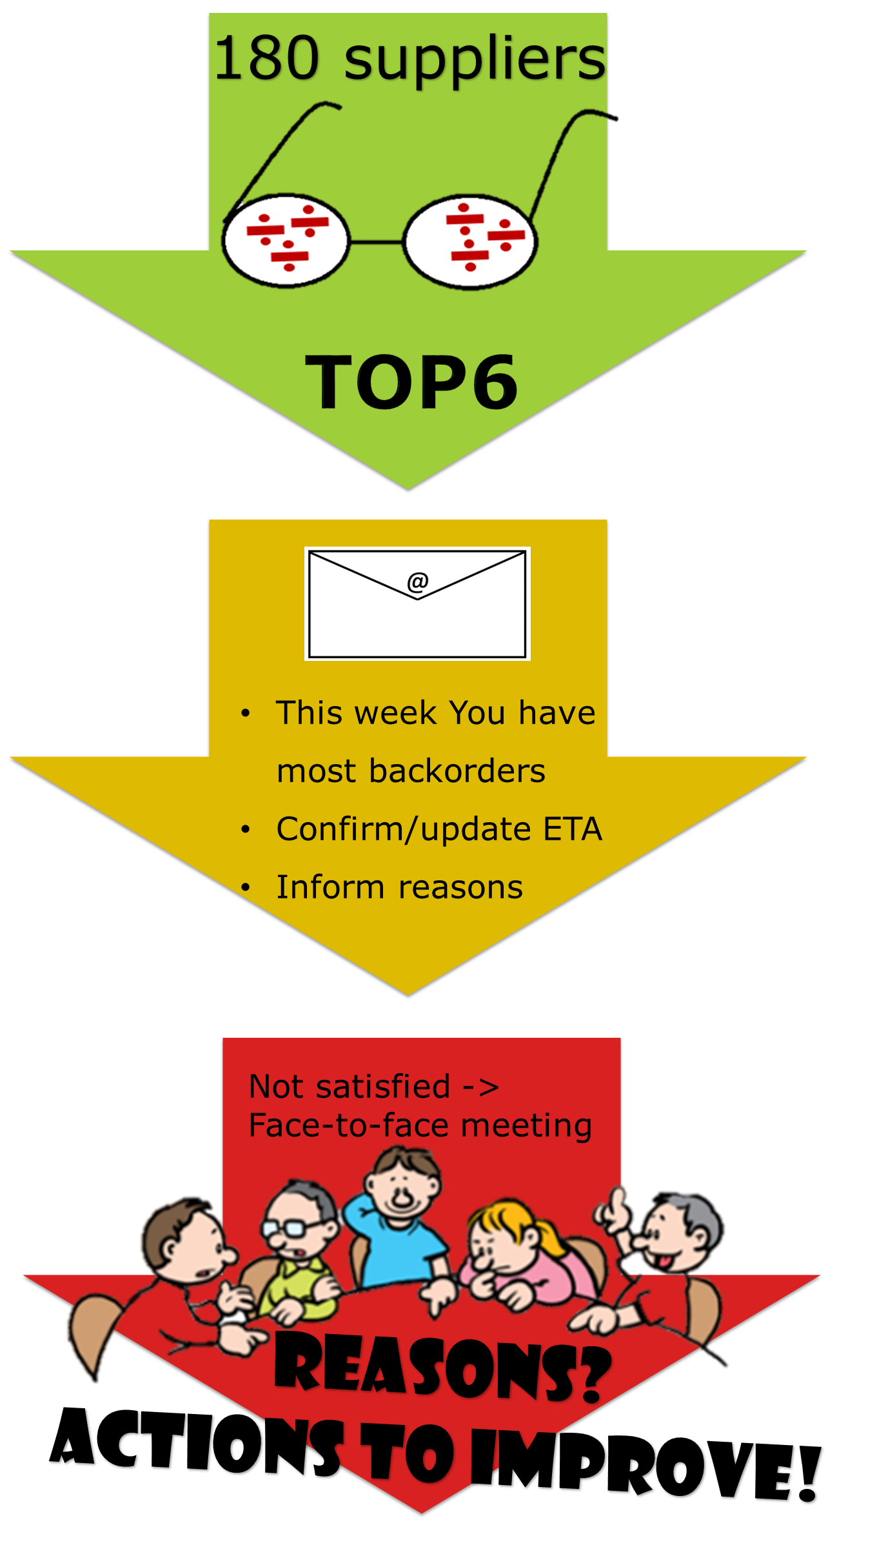
TOP6-backorder program
How: What: KPI’s:
Ownership and framework
Overview
Leading KPI’s
Reporting and celebrating
Patience
replies / week
Meetings/mth

Slide 9
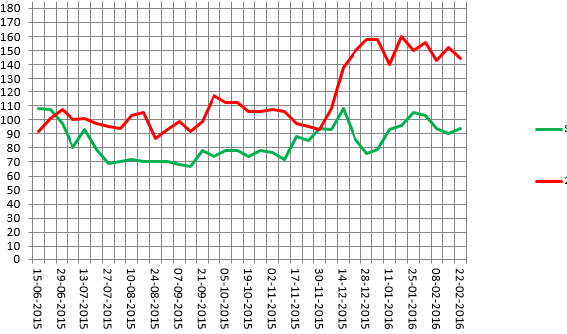
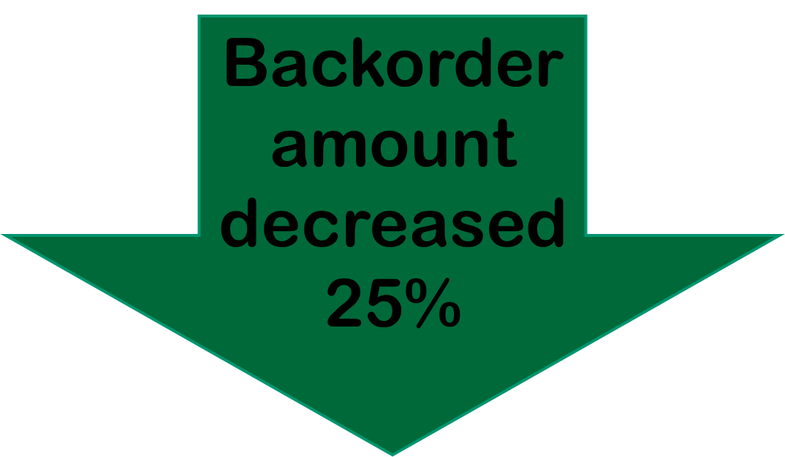
Results
Amount of item-numbers in backorder
2015
2014
Improved supplier collaboration
60% < 14 days
>30 suppliers have experienced our TOP6 backorder follow-up

Slide 10
Next
Continue development of our TOP6 backorder program
Inspire and be inspired
Join us:
LinkedIn group:”Supply Chain Management for Hospital Pharmacies”
or
Write an e-mail to amgros@amgros.dk attention: Lars Munck

Slide 11
Summary
The 3 most important steps in ”turning around the trend” on backorders
Take ownership and create overview
Develop leading KPI’s
Reporting and continuous supplier dialog about the problems

Slide 12






DEVELOPMENT OF A COMPUTER APPLICATION TO REDUCE THE RISK OF ERRORS IN RECONSTITUTION OF CYTOTOXIC DRUGS
VIE15-0185
A. Cheikh, M.A. El Wartiti, Y. Rahali, A. Bennana, A. El Hassani, M. Bouatia

Slide 13
What was done ?
We present a simple and effective method that we have developed in our hospital to solve the problem of reconstitution errors.

Slide 14
Why was it done ?
The cytotoxic drugs account for 15,6% of the medication errors rate¹. Cytotoxic drugs represent the second drug class whose errors lead to death ^{2,3}.
A study of S. limat on 30,819 preparations made in chemotherapy reconstruction unit of the French Hospital of Besançon reported 140 faulty preparations or an error rate of 0.45% ⁴.
The preparation of cytotoxic drugs perfusions can be accompanied by errors that can be fatal to some patients. Several methods were tested to minimize the risk of errors associated with reconstitution of cytotoxic perfusions (camera, HPLC, analytical balance, the presence of a second technician to monitor his colleague). All these methods can be expensive and not available to all hospital pharmacists.

Slide 15
How was it done ?
This work involves the development of a computer application developed from an Open Source voice recognition software. The daily chemotherapy protocols are entered in the application that dictates to the technician the protocol prescribed by physician product by product for all patients. The technician performs the cytotoxic preparations in the order in the centralized pharmaceutical unit for the preparation of cytotoxic drugs and he communicates with the application manually or by speaking.
The application begins with the patient's ID, name and surname, the first drug, the dosage, the dilution solution and the volume of this solution. Then, it passes to the second product and so on. In case of an observation, the application warns the technician to take this observation into account.

Slide 16
What has been achieved ?
This application has helped to provide better assistance to the technicians and pharmacists in the reconstitution of cytotoxic drugs and no event or error was detected until now.

Slide 17
What next ?
Making a large number of reconstitutions using this application to assess its effectiveness and install it in other hospitals who handle cytotoxic drugs.

Slide 18
References
1: Ford CD, Killebrew J, Fugitt P, Jacobsen J, Prystas EM: Study of medication errors on a community hospital oncology ward. J Oncol Pract 2006; 2: 149-54
2: Phillips J, Beam S, Brinker A, Holquist C, Honig P, Lee LY, Pamer C: Retrospective analysis of mortalities associated with medication errors. Am J Health Syst Pharm 2001; 58: 1835-41
3: Muller T: Typical medication errors in oncology: analysis and prevention strategies. Onkologie 2003; 26: 539-44
4: Limat S, Drouhin JP, Demesmay K, Tissot E, Jacquet M, Woronoff-Lemsi MC: Incidence and risk factors of preparation errors in a centralized cytotoxic preparation unit. Pharm World Sci 2001; 23: 102-6

Slide 19


Slide 20


Development of an interactive platform for province clinical pharmacists who are in charge of the treatment of hepatitis C infected patients
Hospital Pharmacists taking the lead –partnerships and technologies
21st Congress of EAHP
16-18 March 2016, Vienna, Austria
S. Jornet Montaña¹, M. Martín Marqués¹, P. Jolonch Santasusagna², M. Juan Aguilar³, C. Gomez Blanco², P. Salvador Collado⁴.
¹Hospital Universitari Joan XXIII, Pharmacy, Tarragona, Spain.
²Hospital Sant Pau i Santa Tecla, Pharmacy, Tarragona, Spain.
³Hospital Verge de la Cinta, Pharmacy, Tortosa, Spain.
⁴Hospital Sant Joan de Reus, Pharmacy, Reus, Spain.

Slide 21

Index
What was done?
Why was it done?
How was it done?
What has been achieved?
What next?

Slide 22

What was done?
Pharmaceutical Association creates an online platform:
  To make inquiries
  To solve doubts
  To establish a shared database
Who has access to this platform?
  Clinical pharmacists who work in the same area of Tarragona (Province of Catalonia, Spain)*

Slide 23
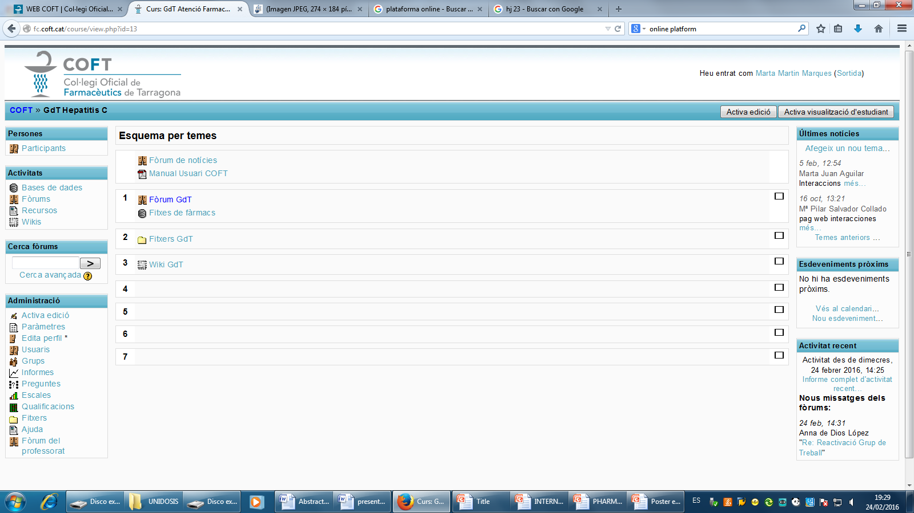

Slide 24
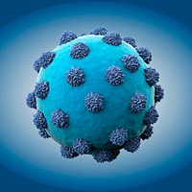

Why was it done?
The constant development of therapies against Hepatitis C
The lack of experience in their management require health professionals to work together

Slide 25
How was it done?
Meetings of the provincial pharmaceutical association:
  To define the necessities
  To determine the best communication system
Efficiency
Reliability
Speed

Slide 26

What has been achieved?
  Interactive platform (virtual campus)
Sending inquiries and comments about side effects and interactions
Creation of debate forums:
To answer questions
To promote knowledge sharing among participants

Slide 27
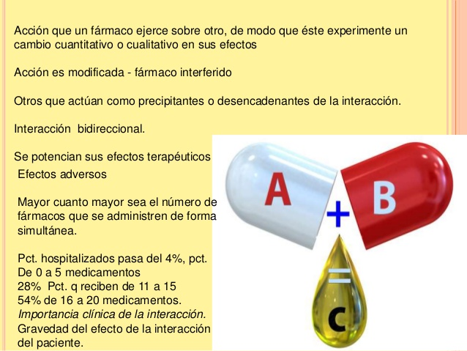
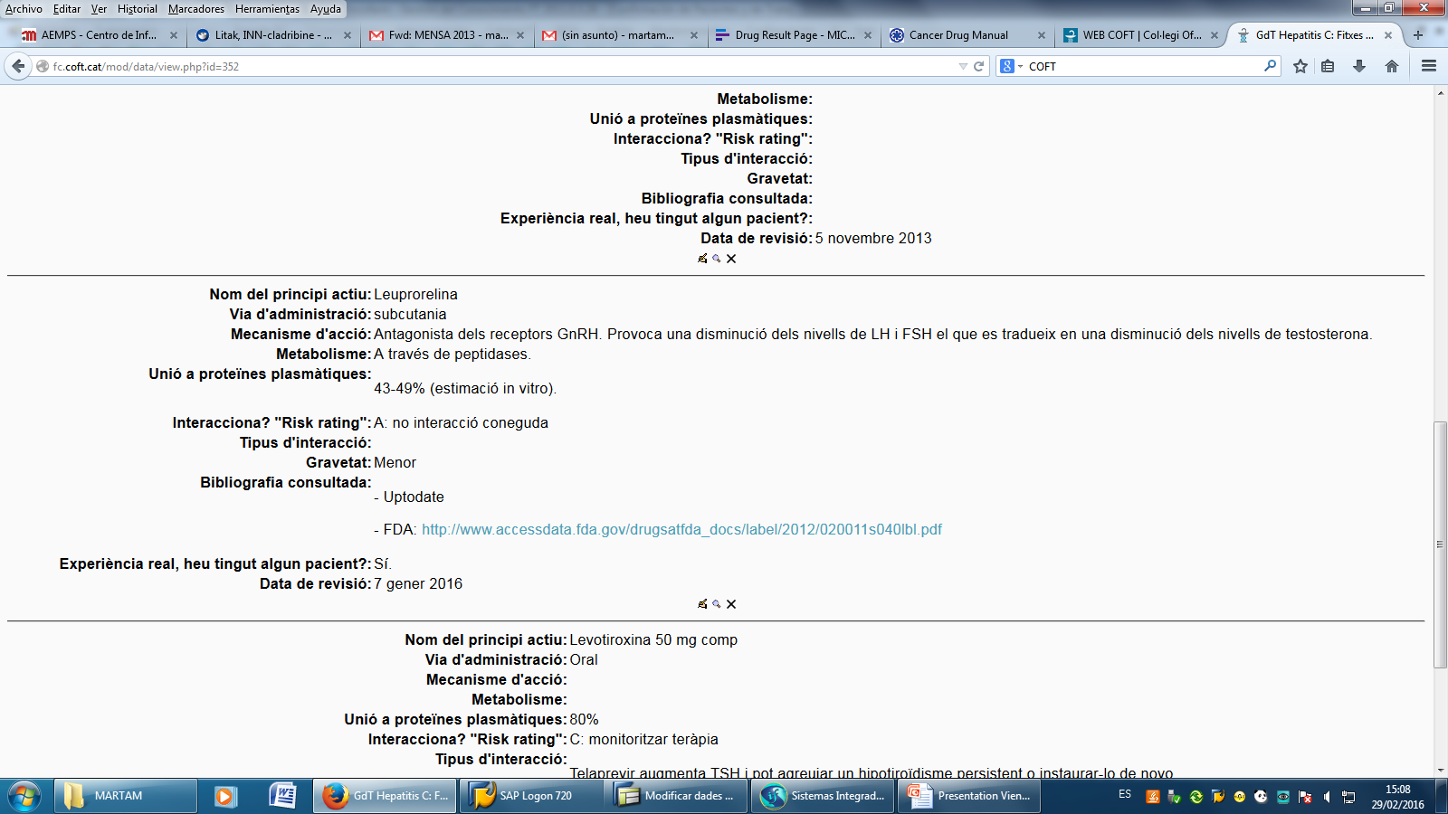

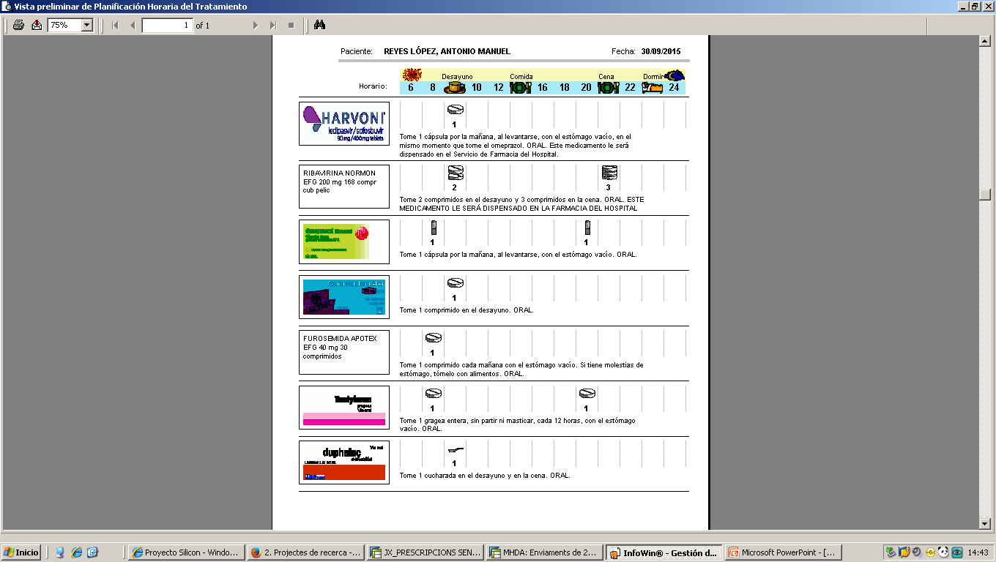
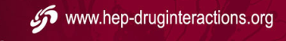
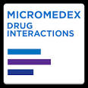

What has been achieved?
Drug interactions database
Written information
(package leaflet for patient, bibliography and links to webpages of scientific societies)

Slide 28

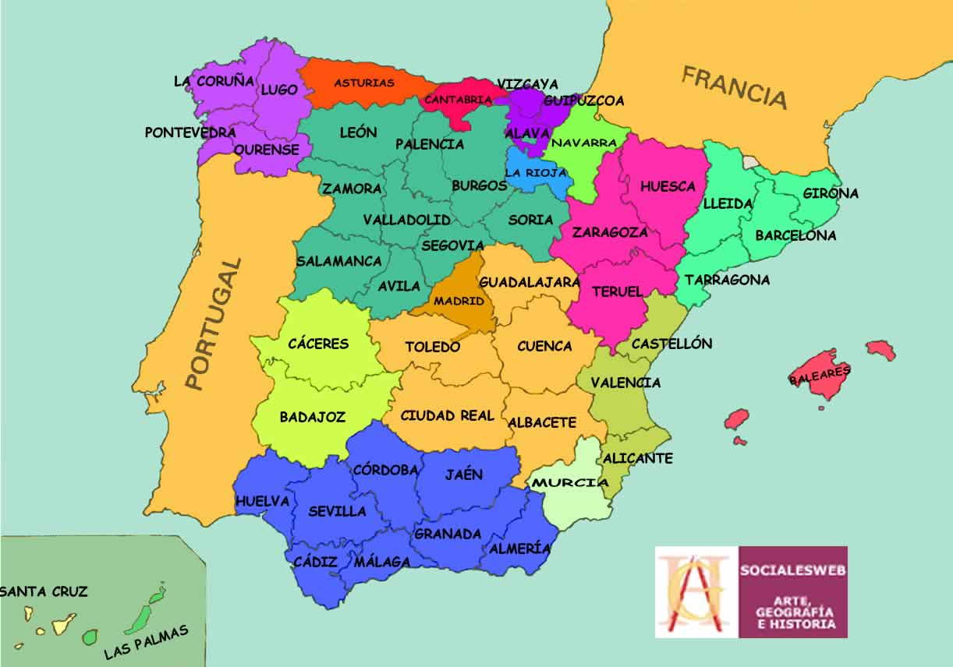
What next?
✓ The equal treatment of all patients
✓ To work together for the same cause and overcome individual knowledge and resources constraints
✓ It will be used for other illnesses for which a special pharmaceutical care is required.
✓ It will be expanded by inviting other provinces.

Slide 29
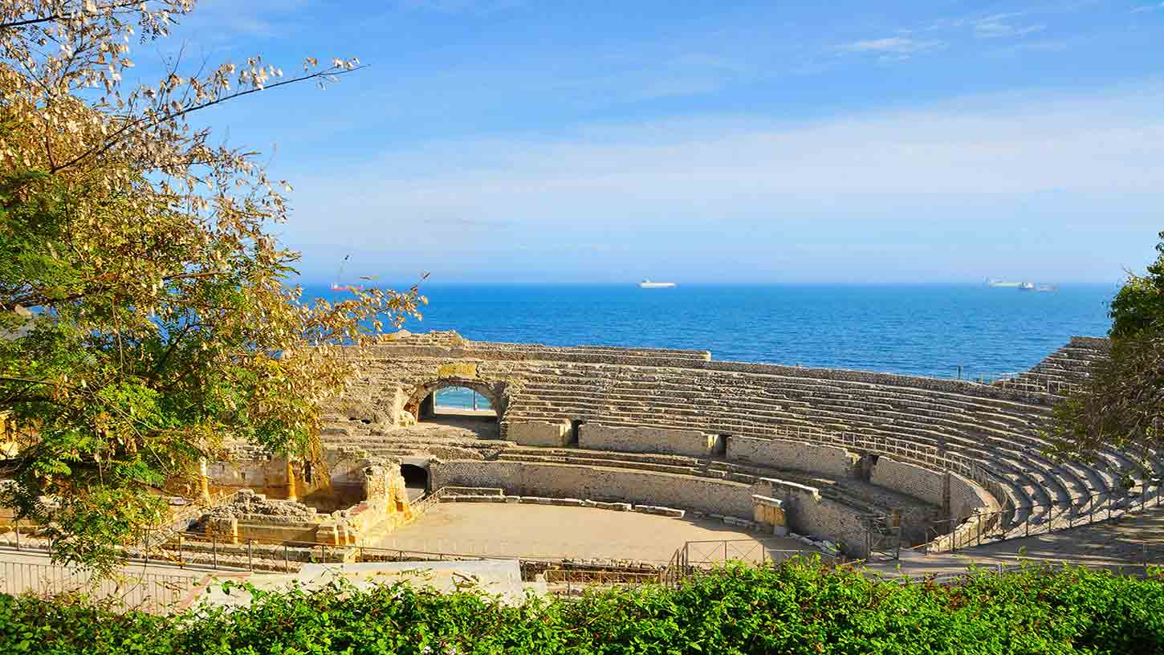
Thank you very much for your attention
e-mail: martamartin.hj23.ics@gencat.cat

Slide 30


IMMPaCT
A THERAPEUTIC EDUCATION PROGRAM TO SUPPORT SEAMLESS CARE FOR PATIENTS LIVING WITH CANCER
Audrey DECOTTIGNIES

Slide 31




What was done | Objectives and means | Outcomes | Next steps
What was done?
IMMPACT (Impact of Illness and Medication in patients undergoing chemotherapy)
Initiated at Paul Brousse hospital’s
Joined by Antoine Beclere’s teams
PARTNERSHIP
OSMOSE/Hospital
CERTIFIED
ETP 13/30
10/2012
08/2013
05/2014
12/2014
03/2016
Preparation for Application for ARS certification
Design educative sessions
Early collective sessions
From 07 To 10/2016
Survey and program conception based on Patients needs
Educational Tools design
Goal : Program designed to better support patients living with cancer in their everyday life.
Notes:
An integrated care model based on a therapeutic education program (TEP) was designed to better support patients living with cancer in their everyday life. The hospital pharmacy led the project launched in October 2013 and implemented for patients in March 2015. It is called IMMPACT (Impact of Illness and Medication in patients undergoing chemotherapy). This TEP was accredited by the National Autority (ref N° ETP 13/30 in August 2013).

Slide 32










What was done | Objectives and means | Outcomes| Next steps
Objectives and means
OBJECTIVE
HOW ?
WHY ?
A transverse working group to design the educational sessions.
Adapt support to allow the patient to understand and control the disease and the treatment consequences
Pharmacist
psychologist
A prospective survey conducted
Doctors
The patient
Dietetician
Cancer impacts still poorly addressed all along patient’s clinical pathway
Sport trainer
nurse
A partnership with a health network
Propose a smooth and safe transition from hospital to home and facilitate seamless care
Notes:
Cancer has become a chronic disease. However, the impact of the disease and the related treatments on patients everyday life remain poorly addressed all along patient’s clinical pathway. The objective was to customize support to patient be able to better understand and control the disease and treatment consequences.
A transprofessional working group was formed. Our concern was to propose a smooth and safe transition from hospital to home. To do so, the hospital set a partnership with the health network to facilitate seamless care. A prospective survey was conducted in October 2013 including 41 ambulatory patients. Three prioritary themes were identified: tiredness, hematological problems and digestive disorders management. According to the results, educational sessions have been collaboratively designed and implemented.

Slide 33
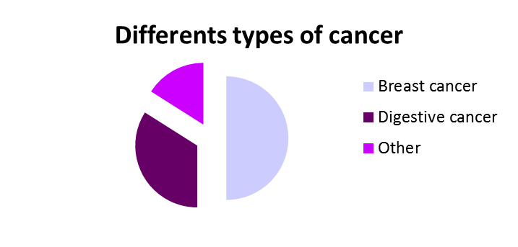
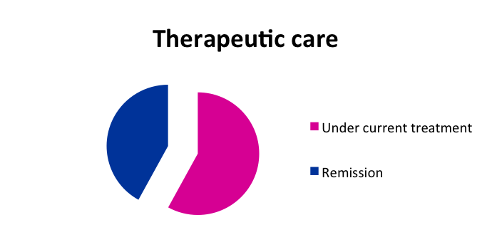
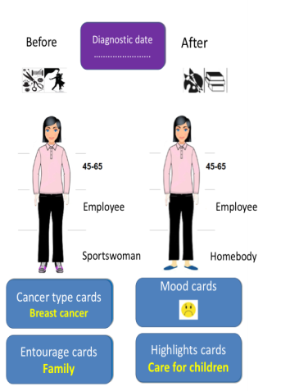
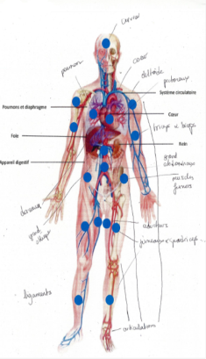
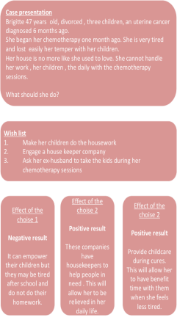
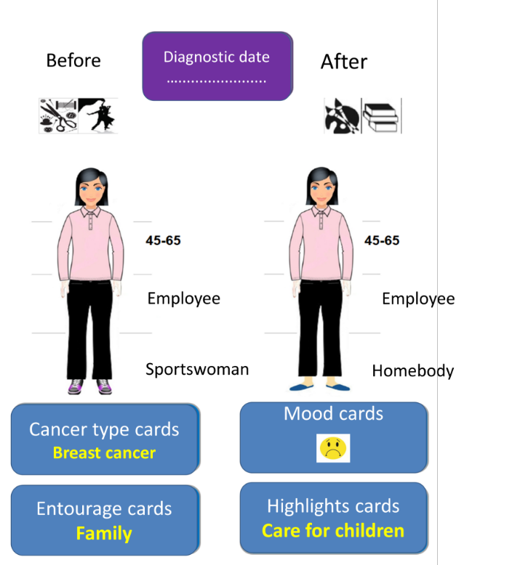
What was done | Objectives and means | Outcomes | Next steps
Outcomes
From January 2014 till now
  31 patients collective workshops
  83 patients have already experienced this program
Educative tools
Most important of all, services are now ETP-aware
Notes:
The patients group workshops began in January 2014. Until now, 31 group workshops were run.These group workshops are facilitated by trained healthcare professionnals using educational tools like Barrows Cards, mosaic characters or metaplan®. Eighty three patients have already experienced this program. Patients global satisfaction is beyond 92 per cent.

Slide 34

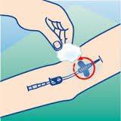
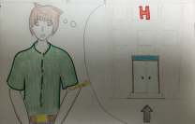
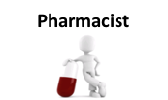



What was done | Objectives and means| Outcomes| Next steps
Next steps
Success of this program
  92% (satisfaction)
To meet growing patients expectations :
  New sequences are being designed
  Developing a serious game
Reinforce partnership with community practitionners
Healthcare network
Notes:
Given the success of this program and to fulfil the growing patients expectations, new sequences are being designed about pain, chemotherapy -related neurotoxicity, socio - aesthetics and lymphedema management as well as developing a serious game for patient.Finally, IMMPAct extension to Community Pharmacist is being considered to further sustain patient’s empowerment and continuity of care.

Slide 35

To go further
What was done | Objectives and means | Outcomes| Next steps
Thanks
Audrey Decottignies
  Pharmacist Antoine Beclere Hospital
  audrey.decottignies@aphp.fr

Slide 36

7-day pharmacy services
Sotiris Antoniou, FFRPS, MRPharmS
Consultant Pharmacist for CV Medicines
Poster number VIE15-0553

Slide 37
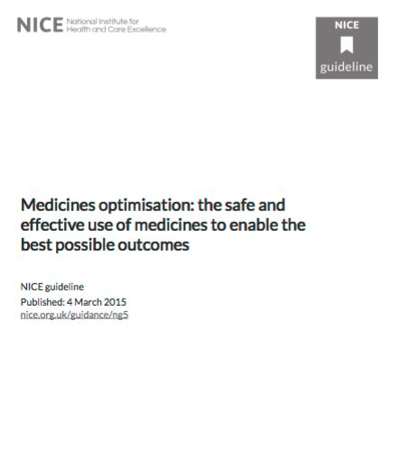

Slide 39

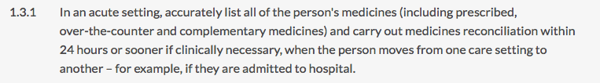

Slide 40
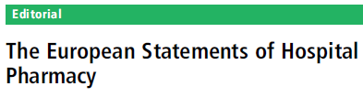
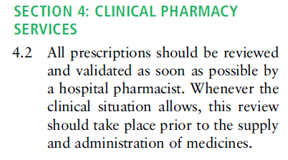
Ref:
Eur J Hosp Pharm 2014;21:256–258.

Slide 41
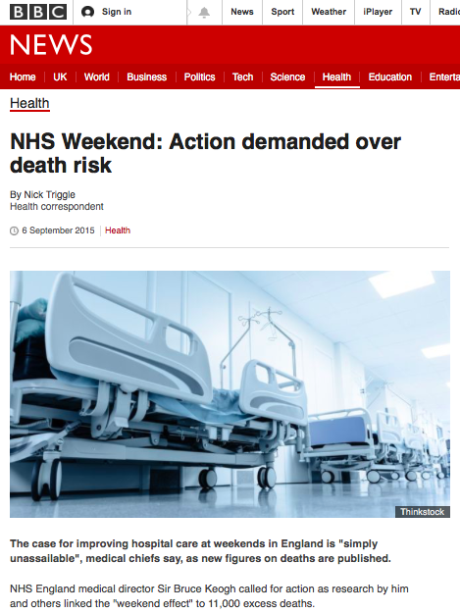
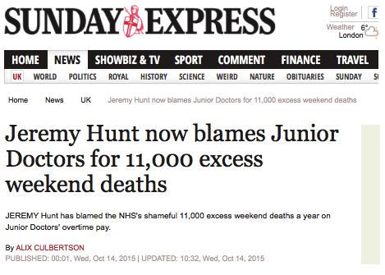
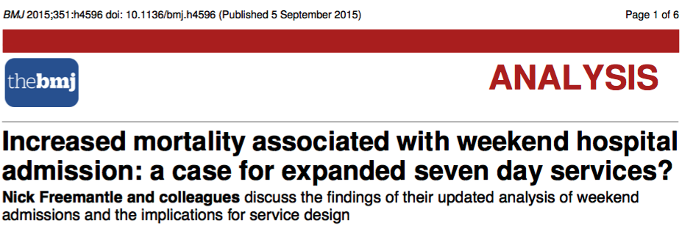
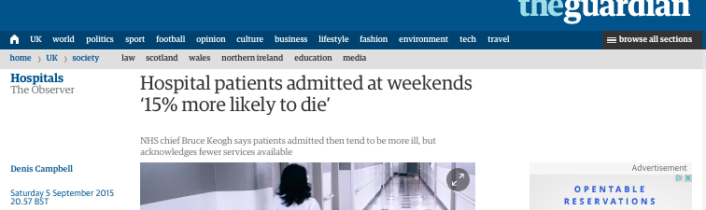
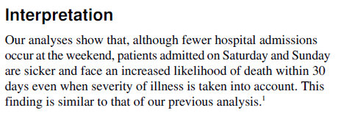

Slide 42

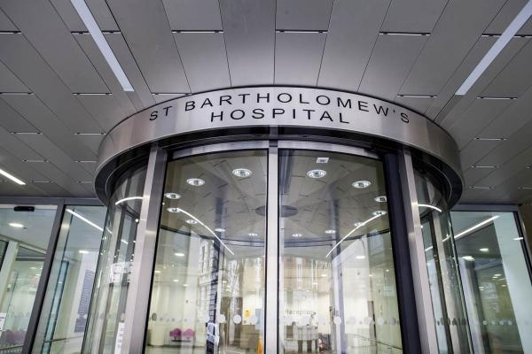
Barts Heart Centre
Largest Cardiovascular centre in UK
10 cath labs, 10 theatres, 250 general beds and 54 critical care beds
Serves a population of 3 million
6500 acute admissions/year

Slide 43
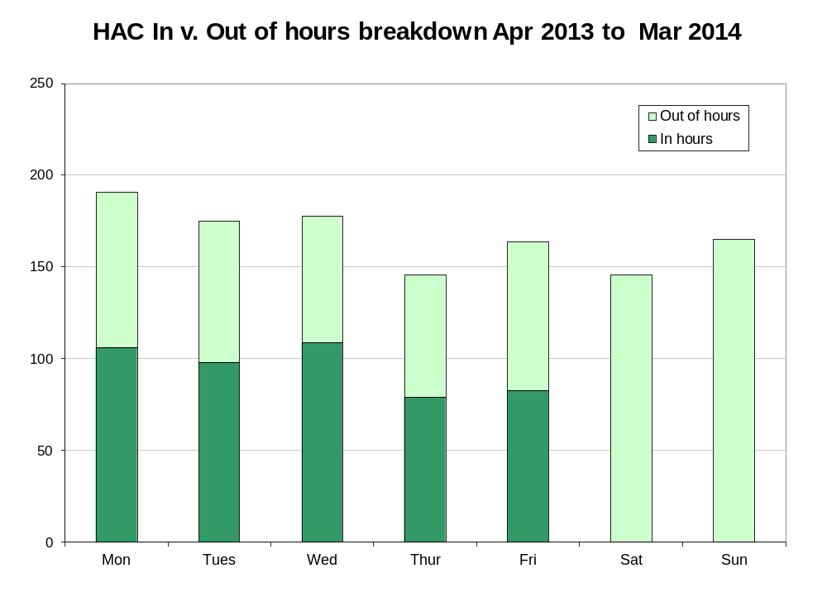

Slide 44
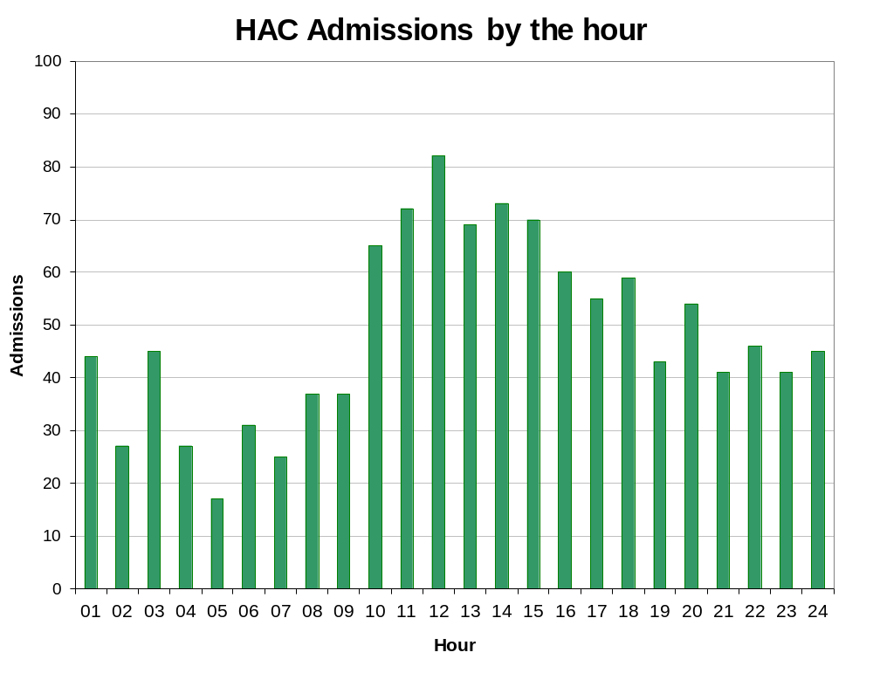

Slide 45
BHC 7-day implementation
7 day service started May 2015
Service delivered by Shift system
Prioritisation
  Acute admissions
  Discharges
  All level 2/3 beds – Coronary care unit/ intensive care

Slide 46
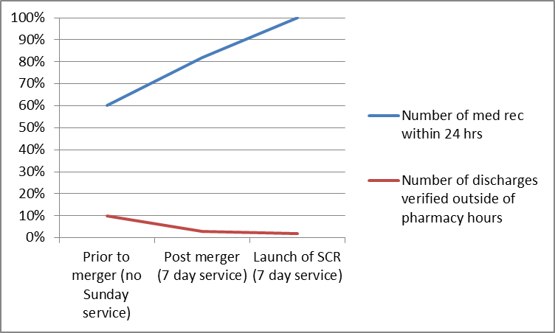
Findings

Slide 47
Summary
7 day NHS services is high on the political agenda
Key enablers
  Electronic prescribing, SCR, Consultant presence
Metrics
  Medicines Reconciliation 90% (95%?) within 24 hours
  No unintentional omitted critical medicines
Challenges
  Workforce / funding

Slide 48
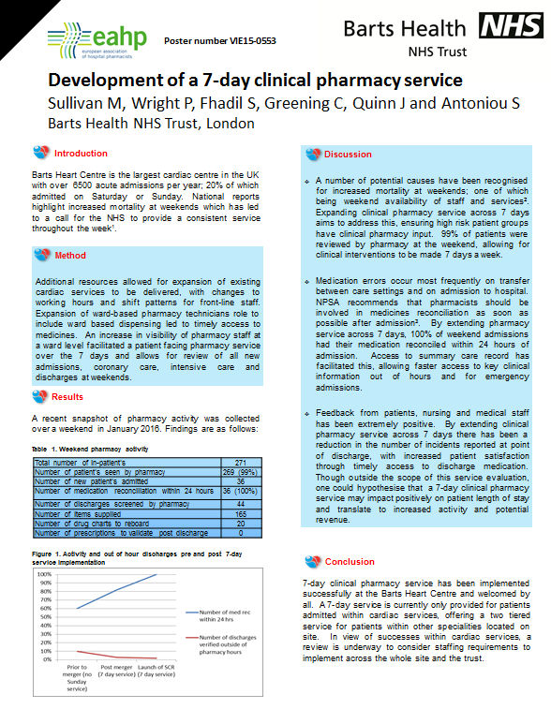

Slide 49
Renal Pharmacist optimises health outcomes for patients
Annett Frisch
Dorle Scharlemann-Mönks
Dr. Katrin Heinitz
Dr. Roberto Frontini
University Hospital
Leipzig, Germany
EAHP Symposium of Clinical Pharmacy 2016

Slide 50
Conflict of interest
No commercial interests to declare

Slide 51

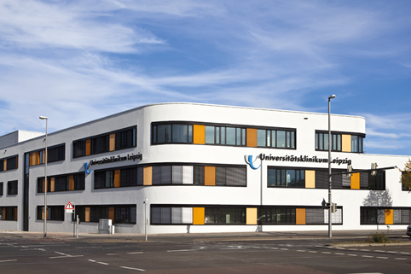
BackgroundPurpose
Material and Methods
Results
Conclusion
Leipzig/Germany: 4 full time equivalent clinical pharmacists
for 1450 beds

Slide 52

BackgroundPurpose
Material and Methods
Results
Conclusion
EUROPEAN STATEMENT 1.3: Health systems have limited resources and
these should be used responsibly to optimise outcomes for patients.
Prioritisation of hospital pharmacy activities
new: Service across the
majority of wards
Aim: Improvement of the effectiveness

Slide 53

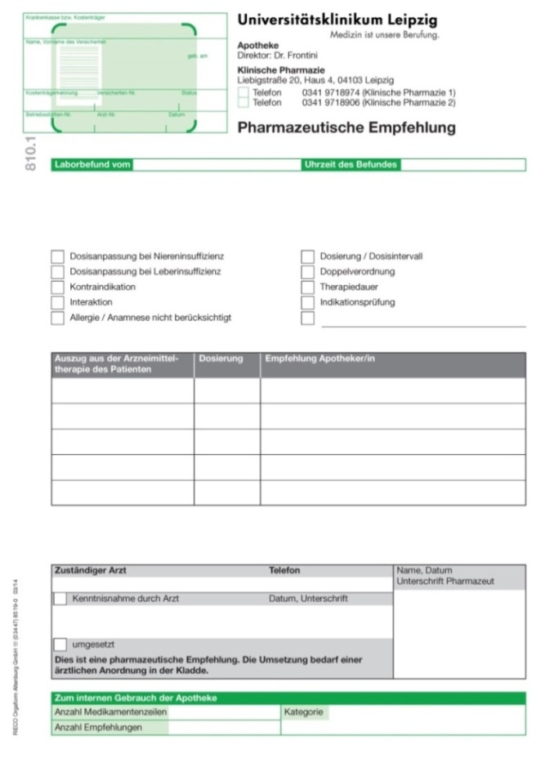


Background Purpose
Material and Methods
Results
Conclusion
Transplant surgery
Gynaecology
Orthopaedics
Dermatology
Radiology
Ear, Nose & Throat
Neurology
Angiology
Urology
...
Glomerular Filtration
Rate <30 ml/min
prescription review
twice weekly
selected wards
daily Email
Laboratory
Renal pharmacist

Slide 54
Background Purpose
Material and Methods
Results
Conclusion
Parameter | Visceral surgical ward¹⁾ (6 months) | Renal Pharmacist (6 months)
Medications | 29,131 | 15,827
Interventions | 697 | 973
Intervention rate (according to medication item) | 2.4 % | 6.1 %
Different drugs on average | 7.3 | 11.2
Critical renal insufficient patients are patients with
polypharmacy and a high risk for medication errors
1) Schneider R,Ranft D,Heinitz K,Uhlmann D,Hauss J,Frontini R,Leinung S.: Pharmaceutical care in a visceral surgical ward. Zentralbl Chir. 2012;137:173-179

Slide 55
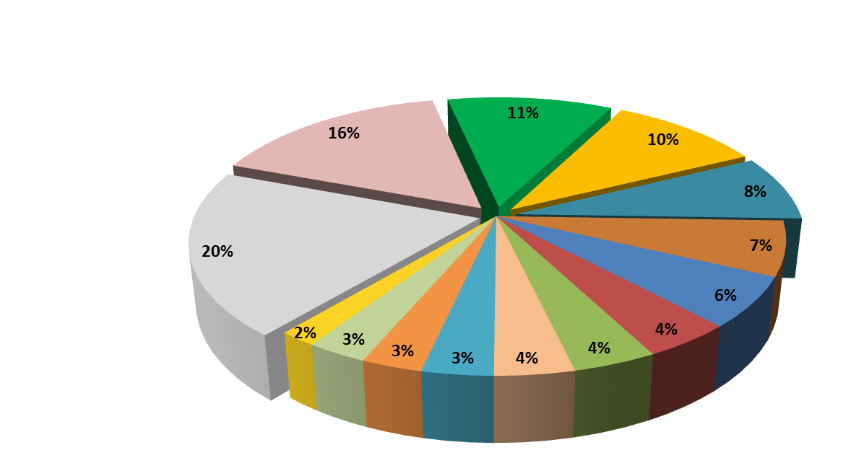
Background Purpose
Material and Methods
Results
Conclusion
Clear indication, but no drug prescribed
Contraindication
Evaluation of interaction
Inappropriate dose
Failure to adjust dose for organ dysfunction
4 % Prescription incomplete
4 % Double Prescription
4 % Drug choice
6 % TDM not performed
7 % Clear indication no longer given
2 % Duration of therapy
3 % Therapeutic/Generic substitution
3 % Inappropriate drug choice for this indication
3 % Transcription error
Fig 1: Reasons for renal pharmacist`s interventions; n= 447 (ADKA-DokuPIK)

Slide 56
Background Purpose
Material and Methods
Results
Conclusion
Nadroparin
Heparin
1/3 of interventions were caused
by antithrombotic drugs
Fondaparinux
Tinzaparin
Fig 2: Frequently used drugs,contraindicated or not dose-adjusted in renal failure

Slide 57
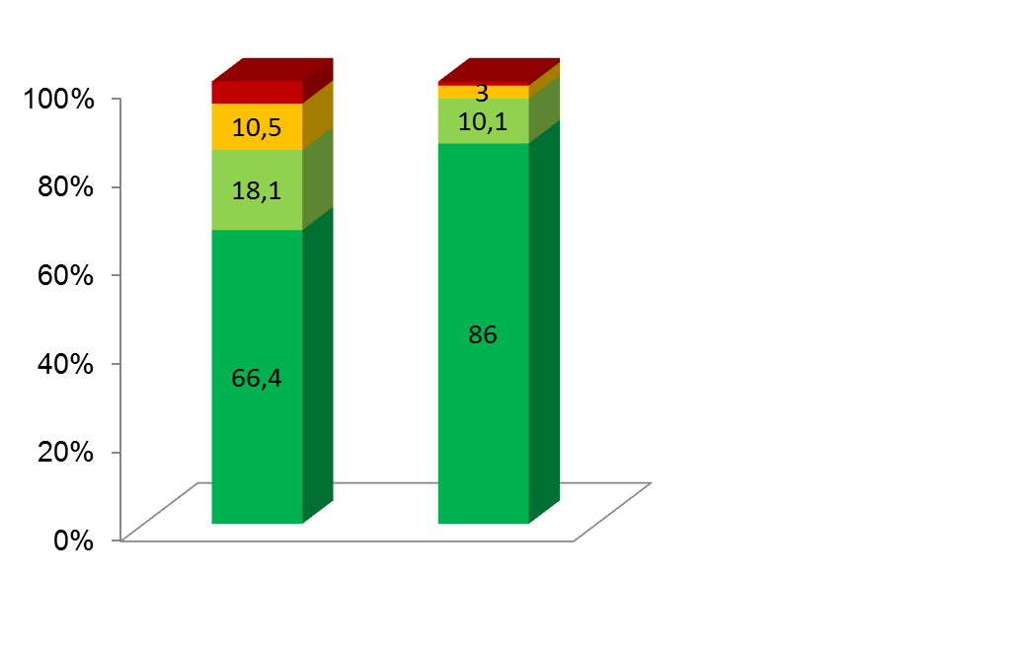
Background Purpose
Material and Methods
Results
Conclusion
0,9
Intervention proposed,
outcome not known
5
Intervention proposed, not
accepted (proposal rejected)
Intervention proposed, not
accepted (risk-benefit assessment)
Intervention proposed and
accepted
20144
20154
Fig 3: Acceptance rate for interventions 09-11/2014 vs 09-11/2015

Slide 58
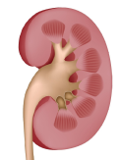

Background Purpose
Material and Methods
Results
Conclusion
Prioritisation to high risk patients is effective
Limitation/aim:
- Is selected target GFR appropriate?
- European Statement of Hospital Pharmacy 4.2
Perspective:
Identifying other high risk patients
[Centre for drug therapy safety]

Slide 59
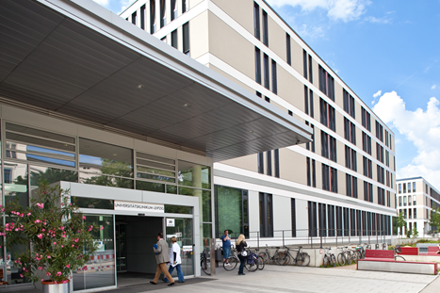
Thank you for your
attention !

Slide 60
GPI Session2016
The last 2 overall EAHP Statements 2014
5. Patient Safety and Quality Assurance
INFLUENCE OF INTEGRATION OF A PHARMACIST IN MEDICATION ERRORS IN CRITICALLY ILL PATIENTS (Esther Domingo-Chiva, Spain)
EASE OF ACCESS TO INTRAVENOUS DRUG COMPATIBILITY INFORMATION FOR CLINICAL PRACTITIONERS (Kaveh Teimori, Sweden)

Slide 61
GPI Session2016
The last 2 overall EAHP Statements 2014
6. Education and Research
INTRODUCTION OF A PATIENT-CENTRED CLINICAL PHARMACY TRAINING SCHEME IN A LARGE UNIVERSITY HOSPITAL PHARMACY (Eva Past, Austria)
SYSTEMATIC APPROACH FOR TRAINING HOSPITAL PHARMACISTS TO PRACTICE CLINICAL MEDICATION MANAGEMENT (Stefanie Walk-Fritz, Germany)

Slide 62



INFLUENCE OF INTEGRATION OF A PHARMACIST IN MEDICATION ERRORS IN CRITICALLY ILL PATIENTS
Domingo-Chiva E¹, Cuesta-Montero P², Monsalve-Naharro JA², García-Martínez EM¹, Plata-Paniagua S¹, Pardo-Ibañez MD², Romero-Candel G¹, Jiménez-Vizuete JM², Peyró-García R², Valladolid-Walsh A¹.
¹Pharmacy Department
²Anaesthesiology and Critical Care Department.
.
Gerencia de Atención Integrada de Albacete. Albacete (Spain).

Slide 63

MEDICATION ERRORS in critical care are
frequent, serious and predictable
Critically ill patients are prescribed twice as many medications as patients outside the intensive care unit and nearly all will suffer a potential error at some point during their stay.

Slide 64
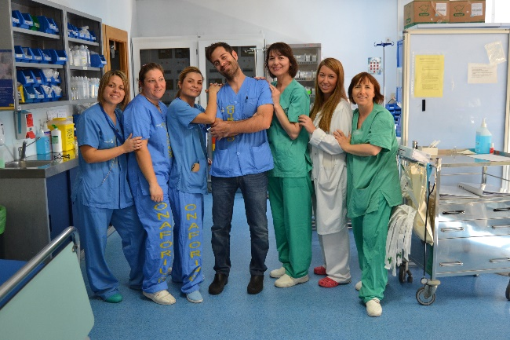
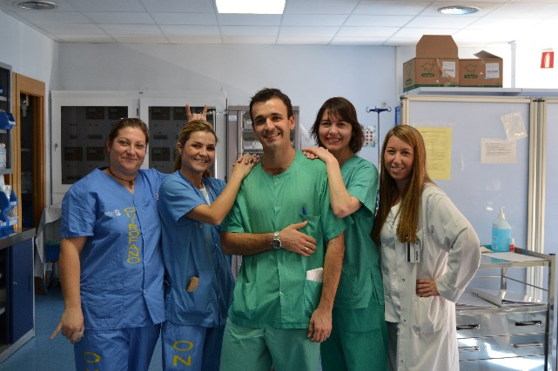
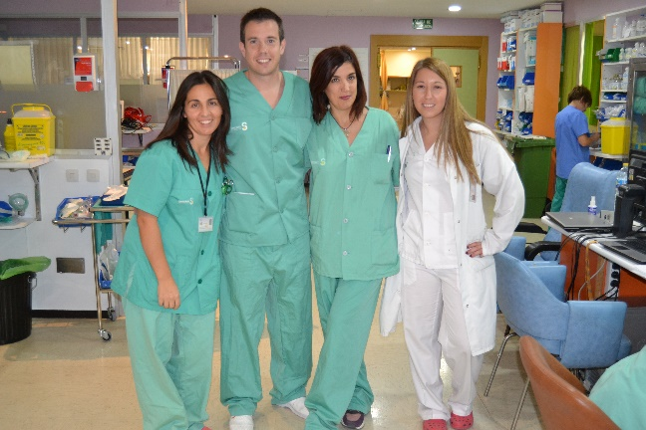
What was done?
A clinical pharmacist was integrated on a full-time basis in the multidisciplinary team of an intensive care anesthesia unit.

Slide 65

Why it was done?
To determine the incidence of medication errors in our environment and implement enhancement systems trying to prevent them, which is a priority for the improvement of the drug treatment process in critically ill patients.

Slide 66

How it was done?
The project was carried out in 3 different stages:
First stage: a prospective observational study was carried out during one month, in order to detect medication errors in Anesthesia ICU and to determine the baseline situation before the pharmacist´s intervention.

Slide 67
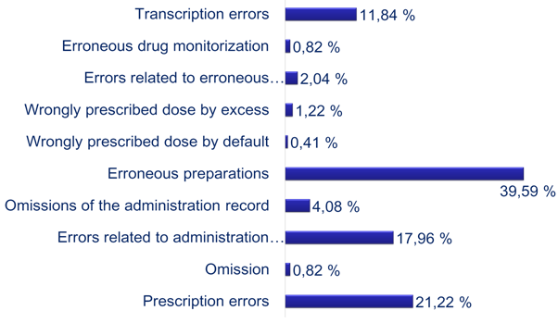
A total of 634 observations made over weekdays and weekends were performed including morning, noon and night shifts.
36,27% observations included some type of error, a total of 245 medication errors were detected.
According to the type of error found:

Slide 68
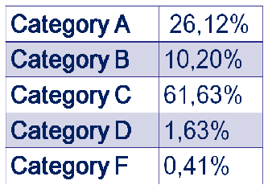
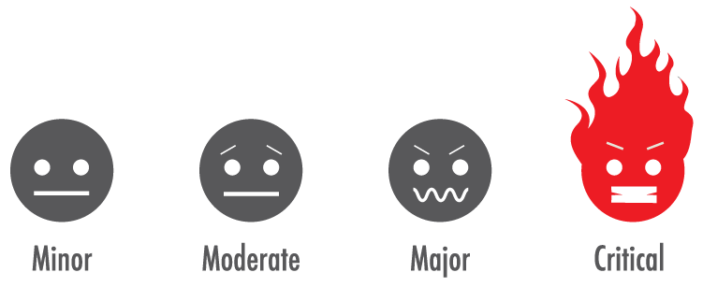
According to severity within categories established by the National Coordinating Council for Medication Error Reporting and Prevention (NCCMERP):

Slide 69
How it was done?
Second stage: (Intervention stage) During 10 months, the pharmacist reviewed the prescriptions of all patients admitted in the Anesthesia ICU unit performing the appropriate interventions over medication.
Furthermore, to educate physicians and nursing staff, we organized educational meetings, and also pharmacotherapeutic protocols and guidelines of medication administration were created to standarize clinical practice.
Finally, a system for reporting medication errors was introduced.

Slide 70
How it was done?
Third stage: a prospective observational study was carried out for a month in order to detect medication errors after pharmacist’s intervention.
In this stage, 5.9% of errors were detected, 68.4% of them of Category C NCCMERP.

Slide 71
What was achieved?
Medication errors were reduced by more than 30%.
A pharmacist is now part of the multidisciplinary team in a critical care unit.
The experience has been broadcasted at the national level to promote the implementation of clinical pharmacists activities in our environment.

Slide 72
What is next?
We are still working on the same areas to improve safety in drug therapy in critically ill patients.
Currently, improvement measures that are being developed are:
New pharmacotherapeutic protocols specifically for this unit.
Drugs and drug-diluent compatibility guidelines.

Slide 73


What is next?
Performing new training sessions.
Standarize medication kits in operating rooms.
Implementation of the computerized prescription.
New labeling system of syringes.

Slide 74

edomingo@sescam.jccm.es

Slide 75


Slide 76

THE POSTER

Slide 77

WHAT WAS DONE?
Created IV-compatibility database
& web application
Developed education & information
plan for healthcare personnel
Identified international pharmacists
interested in collaborating

Slide 78


WHY WAS IT DONE?
Coadministration of incompatible IV drugs put the patient at risk
of nurses uncertain
of drug compatibility
(local survey from 2012)
Point-of-care drug compatibility information
fitted to local traditions needed
International compatibility information
need evaluation of applicibility

Slide 79

HOW WAS IT DONE?
Drug compatibility & physicochemical data assessed for applicability to local clinics
Support & guidance offered to clinical practitioners

Slide 80

WHAT HAS BEEN ACHIEVED?
IV compatibility data for more than
2500
drug combinations produced and
stored in the database
Readily accessible information for
nurses, doctors & pharmacists
Support when deciding which drugs
to coadminister
Procedure documents based on this
database implemented in relevant clinics
Lectures given to nurses and doctors on
a continious basis

Slide 81

WHAT NEXT?
National implementation
Electronic journal system integration
Doctors consider compatibility at
prescribing stage…

Slide 82

…further improving patient safety!

Slide 83

THANK YOU!
THOUGHTS AND QUESTIONS?

Slide 84

Introduction of a clinical pharmacy training scheme In a Large University Hospital Pharmacy
83
Eva Past, Christina Hofer-Dückelmann, Ulla Porsche, Günter Fellhofer
Landesapotheke Salzburg, Austria
Poster: VIE15-0204

Slide 85
Situation in 2014
Hospital:
  “We want more pharmacists on the wards.”
Pharmacists:
  “We want to work more clinically orientated.”
Head of pharmacy:
  “OK, go for it. We do have some resources. There needs to be a quality assurance for new services.”
Notes:
„Tell me, and I will forget. Show me, and I may remember. Involve me, and I will understand.“ Confuzius 450 BC

Slide 86



This is Austria
Image: www.tiscover.com
Image: www.heigenhauser.at
Image: www.cusoon.at
Notes:
This is Austria, we like to stick to traditions: traditional role of the pharmacist is still dispensing and compounding. New roles: counselling patients beyond basic information, medication reviews, more clinically orientated tasks

Slide 87
This is Austria
Obstacles:
  Official
  Clinical pharmacy still at an experimental stage; no full, formal clinical pharmacy education in Austria
  Additional workload
  Rooms, equipment, …
  Personal
  No extra pay
  Less free time, family life
  Cost of studying abroad
Notes:
Vergleich Sprache/Musik lernen

Slide 88
What we
did…
4 pharmacists
with clinical experience & degree in clinical pharmacy
6 “apprentices”
with little to no clinical experience
10 workshops on clinical topics
Monthly discussions on real-world patient cases
Bed-side teaching on two wards

Slide 89
Workshop topics
Lab parameters
Renal & hepatic insufficiency
Cardiovascular disease
Atrial fibrillation
Polypharmacy in the elderly
Antibiotic stewardship
Medicines via enteral feeding tubes
Parenteral and enteral nutrition
Pain management
Various case studies

Slide 90

Why?
Notes:
You could ask yourself, why would anyone do this?
The same reason why people climb a mountain – because it´s fun, clinical pharmacy is fun
you have to get out of your comfort zone and it broadens you horizon.

Slide 91
New clinical services:
Regular medication reviews on an intensive care ward
Post-operative pain management on a neuro-surgery ward
Medicines reconciliation at the surgical admissions unit

Slide 92

Image: Landesapotheke Salzburg

Slide 93
Systematic Approach for Training Hospital Pharmacists to Practice Clinical Medication Management
Dr. Stefanie Walk-Fritz
Good Practice Initiative oral presentations
EAHP 21st Congress
16-18 March 2016, Vienna, Austria

Slide 94
What was done?
Training framework for clinical pharmacists
practicing medication management
Junior Hospital Pharmacists
Clinical Pharmacy skills
Communication skills
Personal skills
Senior Clinical Pharmacists
Maintain and improve their skills
S. Walk-Fritz EAHP 21st Congress
Notes:
A training framework for clinical pharmacists practicing medication management was developed and implemented.
The novel curriculum was designed in order to:

Slide 95

Why was it done?
Current clinical pharmacy education may provide exposure to ward-based clinical pharmacy
No structured prerequisite training for pharmacists practicing clinical medication management
S. Walk-Fritz EAHP 21st Congress
Notes:
For improving drug safety, it is crucial to develop and maintain core competencies in a multidisciplinary medical team.

Slide 96


How was it done? (I)
Training framework:
Initial skill adaption for junior hospital pharmacists
  Drug Information Centre
  Clinical observation („shadowing“)
  Patient case presentation
Maintain and improve skills of all clinical pharmacists performing patient-centered care
  Jour fixe
  Journal Club
  Supervision of participation in medical rounds
  by senior clinical pharmacist
  Feedback discussion
S. Walk-Fritz EAHP 21st Congress

Slide 97

How was it done? (II)
Checklist
  steps can be adapted individually
    depending on the future operational area and background
  eligibility for practicing medication management will be granted by head of the department “clinical pharmacy”
S. Walk-Fritz EAHP 21st Congress
Notes:
within the Hospital Pharmacy.

Slide 98
What has been achieved?
Successful implemenation with a high general acceptance
Parts of the training program have been implemented in the training of pharmacy interns
  e.g. performing face-to face Medication Reconciliation on hospital admission
S. Walk-Fritz EAHP 21st Congress
Notes:
A training framework for clinical pharmacists practicing medication management was developed and implemented.
The novel curriculum was designed in order to:

Slide 99
What next?
Training program will be further expanded and adapted
Establishment of a model with the German Association of Hospital Pharmacists (ADKA) for a national systematic training module
S. Walk-Fritz EAHP 21st Congress

Slide 100
GPI Session 2016
Thank you for attending
- and enjoy the rest of the congress

