Slide 1


  Access to Medicine and the regulatory framework of medicinal products in the EU
  S&D Workshop
  1 July 2015, Brussels
  Richard Price, Policy and Advocacy Officer at the European Association of Hospital Pharmacists (EAHP), representing…
  The European Public Health Alliance (EPHA)

Slide 2







Access: a critical topic for EPHA and its membership
  2013 Joint Declaration on Access to Medicines
Recommendations on:
Health impact assessment of fiscal consolidation measures
Transparency (online database of comparable prices + R&D)
EU level cooperation (e.g. joint procurement)
New innovation models (e.g. tiered pricing by GDP)
Impacts on migrant, minority and vulnerable communities
  2012 Policy Statement on Medicines Shortages
Need for:
Improved reporting and enforcement of requirements
International response, including Commission leadership
  2015 Policy Statement on Sustainable Access
Cost burden away from patients
Transparency and support for pricing innovation

Slide 3
PRESENTATION OUTLINE
What is access?
What is the EU regulatory framework relating to medicines?
Improving the regulatory framework: the availability case study
Improving the regulatory framework: the affordability problem

Slide 4

WHAT IS “ACCESS”?
Affordable
Available
Appropriate
Accessible
Adequate
Source: Patient Access Partnership, 2015

Slide 5
WHAT IS THE EU REGULATORY FRAMEWORK RELATING TO MEDICINES?
Clinical Trials regulation
Pharmacovigilance regulations
Paediatric medicines regulation
Transparency Directive
Directive 2001/83/EC ‘the community code relating to medicinal products’
Advanced Therapy Regulation
Falsified Medicines Directive
Orphan medicines regulation

Slide 6
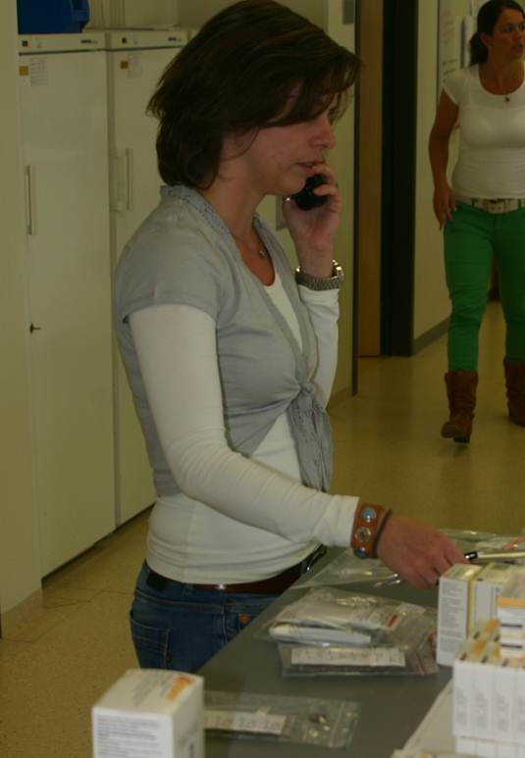
REFORMING EU REGULATION TO IMPROVE ACCESS (AVAILABILITY)
Medicines shortages: Common & increasing problem experienced across Europe in hospital and community pharmacy settings
86% of 600 surveyed hospital pharmacists in 2014 declared medicines shortages to be a current problem in the hospital they work in, in terms of delivering the best care to patients and/or operating the hospital pharmacy

Slide 7
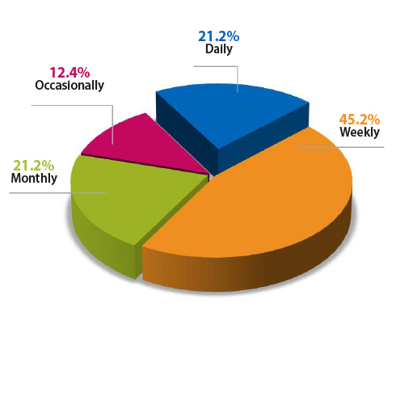
How often does your hospital pharmacy experience shortages?
66% of all respondents are affected on a daily or weekly basis.
An increase from 63% in 2013 saying it was daily or weekly problem
Highest daily occurrence in Malta and Denmark.
100% of Norwegian responses stated it was a weekly or daily problem.
Chart 3: Shortages Frequency.(n=526)
Notes:
Highest daily occurrence – Malta and Denmark
Occasional in Croatia and Bosnia/Herzegovina

Slide 8
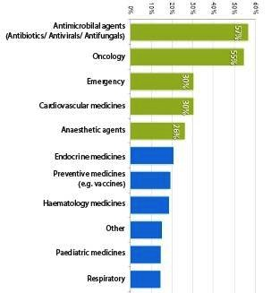
In which area of medicine does your hospital experience shortage most commonly?
57%
55%
30%
30%
26%
Notes:
Antimicrobials and Oncology products were cited in short supply by over 50% of the respondents to this question.

Slide 9
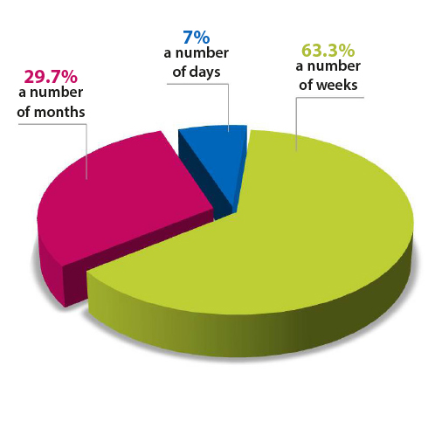
In your experience, how long would you estimate the average or typical medicines shortage normally lasts for?
High % of respondents in Ireland, Italy, Slovakia and Spain report that a typical medicine shortage takes a number of months to resolve
Chart 14: Typical duration of a typical medicine shortage according to European Hospital Pharmacists (n=387)

Slide 10
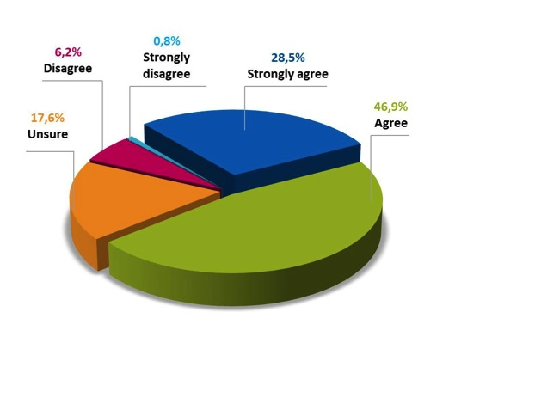
Do you agree with the statement “medicines shortages in my hospital are having a negative impact on patient care”
75.4% of all respondents either agree or strongly agree.
Treatment delay and interuption, medical error, healthcare acquired infection risk.
Chart 20: level of agreement with the statement:: ‘’Medicines shortages in my hospital are having a negative impact on patient care’’. N=369

Slide 11
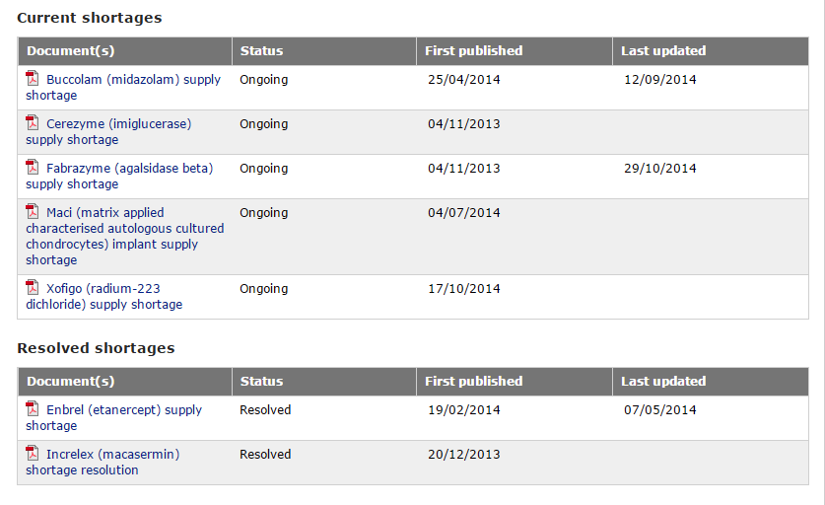
Compare this to the current EMA database…

Slide 12
Why is an EU response to shortages required?
Pan-European problem with pan-European (and international) causes
Cited factors include:
  Global consolidation of manufacturing
  Unintended impacts of pricing policies
  Parallel trade factors
  Small market difficulties
  Demand spikes, disasters
One country alone unlikely to fully resolve the problems

Slide 13
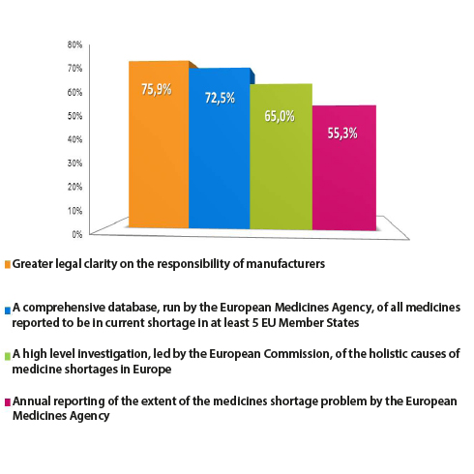
Policy Solutions
Chart 24 – Level of support for the proposed solutions/improvement in dealing with shortages. N=327

Slide 14
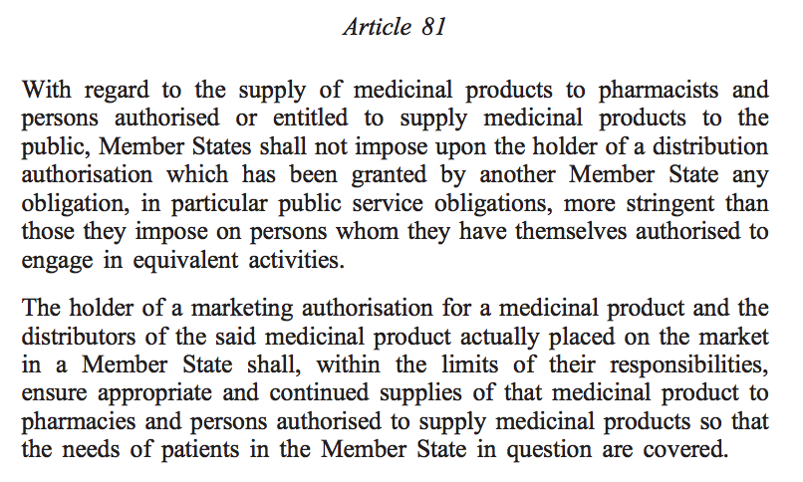
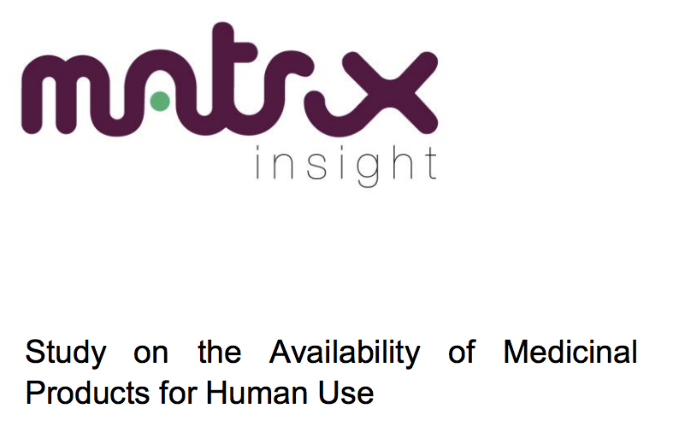
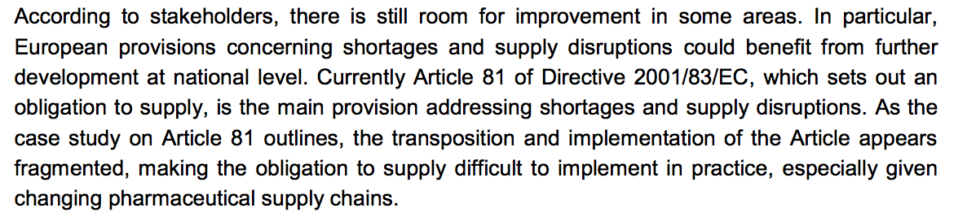
REFORMING EU REGULATION TO IMPROVE ACCESS (AVAILABILITY)
IMPROVE IMPLEMENTATION OF ARTICLE 81 OF DIRECTIVE 2001/ 83/EC

Slide 15
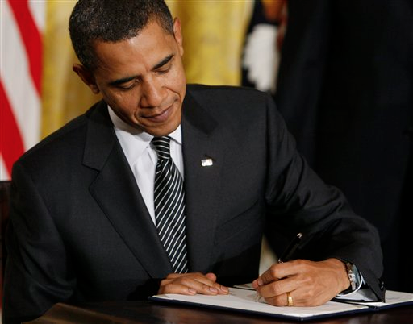
REFORMING EU REGULATION TO IMPROVE ACCESS (AVAILABILITY)
EXPAND THE STATUTORY REMIT OF THE EMA TO ADDRESS THE ‘RESPONSIBILITY GAP’ ON SHORTAGES
Experience from the USA (FDASIA 2012) demonstrates that earlier reporting of likely supply disruption enables contingency plans to be made and many difficulties to be alleviated.
Europe can surely extract lessons from the benefits of clarifying statutory responsibilities in relation to medicines shortage issues

Slide 16
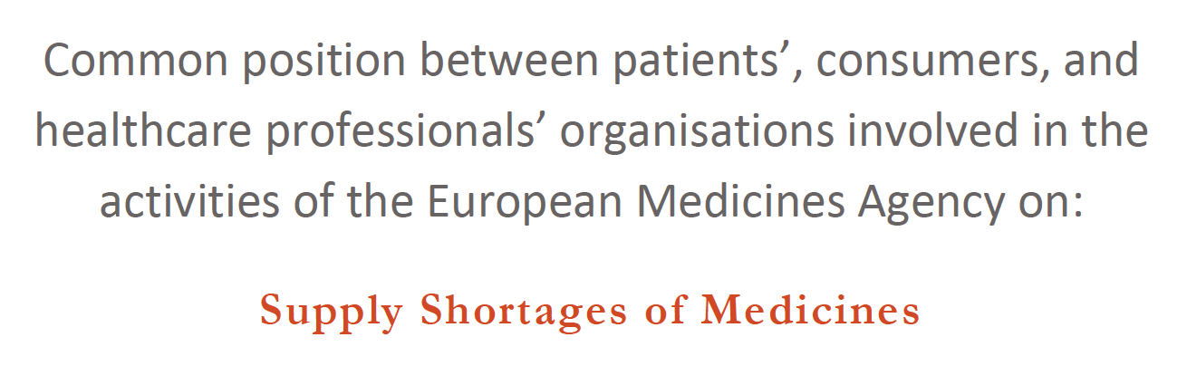
REFORMING EU REGULATION TO IMPROVE ACCESS (AVAILABILITY)
THE WORK CONTINUES….
45 European patient & healthcare professional organisations calling for:
  Improved implementation of shortage notification requirements
  Strengthening the provisions of article 81 of Directive 2001/83/EC
  More transparency and data publication
  Greater European and international coordination via EMA and EU
  Full review of the pricing system

Slide 17
REFORMING EU REGULATION TO IMPROVE ACCESS (AFFORDABILITY)
NO OBVIOUS OR IMMEDIATE REGULATORY TOOLS
NON REGULATORY OPPORTUNITIES PRESENTED BY:
  JOINT PROCUREMENT OF MEDICINES
  HEALTH TECHNOLOGY ASSESSMENT
  GENERIC UPTAKE
  MEASURES TO IMPROVE ADHERENCE AND RATIONAL USE
INNOVATION POTENTIAL PROVIDED BY:
  DIFFERENTIAL PRICING BASED ON GDP
  RISK SHARING PRICING MODELS
  NEEDS-DRIVEN INNOVATION
  ACCESS INDICATORS

Slide 18
NON REGULATORY TOOLS TO IMPROVE ACCESS (AFFORDABILITY)
SCOPE FOR EU RECOMMENDATIONS ON:
  Tendering
  Out of pocket and user payment
  Universal access to healthcare
  Fair distribution
BIGGER QUESTIONS ON:
  Enhanced EMA role in HTA (e.g. alongside authorisation)
  Future Treaty change?

Slide 19
ACCESS AND THE EU LEGAL FRAMEWORK: CLOSING SUMMARY…
“ACCESS TO MEDICINES” IS A MULTI-FACETED ISSUE WHICH PROVIDES CHALLENGES IN NUMEROUS AREAS, NOT ONLY IN RESPECT TO AFFORDABILITY, BUT ALSO AVAILABILITY
IN THE AREA OF AVAILABILITY SOME CLEAR OPPORTUNITIES FOR IMPROVEMENT TO THE EUROPEAN REGULATORY FRAMEWORK EXIST INCLUDING:
  STRENGTHENING AND CLARIFYING THE PROVISIONS OF ARTICLE 81 OF DIRECTIVE 2001/83
  PROVIDING THE EUROPEAN MEDICINES AGENCY WITH NEW REMIT
DEBATE ON TACKLING AFFORDABILITY AT AN EU LEVEL APPEARS MOST FOCUSED CURRENTLY ON NON REGULATORY TOOLS BUT SCOPE FOR EU RECOMMENDATIONS AND MAJOR INNOVATION CLEARLY EXISTS AND SHOULD BE PROMOTED

