Slide 1

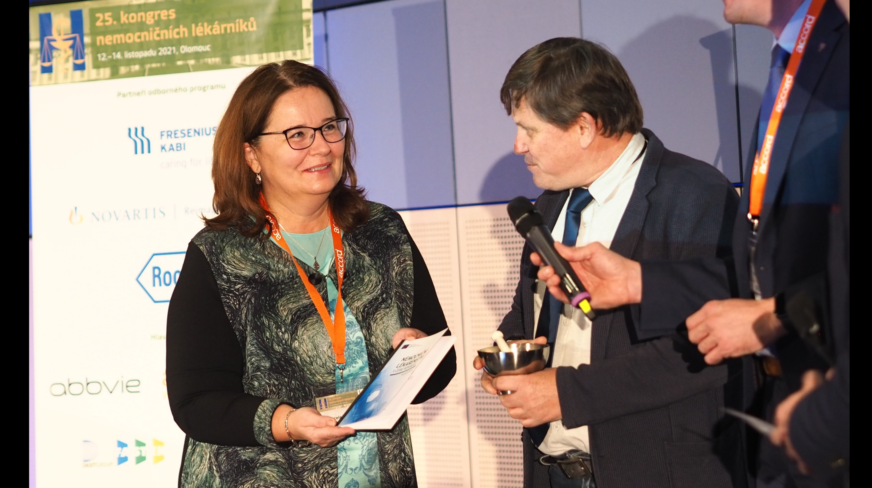
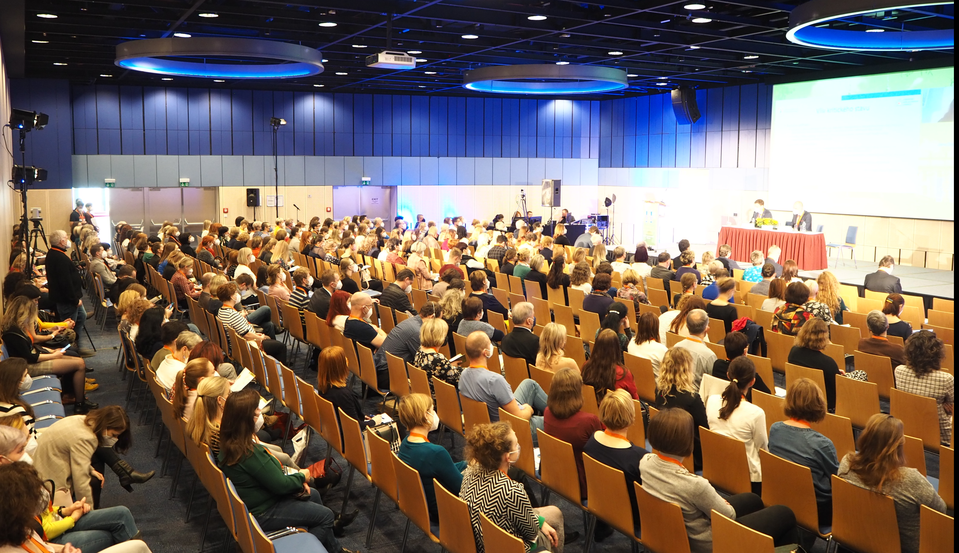
Life of the hospital pharmacist in the Czech Republic in 2021
A new textbook on hospital pharmacy was authored and edited by our association members. The publication aims mainly on the young pharmacists in specialisation training.
The main chapters of the publication:
drug delivery system
supply
automation in the hospital pharmacy
information about the drugs
clinical evaluation
cytostatic
research activitiess, etc.
The board of the Czech association has been working on a new strategy document for hospital pharmacy in our country. In the past two years, several rounds of public discussion with our members and other colleagues have been under taken.
Similarly to many other countries, hospital pharmacists' activities have gained a lot of attraction and have been crucial in managing all the difficulties stemming from the pandemic. For the first time ever, our association was in the lead in organising the proper allocation of scarce resources, such as anti-sars-cov-2 monoclonal antibodies, antivirals or protamine.
“Intensive care” was the main subject of our 25th Annual Congress. The presentations focused on providing care to critically ill patients, including nutritional and metabolic aspects and ensuring optimal quality of life. Our Congresses always welcome hospital pharmacists and pharmacy assistants. Altogether, there were about 650 participants from both professions.

