Slide 1

Update GMP ANNEX 1
Manufacture of Sterile Medicinal Products

Slide 2
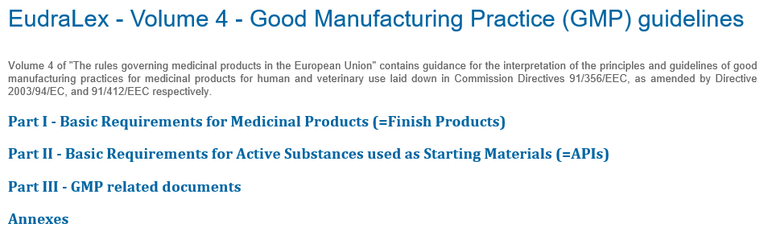
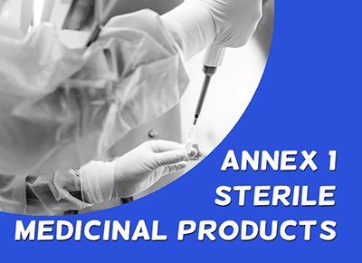
Eudralex Volume 4

Slide 3
ANNEX 1: Principle
Principle
The manufacture of sterile products is subject to special requirements in order to minimize risks of microbiological contamination, and of particulate and pyrogen contamination.
Much depends on the skill, training and attitudes of the personnel involved.
Quality Assurance is particularly important, and this type of manufacture must strictly follow carefully established and validated methods of preparation and procedure.

Slide 4
ANNEX 1: updated draft
Update
GMP Annex 1 was published in 1971 and had with several targeted updates over the past decades with a last update in 2003.
End 2017 EMA published for review the updated draft with a consultation period between 20 December 2017 and 20 March 2018.
The current version of Annex 1 contains 16 pages, the updated draft consists of 50 pages, hence comprising much more details.
After the consultations it became clear that +6.000 individual comments have been raised by the pharmaceutical industry towards the draft. With observations regarding the needed capital investment, changes to the approaches requiring additional studies, validation and training, hence calling for a substantial implementation period.

Slide 5
Consequences
Consequences
Changes to GMP guidelines must be balanced with the aim of improving the quality and safety of product to patients, while at the same time not having an adverse impact on manufacturers ability to meet market requirements for existing lifesaving products which are demonstrably safe.
The new obligations in Annex 1 will have no enhancement to the quality or safety of medicines and the new obligations will force changes primarily to API manufacturing that will reduce the availability of critical medicines already, included in WHO drug shortage list, to patients in the EU.
The updated Annex 1 calls for further in-dept discussion and interaction between pharmaceutical industry and EMA, prior to finalization and adoption of the new version.

