Slide 1
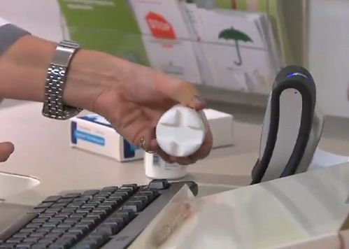
The European Stakeholder Model (ESM)
Fighting Counterfeit Medicines to Ensure Patient Safety in Europe
Speaker: Andreas M. WALTER
Event: EAHP Board, Brussels
Date: 25 April 2014

Slide 2
Overview
THE ESM IN PRACTICE
ESM Governance
Timeline
ESM & Pharmacists
Excursus: FMD & Unit Dose Coding

Slide 3
The Directive – Safety Features
What Does the Directive Mandate?
What Will Be Decided by Implementing Measures?
Safety features that enable relevant persons to
  “verify…authenticity”
  “identify individual packs”
  Tamper evidence
All Rx included, all OTCs excluded. some exceptions based on a risk assessment
Governments can use the system for reimbursement and/or pharmacovigilance purposes
MAHs will pay for the ‘repositories systems’
Characteristics & technical specifications of the ‘unique identifier’
Criteria for the risk assessments & process for notification of products included
“Extent and modalities of verification of the safety features” to “ensure the verification of authenticity of each dispensed pack”
Establishment (including accessibility) of the ‘repositories’

Slide 4
Result of COM’s impact assessment
Conclusions
In summary, the Commission will propose:
  Harmonisation of the composition of the number and the data carrier
  Systematic verification of the safety features at the dispensing point and risk-based verification by wholesale distributors
  Establishment and management by stakeholders with supervision by the relevant competent authorities
  Source EC presentation at 13th EGA regulatory and scientific affair conference, 24 Jan 2014

Slide 5
ESM is Stakeholders’ Answer to FMD
2011 EU Falsified Medicines Directive (FMD) defines measures to increase reliability of the medicinal supply chain
  Manufacturers to apply safety features to allow verification of authenticity and identification of individual packs
  Repository systems must be established to house information on safety features
Costs for repository system to be borne by Manufacturing Authorisation Holders
ESM partners are developing an effective system that will
  Meet requirements of the FMD
  Provide high level of safety for patients
  Be cost-effective
  Integrate effectively into existing supply chain processes

Slide 6
What is the ESM?
The ESM is
  A European end-to-end system enabling medicines to be verified at point of dispensing to the patient
  Developed and governed by the stakeholders who will use it in day-to-day operations.
Key takeaways: The ESM
  Is a tried-and-tested European approach
  Ensures safe access to medicines
  Is a cost-efficient and interoperable solution
  Is stakeholder-run on a non-profit basis
  Is now ready for first roll-out step

Slide 7

Who Are The ESM Partners?
EAEPC European Assoc. of Euro-Pharmaceutical Companies (Parallel Distributors)
EFPIA European Federation of Pharmaceutical Industries and Associations
GIRP European Association of Pharmaceutical
Full-line Wholesalers
PGEU Pharmaceutical Group of the European Union

Slide 8
2. THE ESM IN PRACTICE

Slide 9
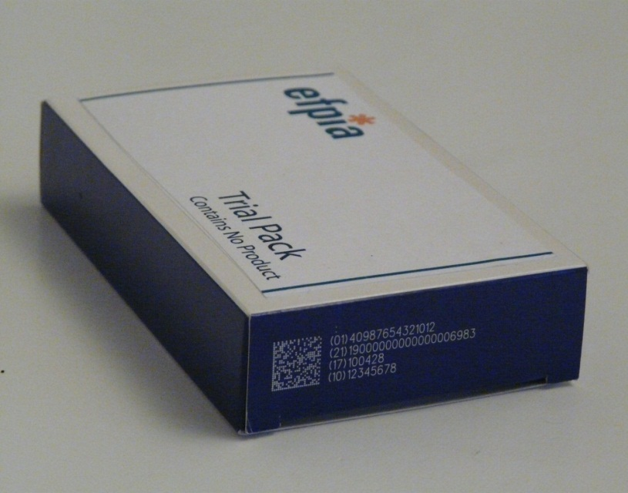

Data Carrier and Contents
ESM uses 2D Data Matrix code, developed to internationally recognised standards (GS1)
Four key data elements
  Manufacturer Product Code
  Randomised Unique Serial Number
  Expiry Date
  Batch Number
Example
Product #: 09876543210982
Batch: A1C2E3G4I5
Expiry: 140531
S/N: 12345AZRQF1234567890
On 31 Jan. 2014, European Commission confirmed usage of 2D Data Matrix Code with four data elements plus nat’l reimbursement number.

Slide 10


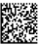
Point-of-Dispense Verification Process
Pharmaceutical Manufacturer
Wholesaler
Wholesaler
Pharmacist
Patient
Product
Flow
Unique Serialisation with Random Numbers
Verification upon Dispense to Patient
Risk-based
Verification
2D Data Matrix Code
on 2nd Pack
Medicines
Verification
Repository
GTIN
Batch
Expiry
S/N
Upload Number
Authenticate Number
On 31 Jan. 2014, European Commission confirmed to proceed with
Point-of-Dispensing verification concept.

Slide 11
European Medicines Verification System (EMVO)
European
Hub
Pharmaceutical
Manufacturer
Parallel
Distributor
securPharm (Germany)
National
Blueprint
System 1
National
Blueprint
System n
National
System n
Wholesaler
Pharmacy
Pharmacy
Wholesaler
Pharmacy
Wholesaler
Wholesaler
Pharmacy
Parallel Distributor: mandatory verification + data upload
Manufacturer: data upload + voluntary verification
Periodic cross-region update
Pharmacy: mandatory verification
Wholesaler: voluntary verification

Slide 12
The benefit of Hub and Blueprint systems
European
Hub
European Hub
Secures cross-border trade
Provides cost savings for connecting manufacturers
Ensures interoperability between national systems
Supports establishment of standard interfaces
National
System
(Blueprint)
National Blueprint system (nBPS) - optional
Allows national stakeholders to join the EMVS without the need of building a separate own national system
  Based on a “standard” national verification system providing all necessary functionality
Fewer, but bigger (aggregate) systems are less costly than many (individual) smaller systems
Particularly attractive for Member States with no system/ infrastructure in place

Slide 13
Testing and Evolution
Swedish pilot project (Sep 2009 - Feb 2010)
  25 pharmacies in greater Stockholm area.180 dispensing points
  25 products. 110,000 packs. 14 manufacturers
Key findings
  Allows pharmacists to work at normal pace
  Is customised to existing workflows
  Is integrated into existing pharmacy software
  Pharmacists and wholesalers are keen to get expiry date and batch number in machine-readable form
In 2014, ESM partners continue to work on national system interface with ‘securPharm’ project in Germany

Slide 14
3. ESM Organisation

Slide 15

Who should be member of the governance organisation ?
Each relevant market partner constituency should be represented:
  Pharmacists
  Wholesalers
  Marketing Authorisation Holders (branded & generic products)
  Parallel traders
supervision by competent authorities

Slide 16
Governance is required at European and National level
EU Hub
European Medicines Verification Organisation (EMVO) will
Govern EU Hub
Set standards for the system
Conclude agreements with NMVOs
Governance
EMVO Board
System management
EMVO
System operation
IT provider to EMVO
National stakeholders govern national systems through National Medicines Verification Organisation (NMVO)
Cooperation agreements
NMVO Board
NMVO Board
NMVO
NMVO / EMVO
Blueprint system to be governed nationally, but managed by EMVO
IT provider to NMVO
IT provider to EMVO
National
System
National
System
(Blueprint)
supervision by competent authorities
On 31 Jan. 2014, European Commission confirmed stakeholder governance –with system access and supervision of National Competent Authorities.

Slide 17
4. Timeline

Slide 18
The EMVS: Result of a Long Evolution
2010
Involvement of PGEU, GIRP, EAEPC
2015-2018
Introduction of medicines verification systems in EU Member States
Provision of coded products
2006
EFPIA’s initial activities for traceability of medicines
2012
Stakeholders’ Memorandum of Understanding`
2014
European Hub in operation (Q1),
Liaison with securPharm (Q3)
2009 / 2010
EFPIA pilot in Sweden
2008 - 2013
System design
2013 - 2015
System build
2015 - 2018
Ramp up
2007
2014
2018
July 2011
Publication of FMD
Q1 2015 exp.
Publication of Delegated Acts
Notes:
Please note that this slide was included in the EFPIA slide deck. Cambre understands that this will be replaced by a new timeline developed as part of the ESM brochure.

Slide 19
5. ESM & Pharmacists

Slide 20
Pharmacies connect through their existing SW systems
nBPS provides standard interfaces to allow users’ SW suppliers to connect and use standard functional modules
  Verify pack
  Dispense pack / undo dispense
  Decommission pack / undo decommission
  Export pack (out of EU or for parallel trade)
  Verify multiple packs (restricted use to prevent overload)
Pharmacy workflow is not determined by nBPS, but by pharmacy SW

Slide 21

Integration of verification into pharmacy work flow: Example
EU Hub connection
National Medicines Verification System
Verify
Dispense
Multi Verif.
Decommission
Interface
Interface
Pharmacy Software
Goods receipt
Check pack
Dispense pack

Slide 22
5. Excursus: FMD & Unit Dose Coding (UDC)

Slide 23
FMD and UDC
Scope:
Implementation of Data Carriers on primary packaging for Pharmaceutical Products
Hurdles, e.g.:
Formally no direct regulatory link
Change in primary pack format could result change/increase in secondary pack formats
Increase in investments
New machinery
IT
Authority approvals if change in Artworks and design of pack and contents of the labeling
BUT

Slide 24
FMD and UDC
ESM asks for 2D Matrix
ESM requires 4 code elements
THEREFORE
While supporting ESM principles, two step
approach conceivable:
First step: Primary package contains a 2D Matrix code or linear barcode containing a GTIN only.
Second step: Primary package contains a 2D Matrix code containing GTIN, Expiry Date and Batch Number (codification) .

Slide 25
www.esm-system.eu

