Slide 1

25 April 2014
European Association of Hospital Pharmacists (EAHP)

Slide 2
Governance of mass serialisation systems
What is the background to the project?
The eTACT project
Patient access
Public supervision
Next Steps
Hospital Pharmacy

Slide 3
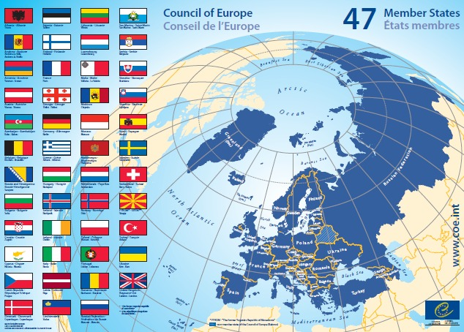
Council of Europe
  Inter-governmental organisation
  Core values:
    human rights
    pluralist democracy
    rule of law

Slide 4
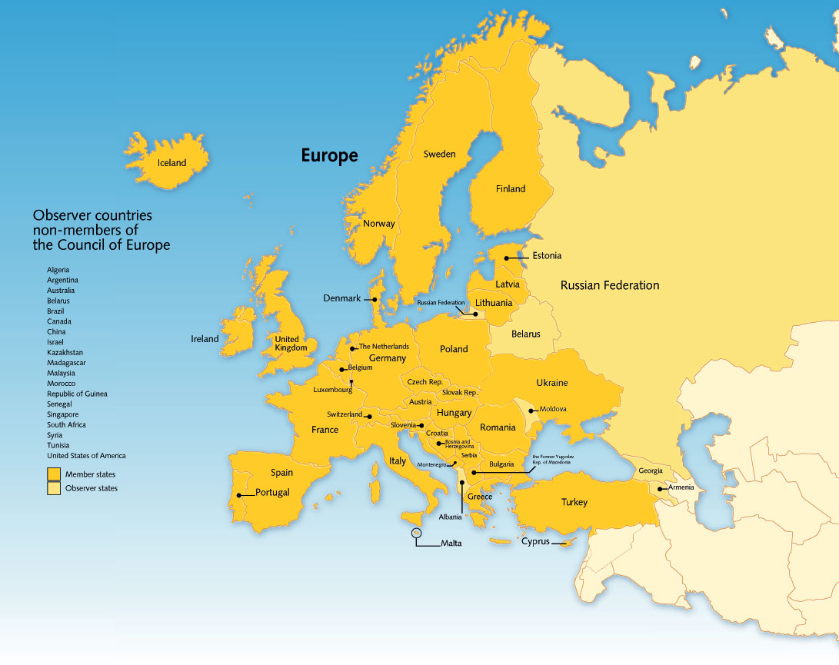
European Directorate for the Quality of Medicines & HealthCare (EDQM)
  Council of Europe Directorate
  Convention on the Elaboration of a European Pharmacopoeia (1964)

Slide 5

CoE/EDQM anti-counterfeiting strategy
Multisectorial training
Medicrime
Inspection
Testing

Slide 6
Falsified Medicines Directive (FMD)
Directive 2011/62
  Safety features
    Identifier that is readable by wholesale distributors and pharmacists
    Tamper-proof device (outside scope of eTACT)
  Public consultation Nov 2011-Apr 2012
  Impact study ⇨ Delegated Acts 2014 - 2015

Slide 7
Scope
Any pharmaceutical products
Actors:
  Any registered business stakeholders
  Authorities
  Patients
37 member states of the European Pharmacopoeia
and beyond
Secondary packaging
Notes:
Je ne mettrai pas ce map (trop Ph Eur / restreint)

Slide 8
Governance of mass serialisation systems
What is the background to the project?
The eTACT project
Patient access
Public governance
Next Steps
Hospital Pharmacy

Slide 9
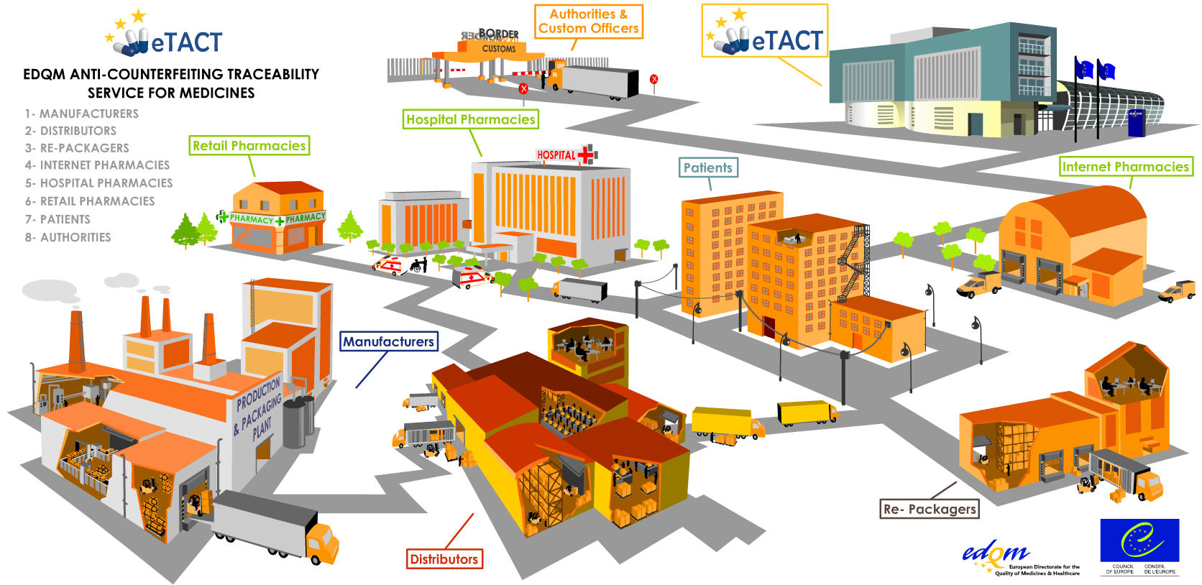

Slide 10




EDQM Traceability service - eTACT
Pharmacy
Manufacturer
Distribution
Internet
Mail-order
Patients
Generation of UMI = Unique Medicine Identifier
NOT a Track&Trace / pedigree system
Verification
of UMI
Verification of UMI

Slide 11
General overview of eTACT project
Phase 3:
Service development
2a: System development
2b: Workshops
Phase 1:
Concept development
Phase 2: Live demo
2010 – 2013
2009-2010
From 2013

Slide 12




Proposal for future coding
 | GTIN (01) :07680303330054 SERIAL (21) : 0402748246 Batch (10) : 144GC1214 EXPIRY (17) : 111120 NHRN (710) : 049-75241456
GTIN: product number
Serial: randomised number
Batch No.
Expiry date: yymmdd
NHRN: National Health Reimbursement Number

Slide 13
Governance of mass serialisation systems
What is the background to the project?
The eTACT project
Patient access
Public supervision
Next Steps
Hospital Pharmacy

Slide 14
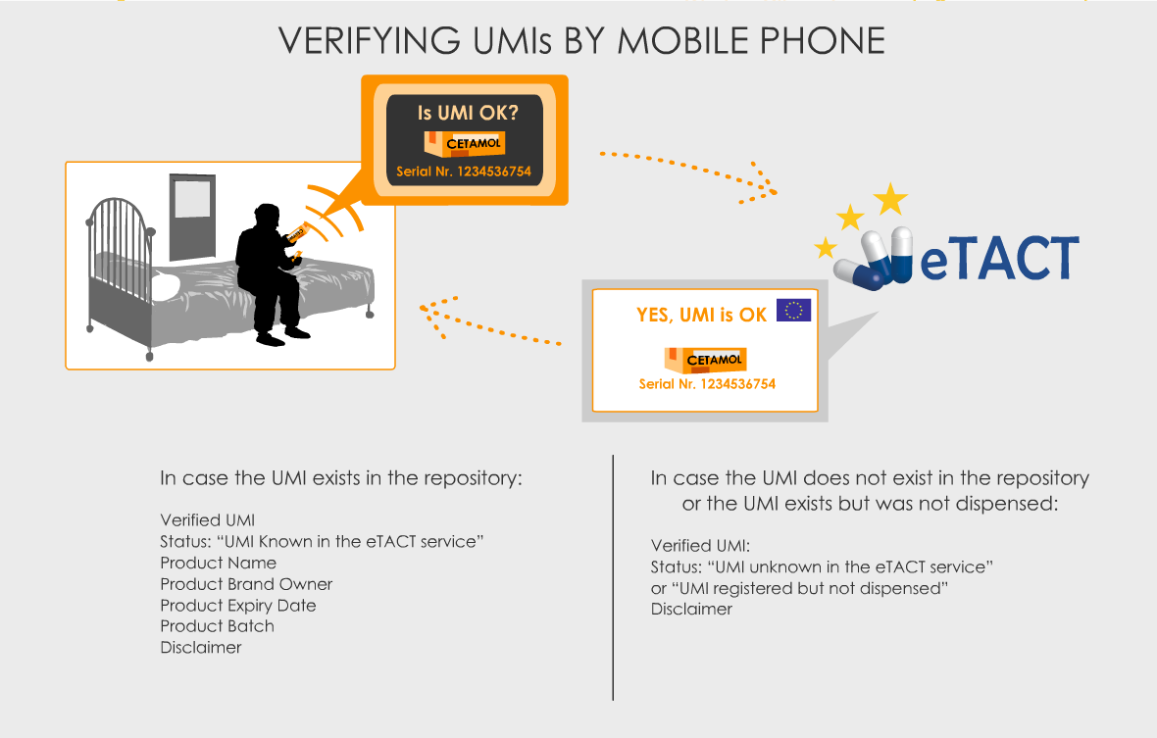

Slide 15
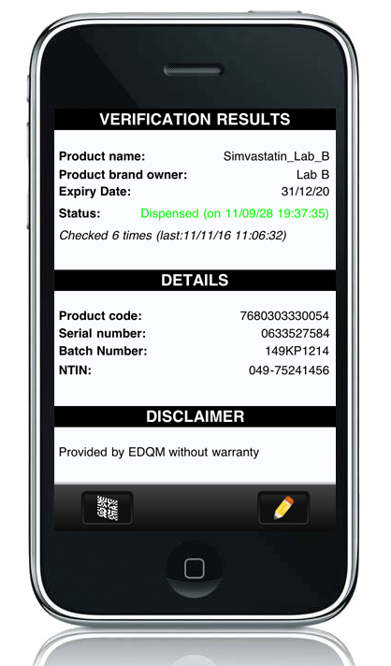
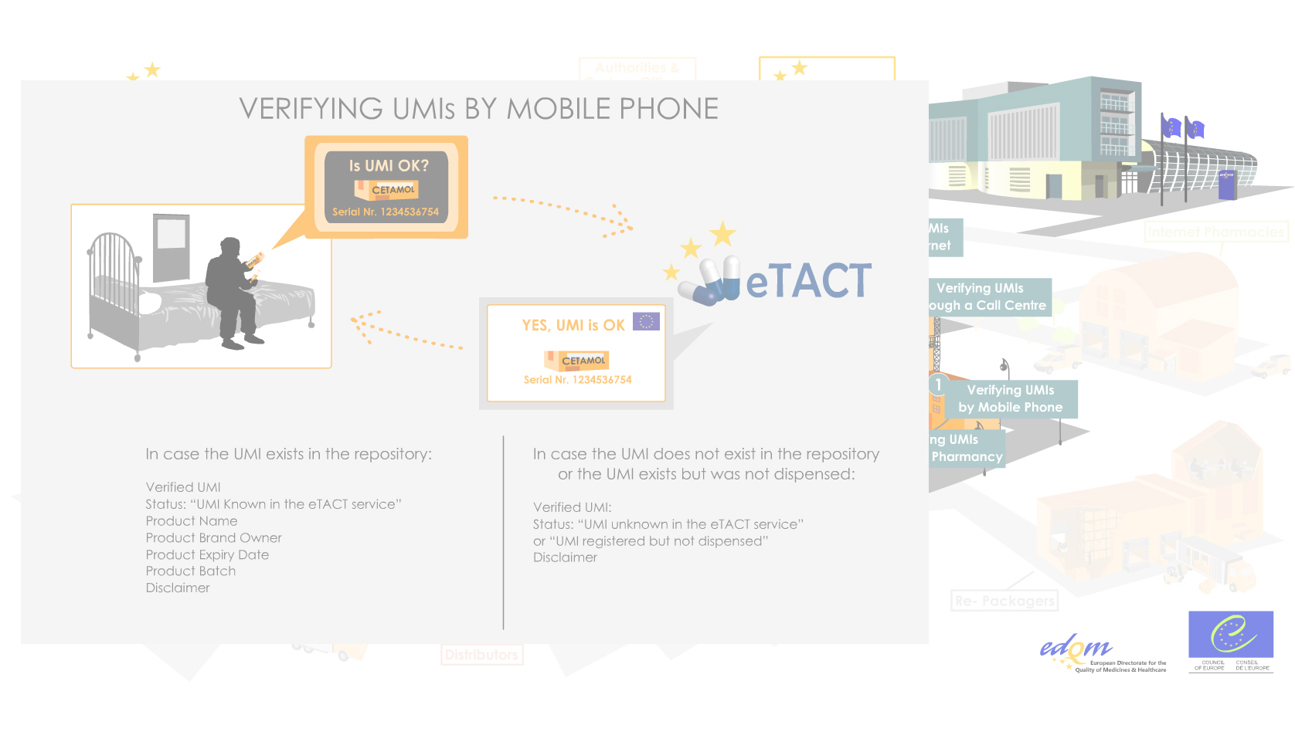
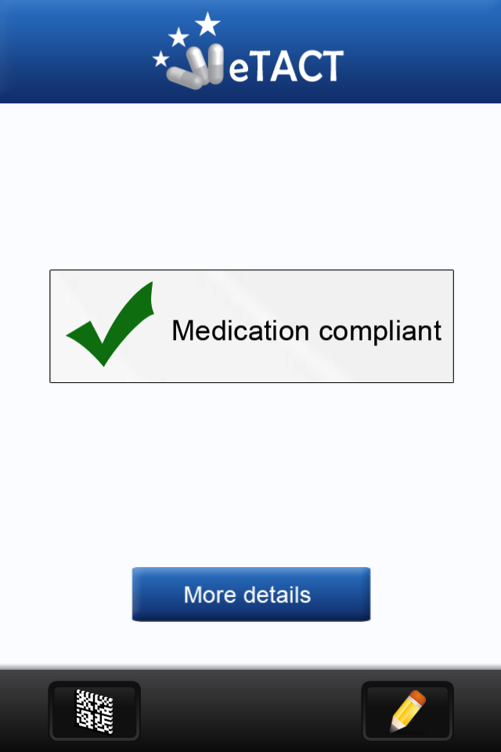

Slide 16
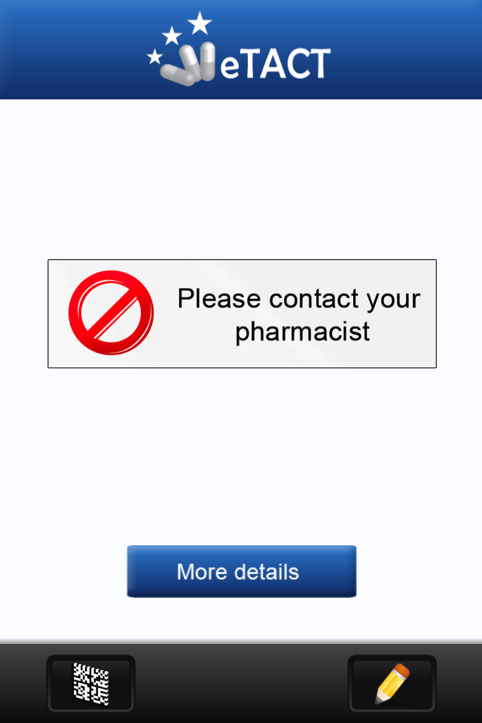
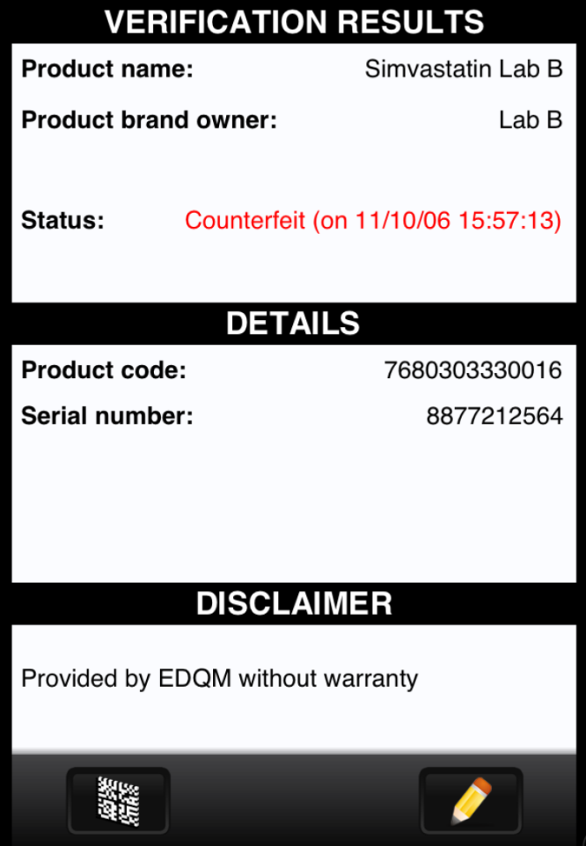

Slide 17
Patient involvement
Active role vs. passive recipient of information & care*
  Partners and stakeholders in healthcare policies*
  Awareness about risks of fake e-pharmacies
  (*: Keith Allan, Director of Global Advocacy, Novartis, Switzerland, DIA Euromeeting 2013)

Slide 18
Governance of mass serialisation systems
What is the background to the project?
The eTACT project
Patient access
Public supervision
Next Steps
Hospital Pharmacy

Slide 19










Proposed governance
Supervisory role
Authorities/Patients
---------------------------------------------------------
Advisory Board
Executive role
Manufacturer
Distributor
Pharmacy
Patients
Notes:
- EDQM long-term experience in balancing different interests and viewpoints (authorities, business stakeholders)
Public governance:
Industry associated in the regulation process through consultation and cost-effectiveness
Regulators not limited to ex-post controlling role in the implementation of the future system(s)
eTACT role
provide an interface for the interoperability of future systems
harmonised European landscape
integrated governance

Slide 20
  eTACT key assets
Public Supervision creates a harmonised approach
  Inter-operable and flexible
  Standards/rules defined by public Autorities
  Existing National systems can be integrated

Slide 21
Governance of mass serialisation systems
What is the background to the project?
The eTACT project
Patient access
Public supervision
Next Steps
Hospital Pharmacy

Slide 22
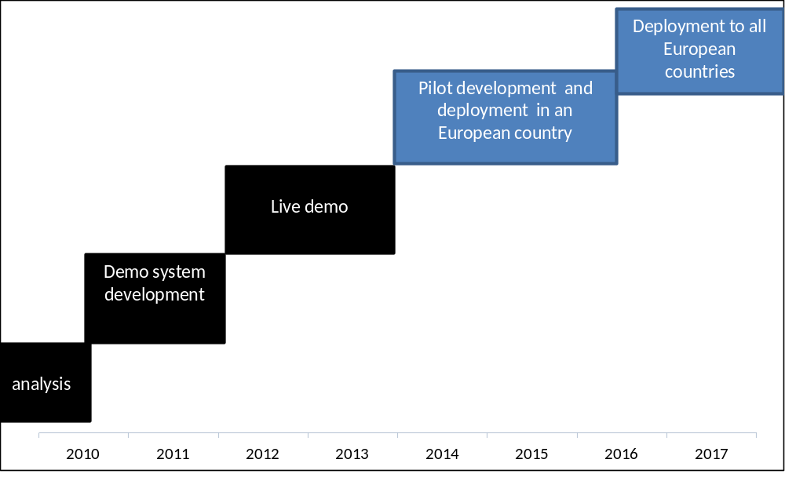
Next steps

Slide 23
Hospital Pharmacy
Several options to adapt to Hospital processes:
Receiving
Dispensing
Use of the dispensing business process: Remove a portion of a product for use while retaining the remainder for subsequent dispensing (GS1/EPCIS compliant - epedigree)

