Slide 1
EAHP Members’ Meeting
22 March 2023

Slide 2
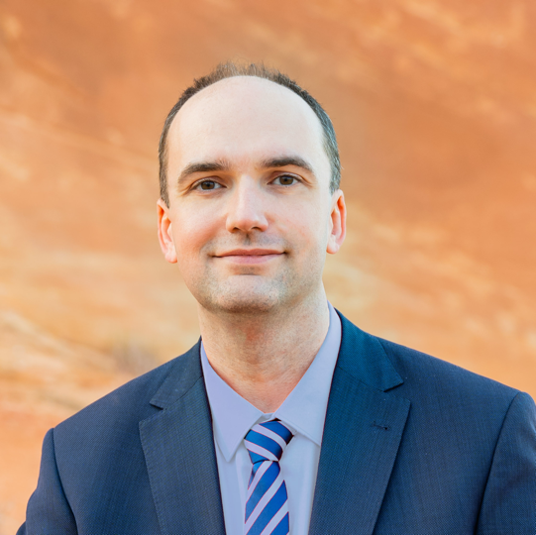
Welcome by EAHP’s President
On today’s agenda
Investigation of profession
EAHP’s new event
EAHP’s financial situation
Update on policy & projects
Q&A

Slide 3

Investigation of the hospital pharmacy profession in Europe
Thank you for engaging
BUT
Very low to no engagement from some member countries

Slide 4
EAHP’s new event
To be added after policy call

Slide 5
EAHP’s financial situation
To be added after policy call

Slide 6
Policy & Project Update
Ongoing & upcoming
2023 Shortage Survey
Revision of the EU general pharmaceutical legislation (EAHP will share feedback for engagement with members)
European Health Data Space (EHSD)
Revision of the EU legislation on blood, tissues and cells

Slide 7
Policy & Project Update
European Statements
Sustainability Working started
CTF project
Meeting with DG Grow & engagement with likeminded associations
EAHP’s SIGs
Publications by 5 of EAHPs SIG coming soon
SIG on Controlled Substance Management starting soon
SIG on Automated Medication Management – new mandate

Slide 8
Time for discussion!

Slide 9
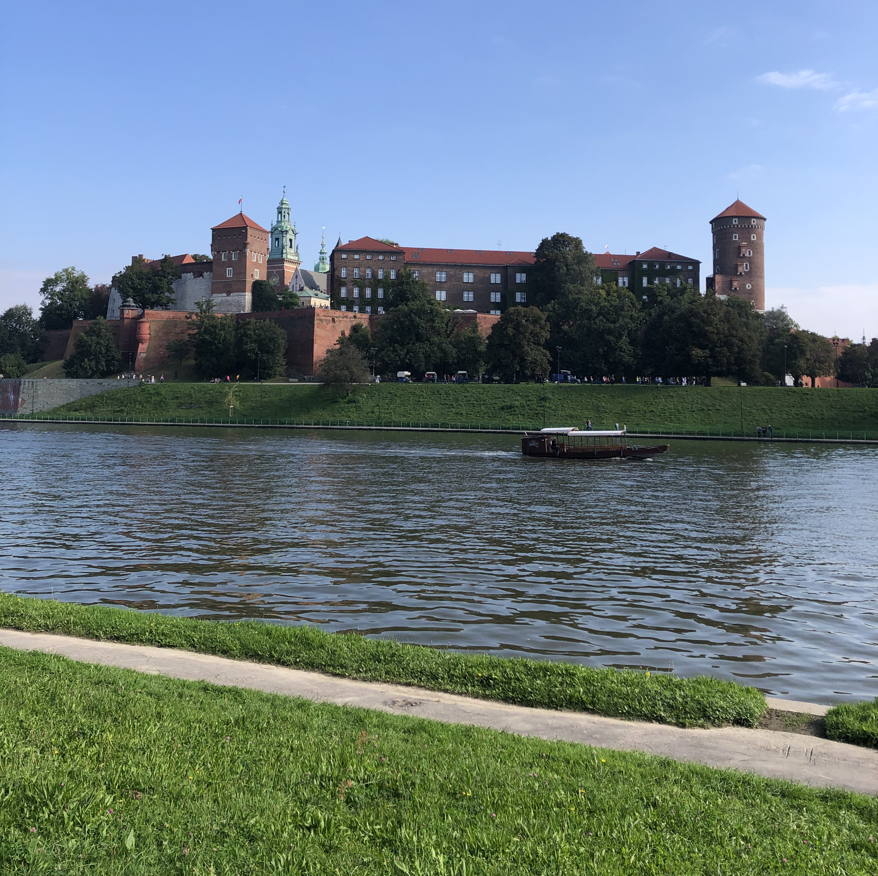
See you soon in Krakow!
EAHP General Assembly
8 to 11 June 2023

