Slide 1
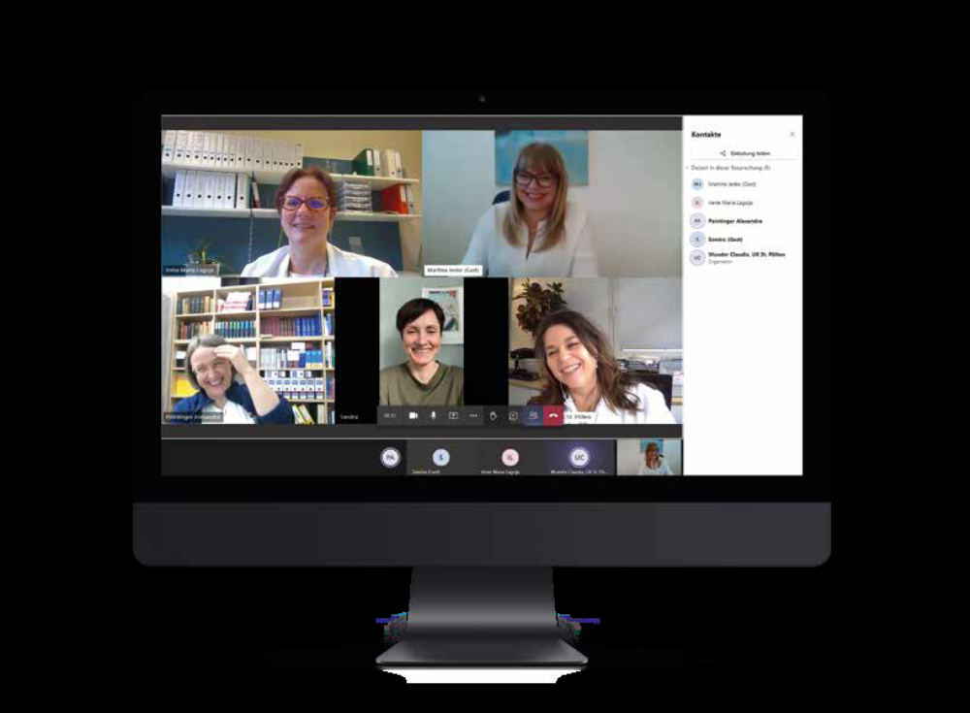
Country Report Austria 2022
Changes in the national
board of our Association
Good-Bye and Thank you to:
Karin Kirchdorfer (president)
Thomas Langebner (vice-president)
Gunar Stemer (secretary)
Welcome to:
Irene Lagoja (2nd vice president elect)
Sandra Freimann-Pircher (secretary elect)
Alexandra Pointinger (treasurer elect)
Going on strong are:
Martina Jeske (president elect); Claudia Wunder (vice president elect)

Slide 2
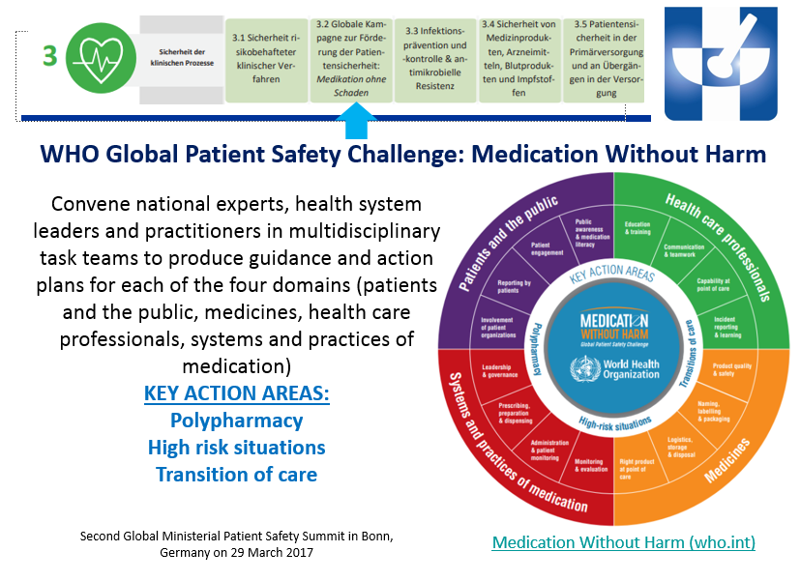
Country Report Austria 2022
National Action plan „Medication
Safety“
This is something that we are working on
Based on the WHO „Medication
without harm“
Inspired by Germanys „AMTS“
First meetings with national
authorities took place
goal: highlighting the and achieving
a legal framework for the work of hospital
pharmacists within this national action plan.

Slide 3
Country Report Austria 2022
National Strategy „Drug shortages“
During COVID national taskforces
concerning Covid-Therapies and
Drug shortages were founded
The drug shortages Taskforce is
now working on a screening tool
to be implemented nationally
?

